Slide 1

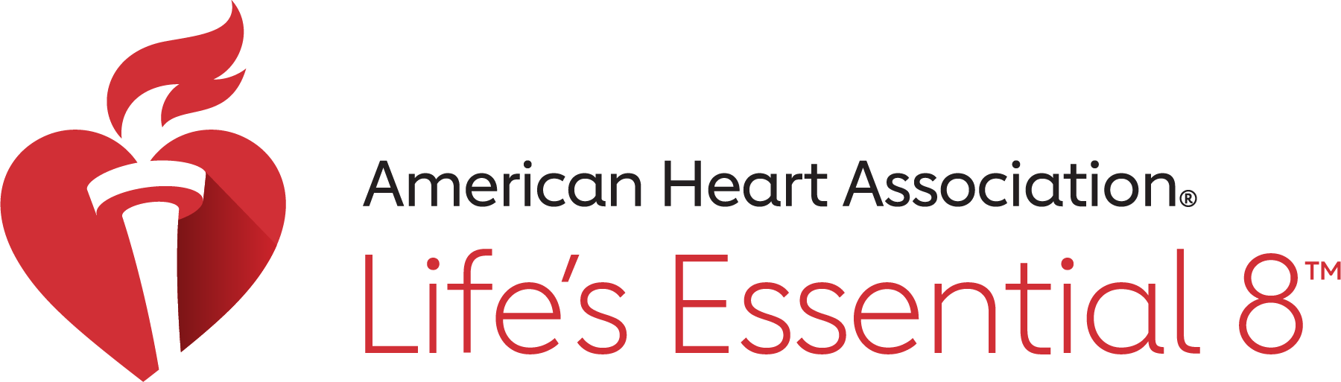
Clear the Air:
Tobacco and Vaping Prevention
Protect your heart, protect your future
Notes:
Speaker Notes:
“Hi everyone! Today we’re going to talk about an important choice—staying tobacco and vape free. This is all about protecting your heart, lungs, and future. You have the power to stay healthy.”

Slide 2
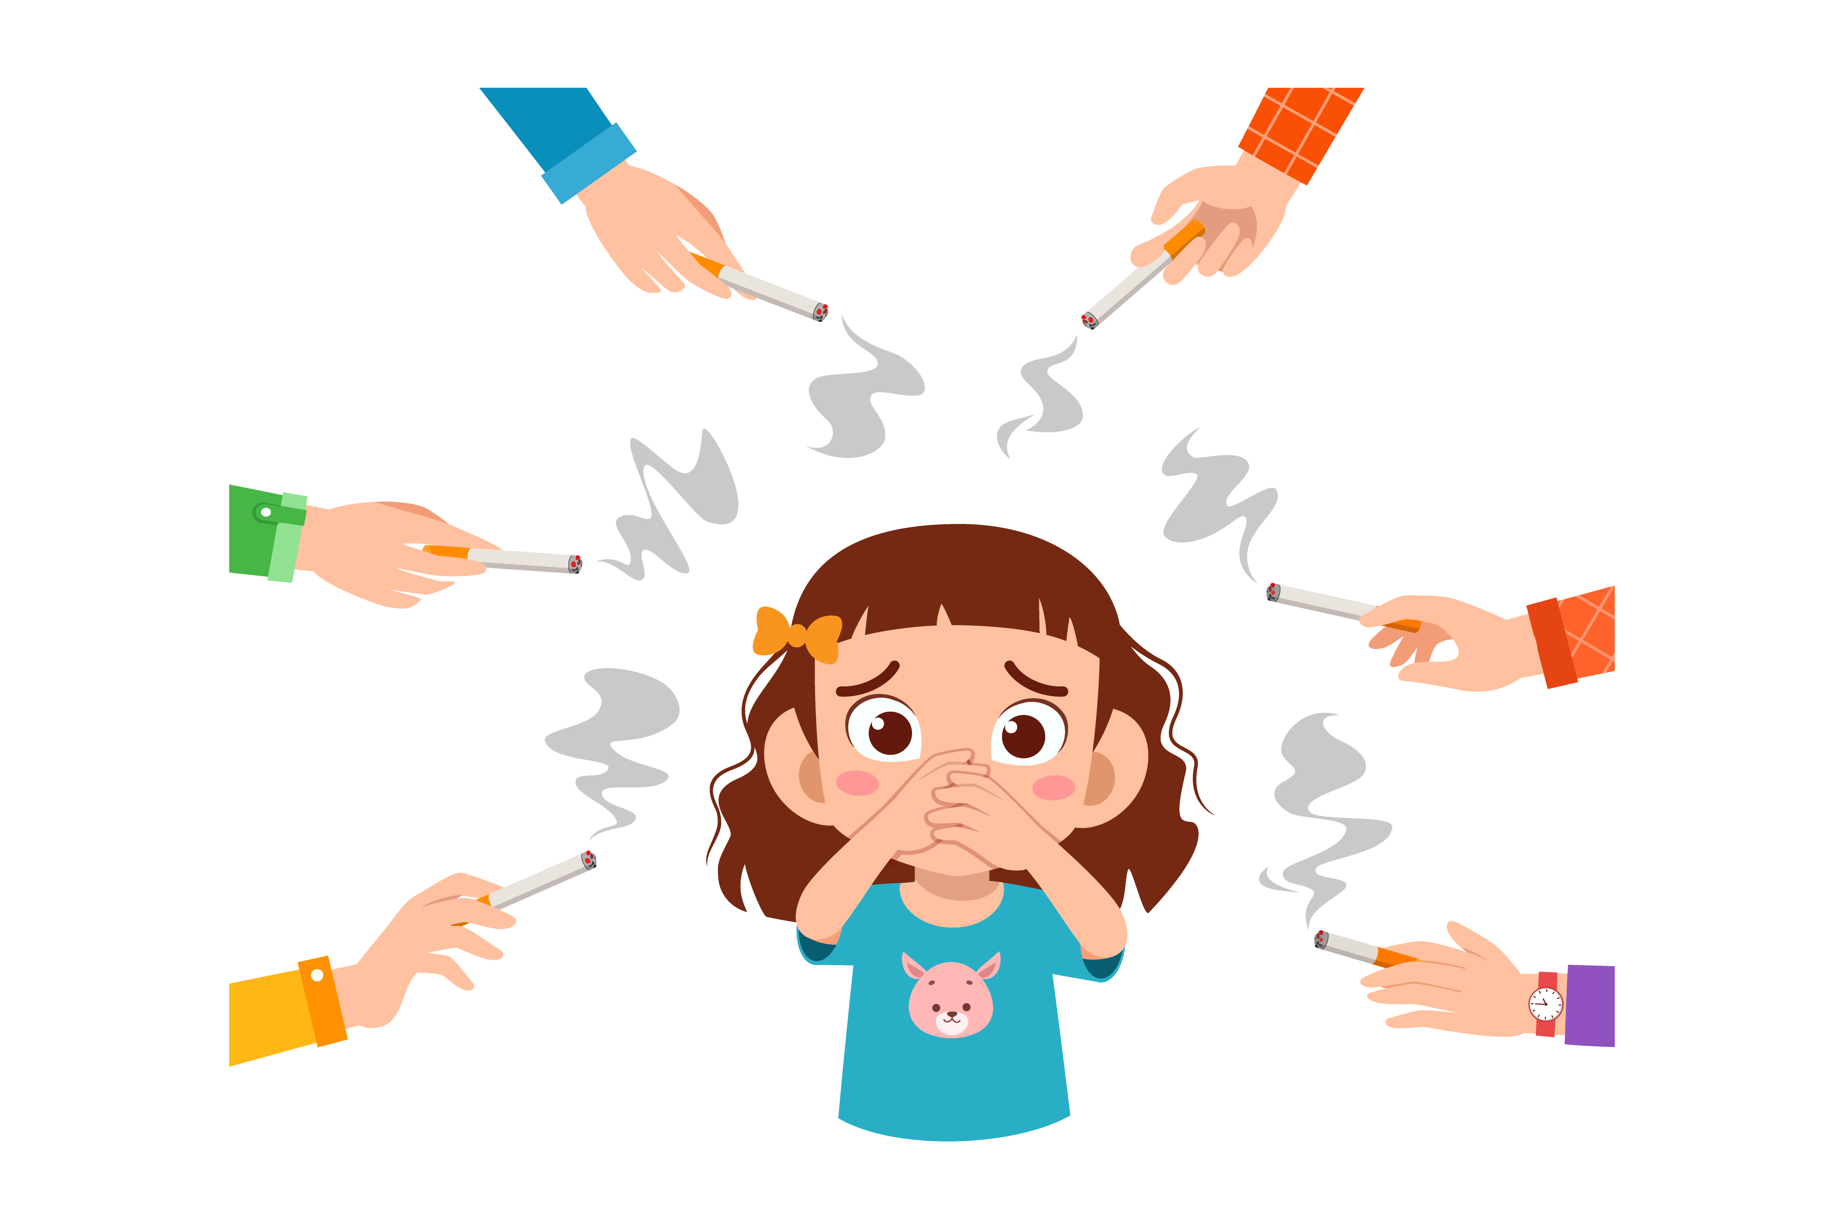
Why This Matters
Smoking and vaping hurt your lungs and heart.
Nicotine is addictive and makes it hard to quit.
You deserve to breathe easy and live healthy.
Notes:
Speaker Notes:
“Smoking and vaping hurt your lungs and your heart. They make it harder to breathe and put stress on your body. The big problem is nicotine—it’s very addictive and makes it hard to quit once you start. You deserve to breathe easy and live healthy.”

Slide 3
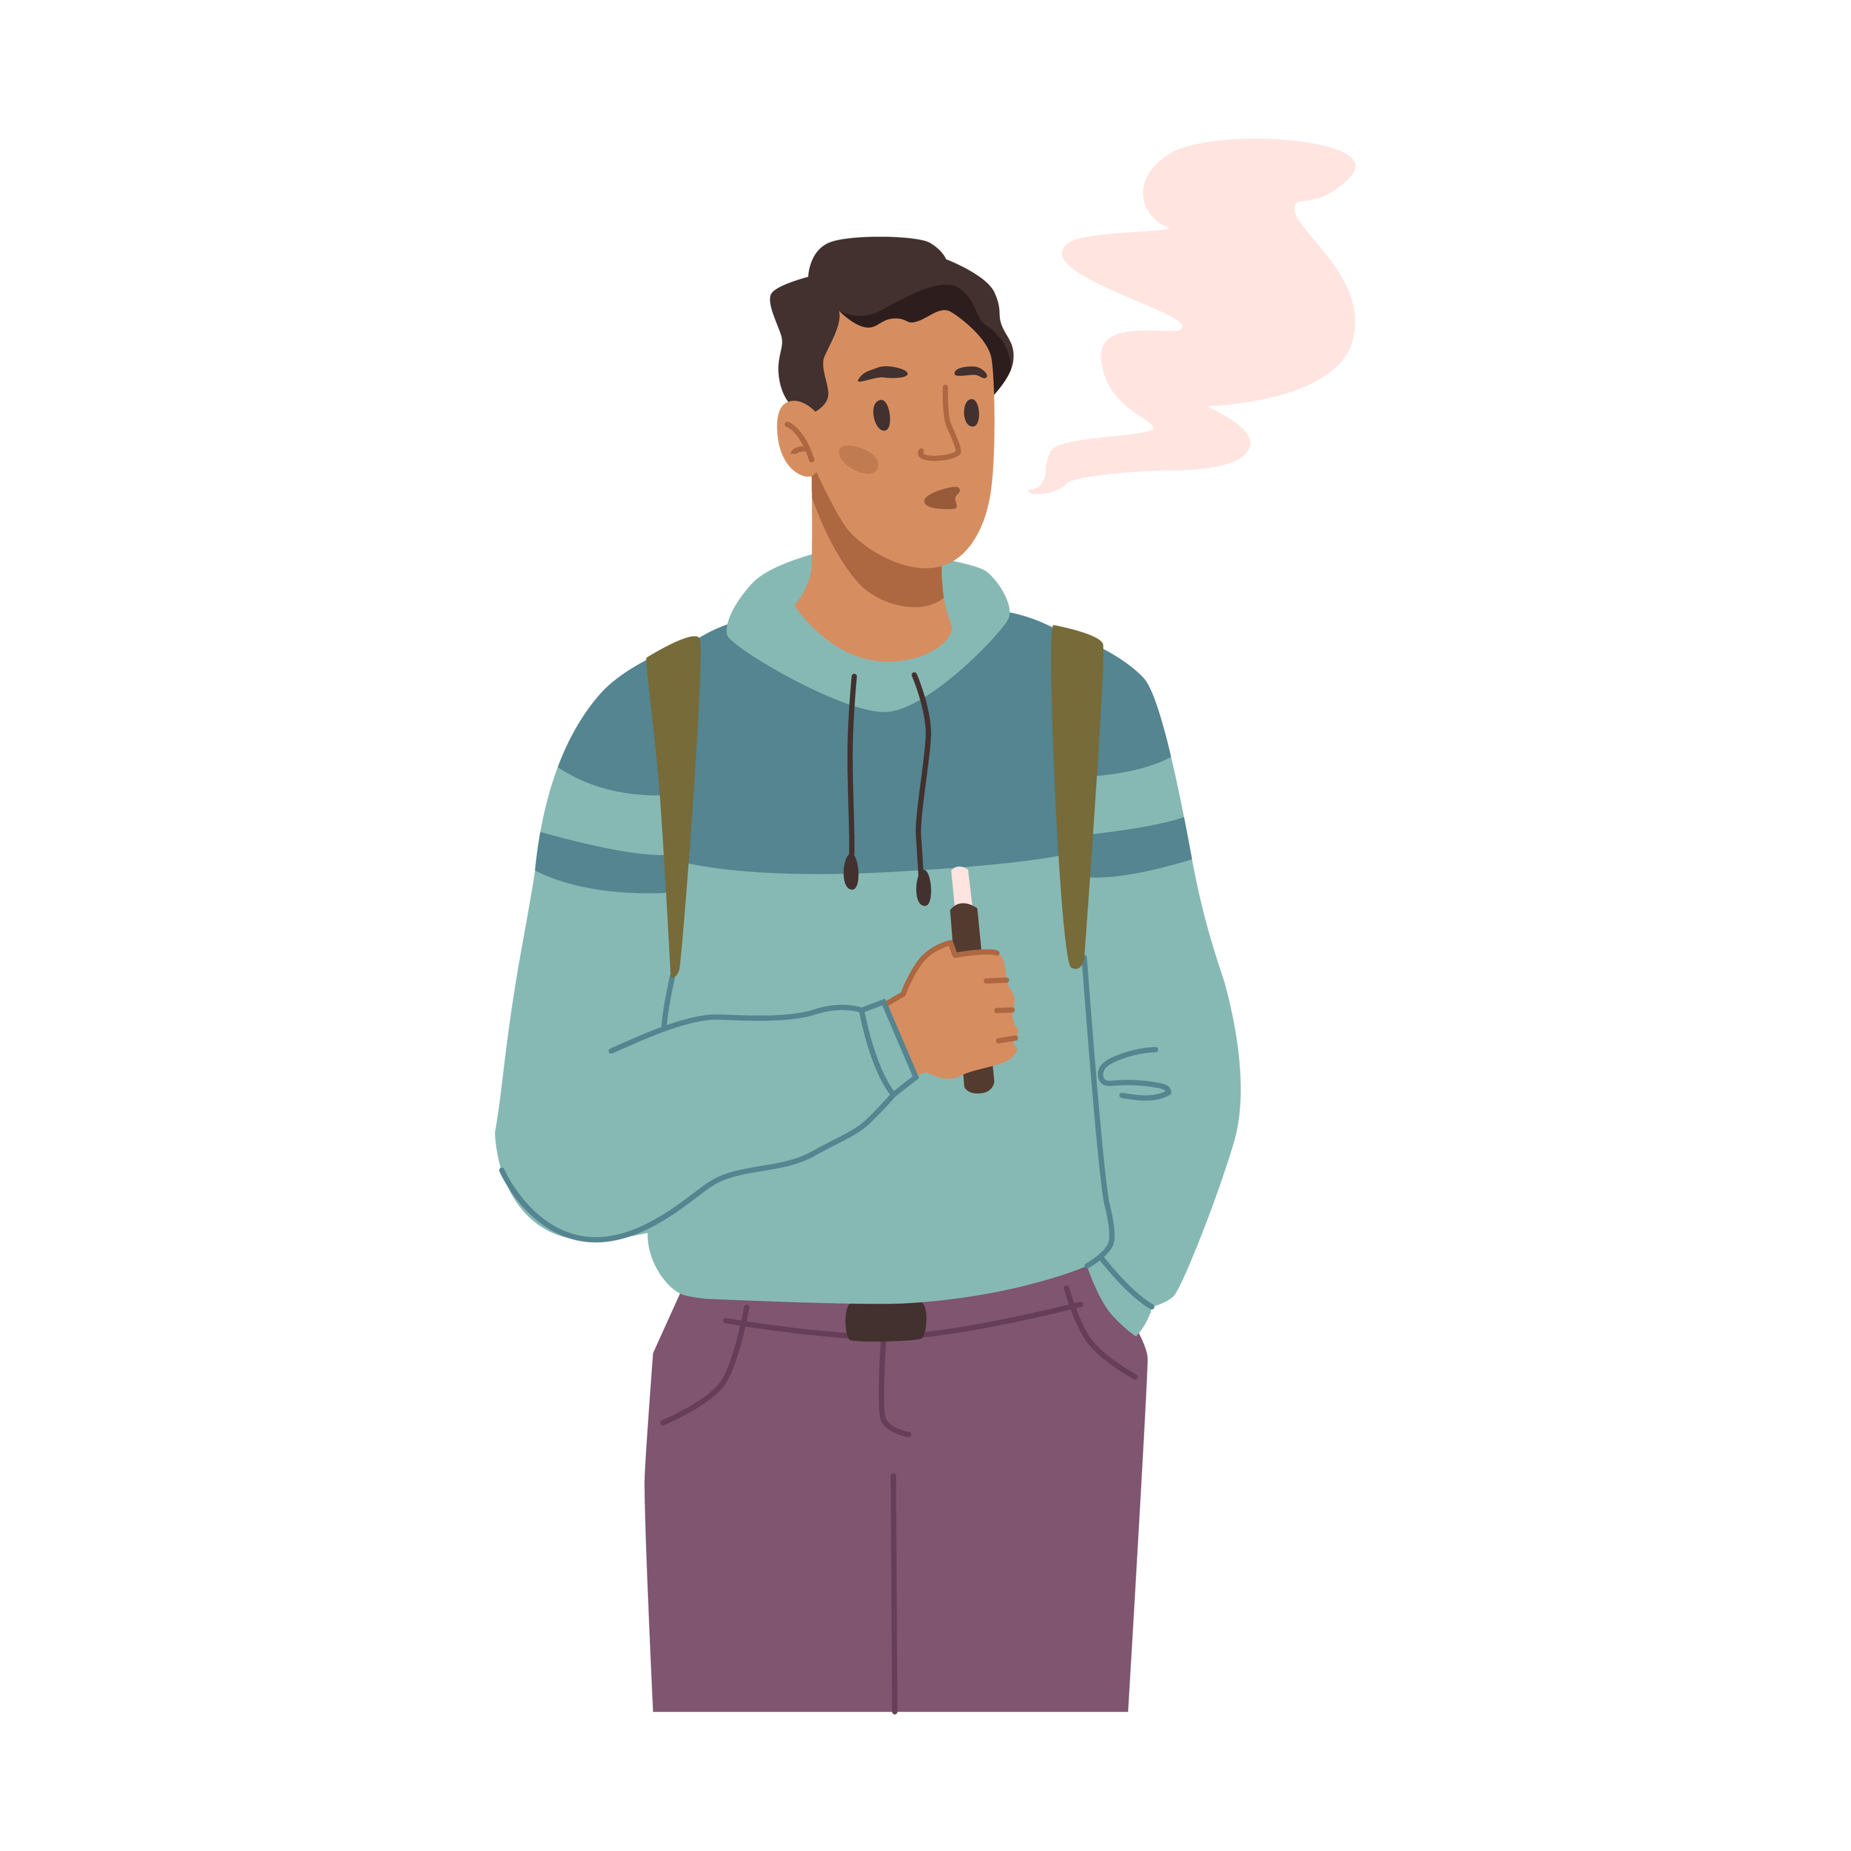
Quiz #1: Vaping is just flavored water vapor and harmless.
True
False
Notes:
(Answer: False – vaping contains nicotine and harmful chemicals.)
Speaker Notes:
“Let’s try a quick quiz! True or False: Vaping is just flavored water vapor and harmless.
The answer is… False! Vape juice contains nicotine and harmful chemicals that hurt your body, even if it smells or tastes good.”

Slide 4
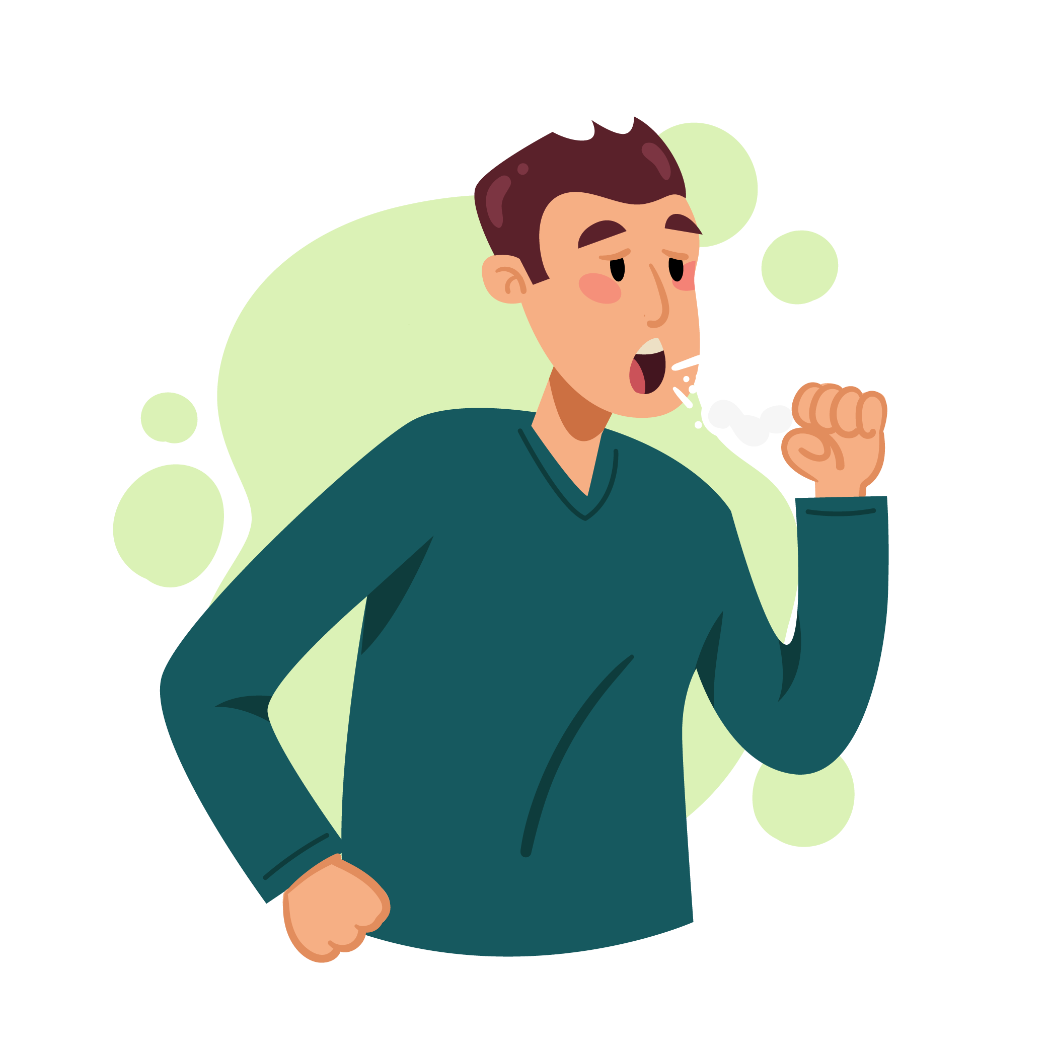
The Truth About
Tobacco
Cigarettes, e-cigarettes, and vapes damage your blood vessels.
Smoking can cause cancer, heart disease, and stroke.
Even “smokeless” tobacco harms your body.
Notes:
Speaker Notes:
“Cigarettes, e-cigarettes, and vapes all damage your blood vessels. Smoking can cause cancer, heart disease, and stroke. Even smokeless tobacco—like chew—can hurt your body. There’s no safe kind of tobacco.”

Slide 5
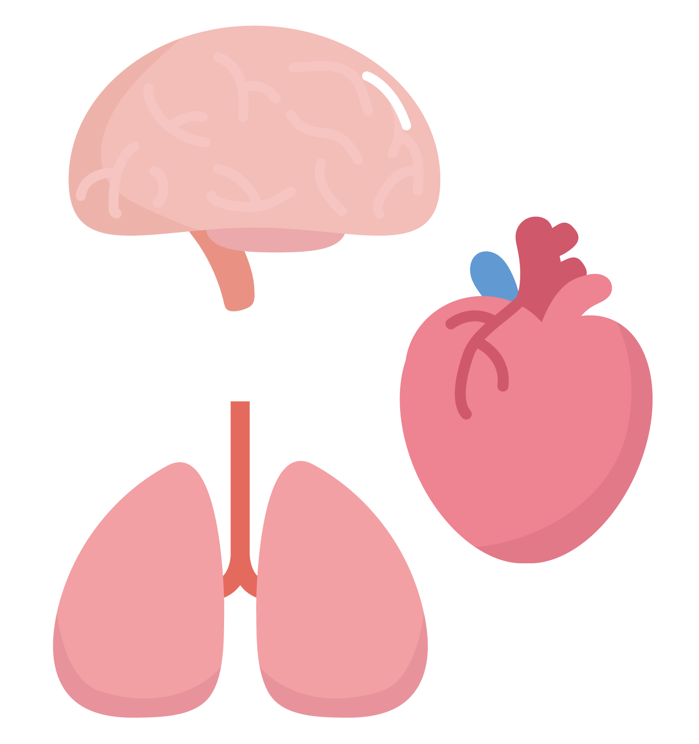
Quiz #2: Which body parts can be harmed by smoking/vaping?
Heart
Lungs
Brain
All of the above
Notes:
(Correct: d – All of the above!)
Speaker Notes:
“Which body parts can be harmed by smoking or vaping?
A) Heart
B) Lungs
C) Brain
D) All of the above
The answer is D – all of the above! Tobacco and vaping affect your whole body.”

Slide 6

What About Vaping?
E-cigarettes contain nicotine, heavy metals, and chemicals.
Can damage brain development in teens.
Not a safe alternative to smoking.
Notes:
Speaker Notes:
“Some people think vaping is safer than smoking, but it’s not true. E-cigarettes contain nicotine, heavy metals, and other chemicals. They can damage your brain while it’s still developing as a teen. Vaping is not a safe alternative to smoking.”

Slide 7
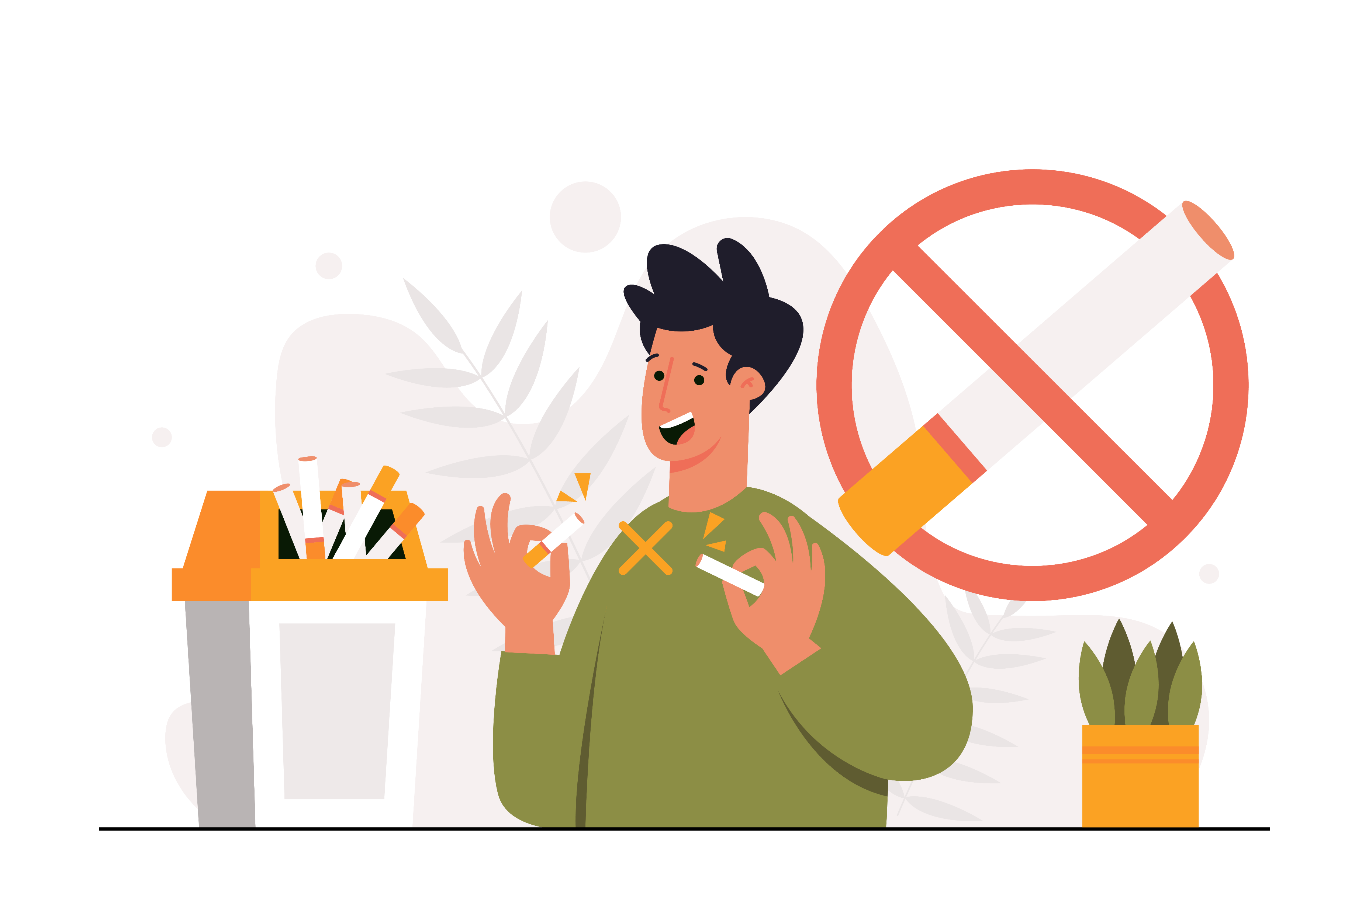
Quiz #3:
Nicotine can:
Improve your sports performance
Rewire your brain and cause
addiction
Make you healthier
Notes:
(Correct: b – It rewires the brain and leads to addiction.)
Speaker Notes:
“Nicotine can do what?
A) Make you healthier
B) Rewire your brain and cause addiction
C) Improve your sports performance
The answer is B. Nicotine changes the way your brain works and makes you crave more—it’s addictive.”

Slide 8
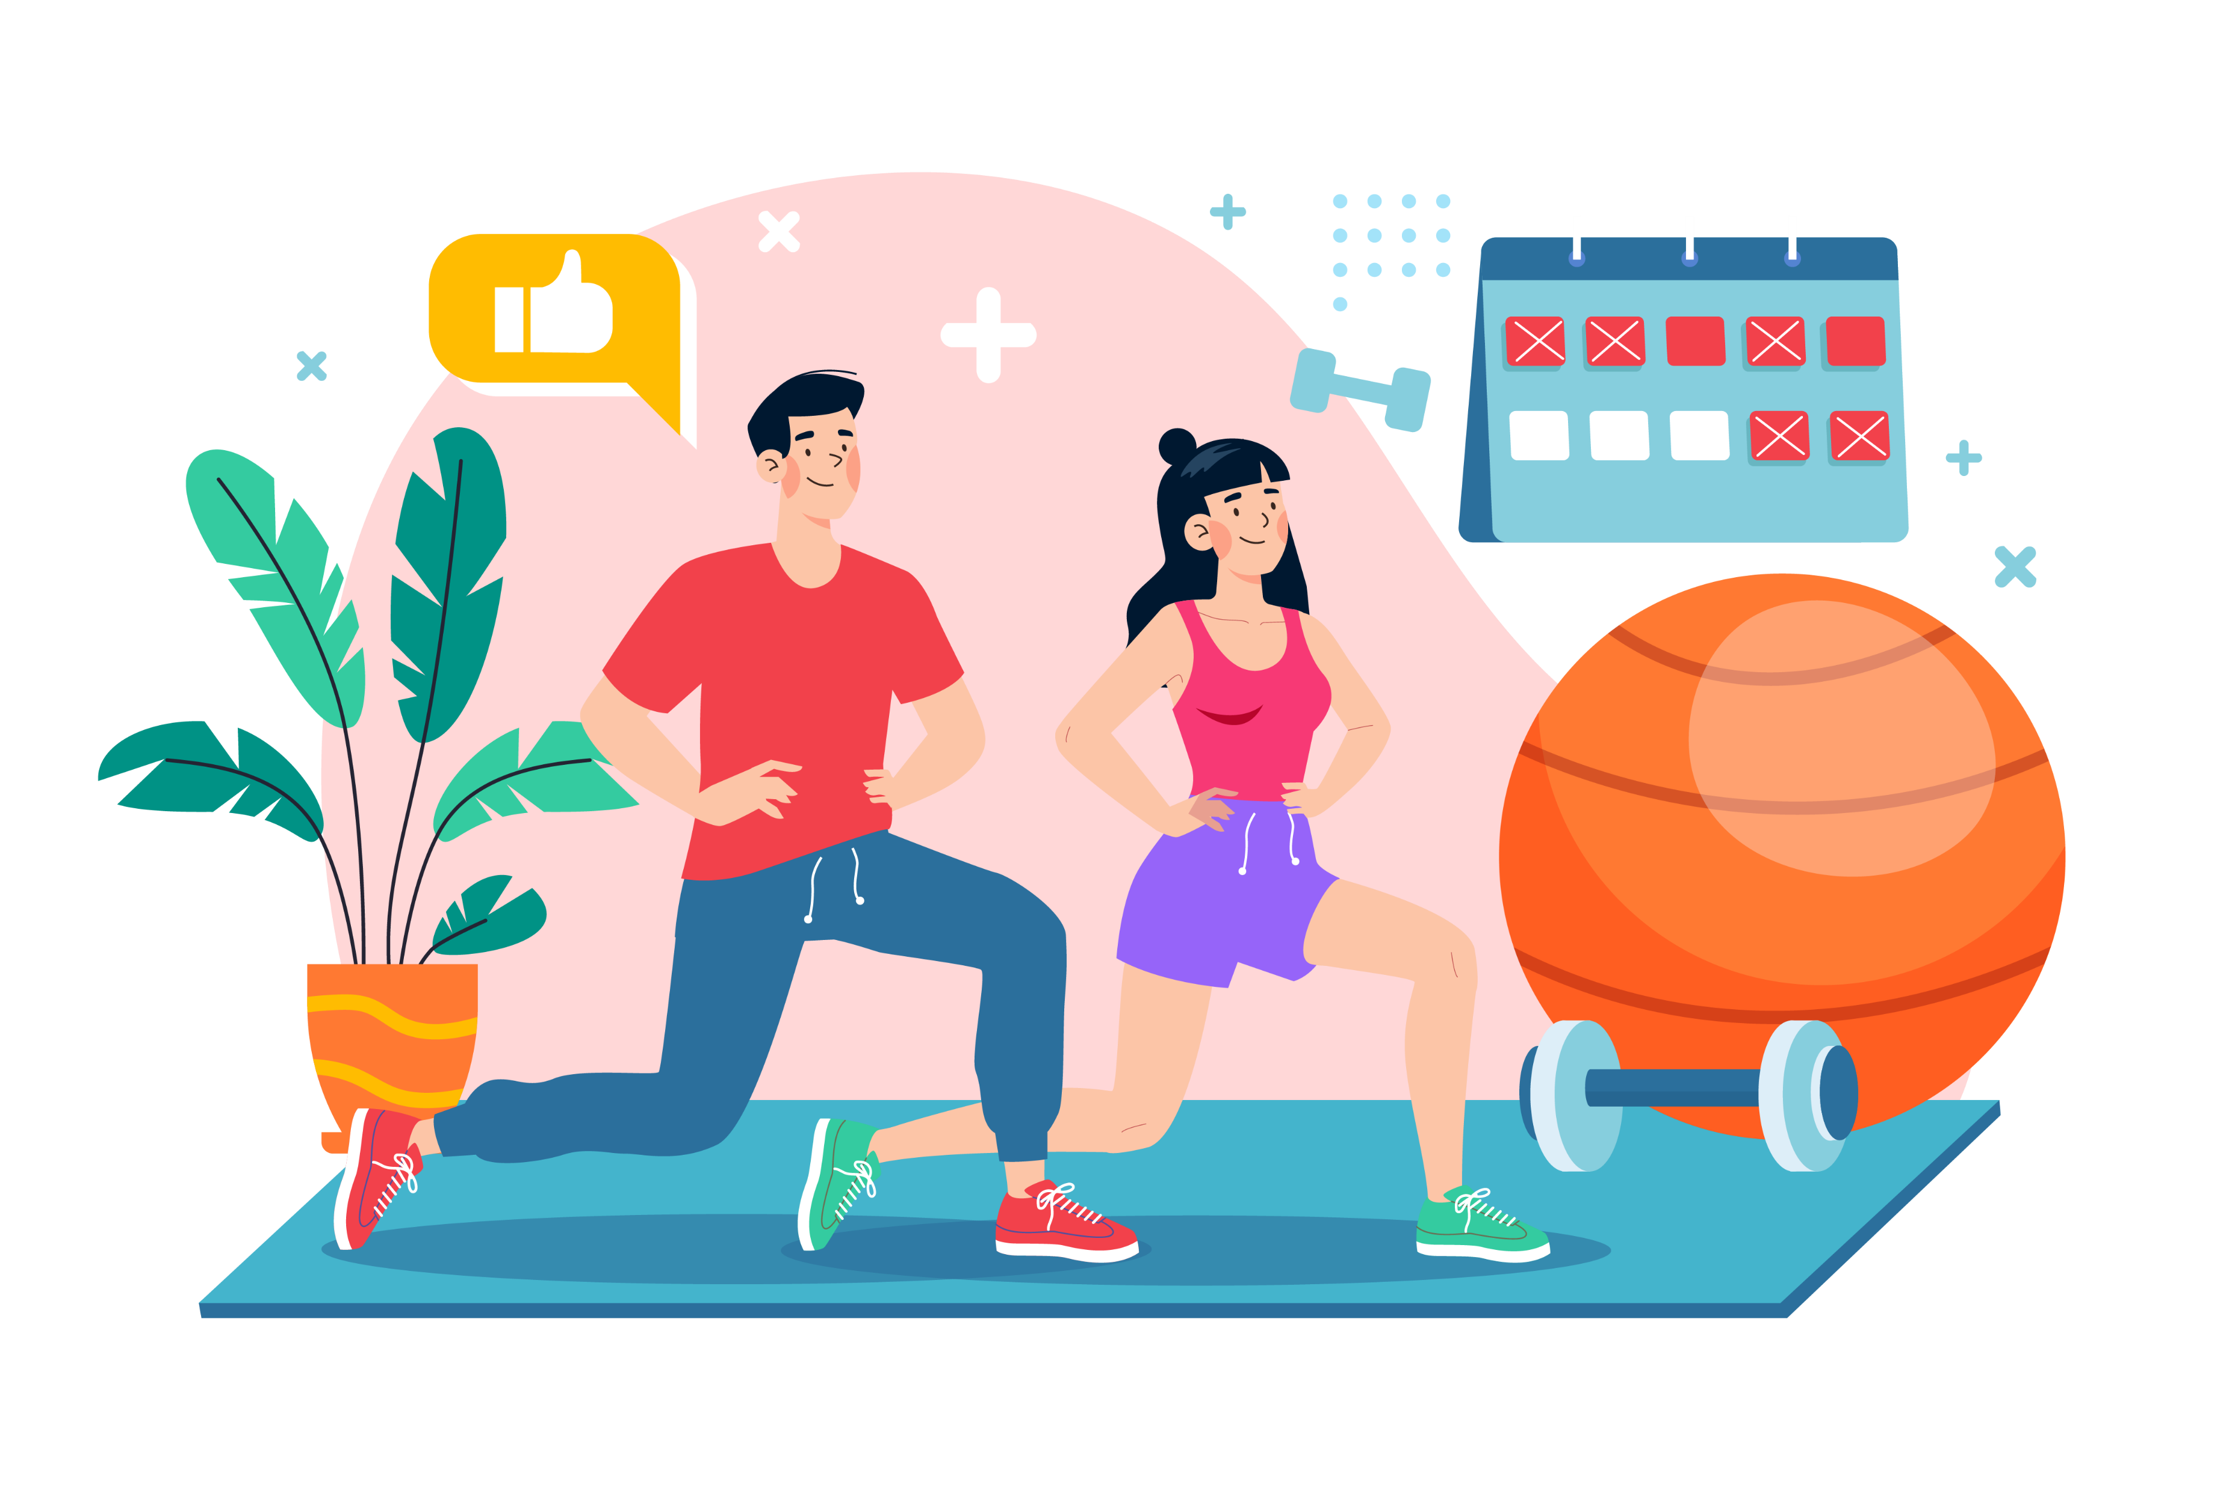
Protecting
Your Future
Staying tobacco-free = stronger heart, lungs, and mind.
You’ll have more energy for sports, school, and fun.
You’re in control of your health.
Notes:
Speaker Notes:
“When you stay tobacco-free, your heart, lungs, and brain are stronger. You’ll have more energy for sports, school, and fun. Most importantly—you stay in control of your health.”

Slide 9
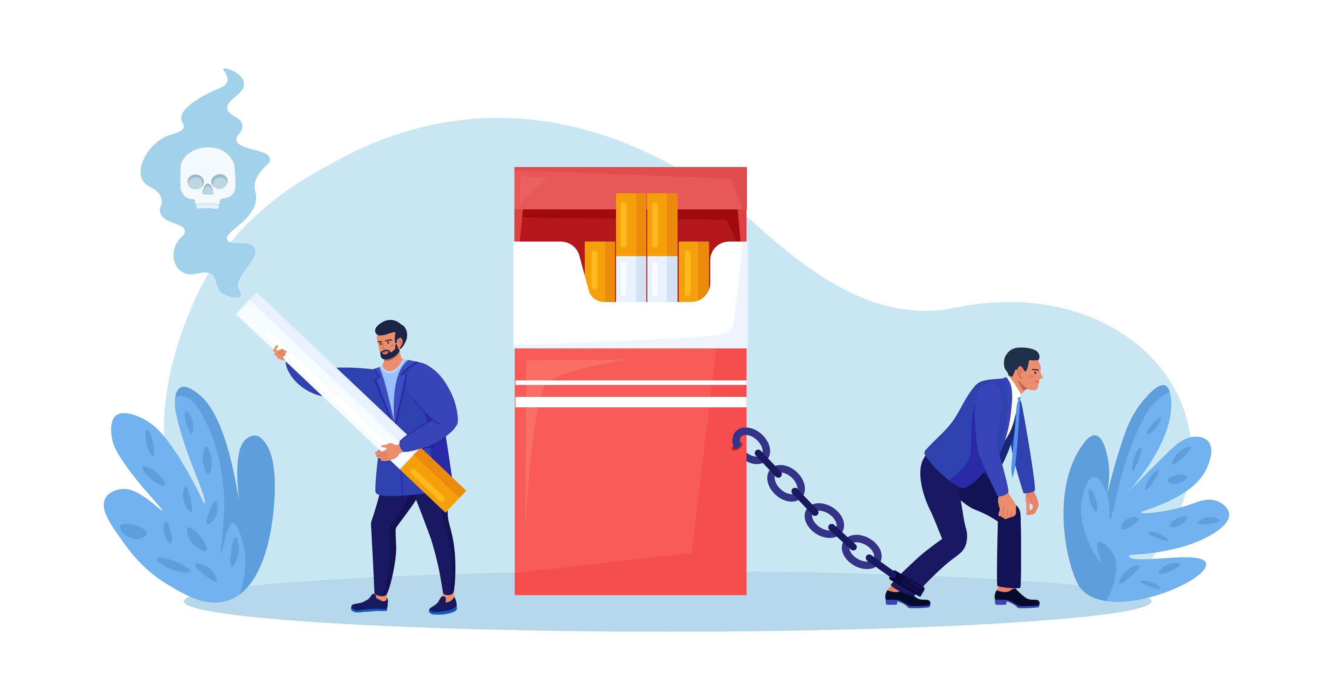
Quiz #4: Quitting is easy once you’re addicted to nicotine.
True
False
Notes:
(Answer: False – nicotine is highly addictive and quitting can be very hard.)
Speaker Notes:
“True or False: Quitting is easy once you’re addicted to nicotine.
The answer is False. Nicotine is one of the hardest substances to quit, which is why it’s so important not to start.”

Slide 10
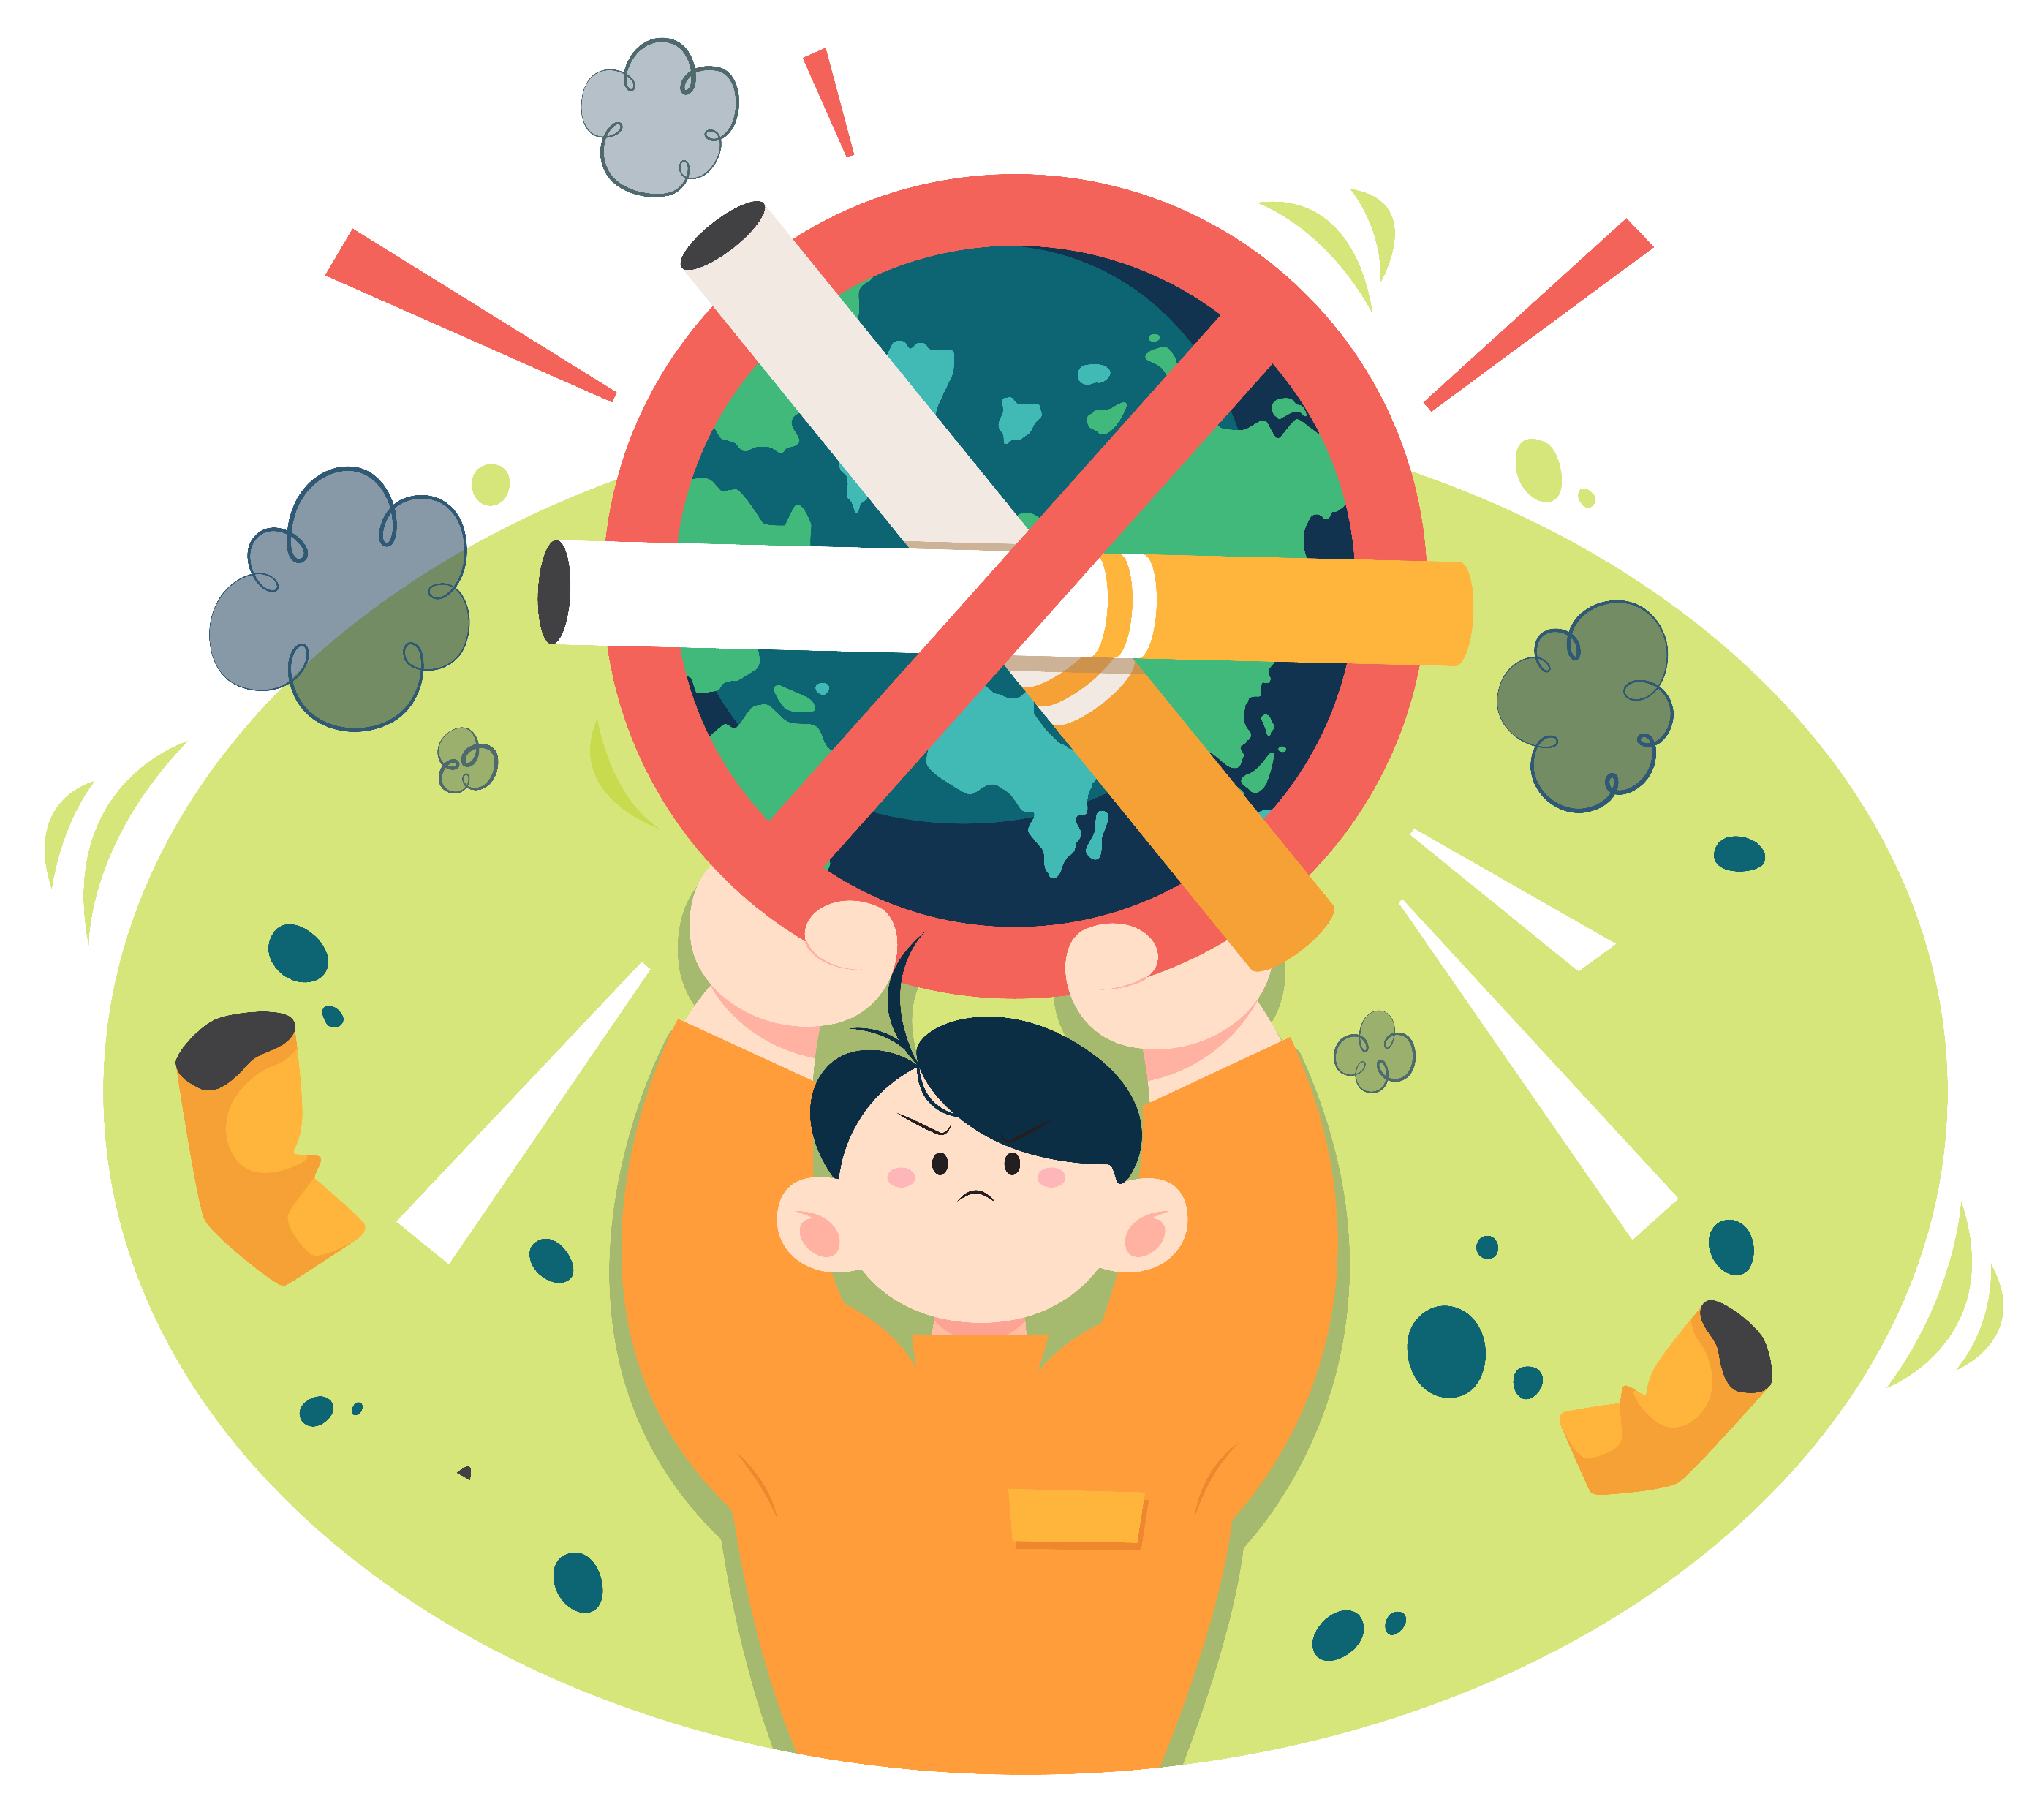
How to Say “No”
Have a script ready: “No thanks, I want to stay healthy.”
Choose friends who respect your decisions.
Find healthy ways to cope with stress (sports, music, art).
Notes:
Speaker Notes:
“Sometimes friends might offer you a vape or cigarette. Have a simple script ready—something like, ‘No thanks, I want to stay healthy.’ Choose friends who respect your choices. And if you feel stressed, find healthy ways to cope—play sports, listen to music, draw, or hang out with people who lift you up.”

Slide 11
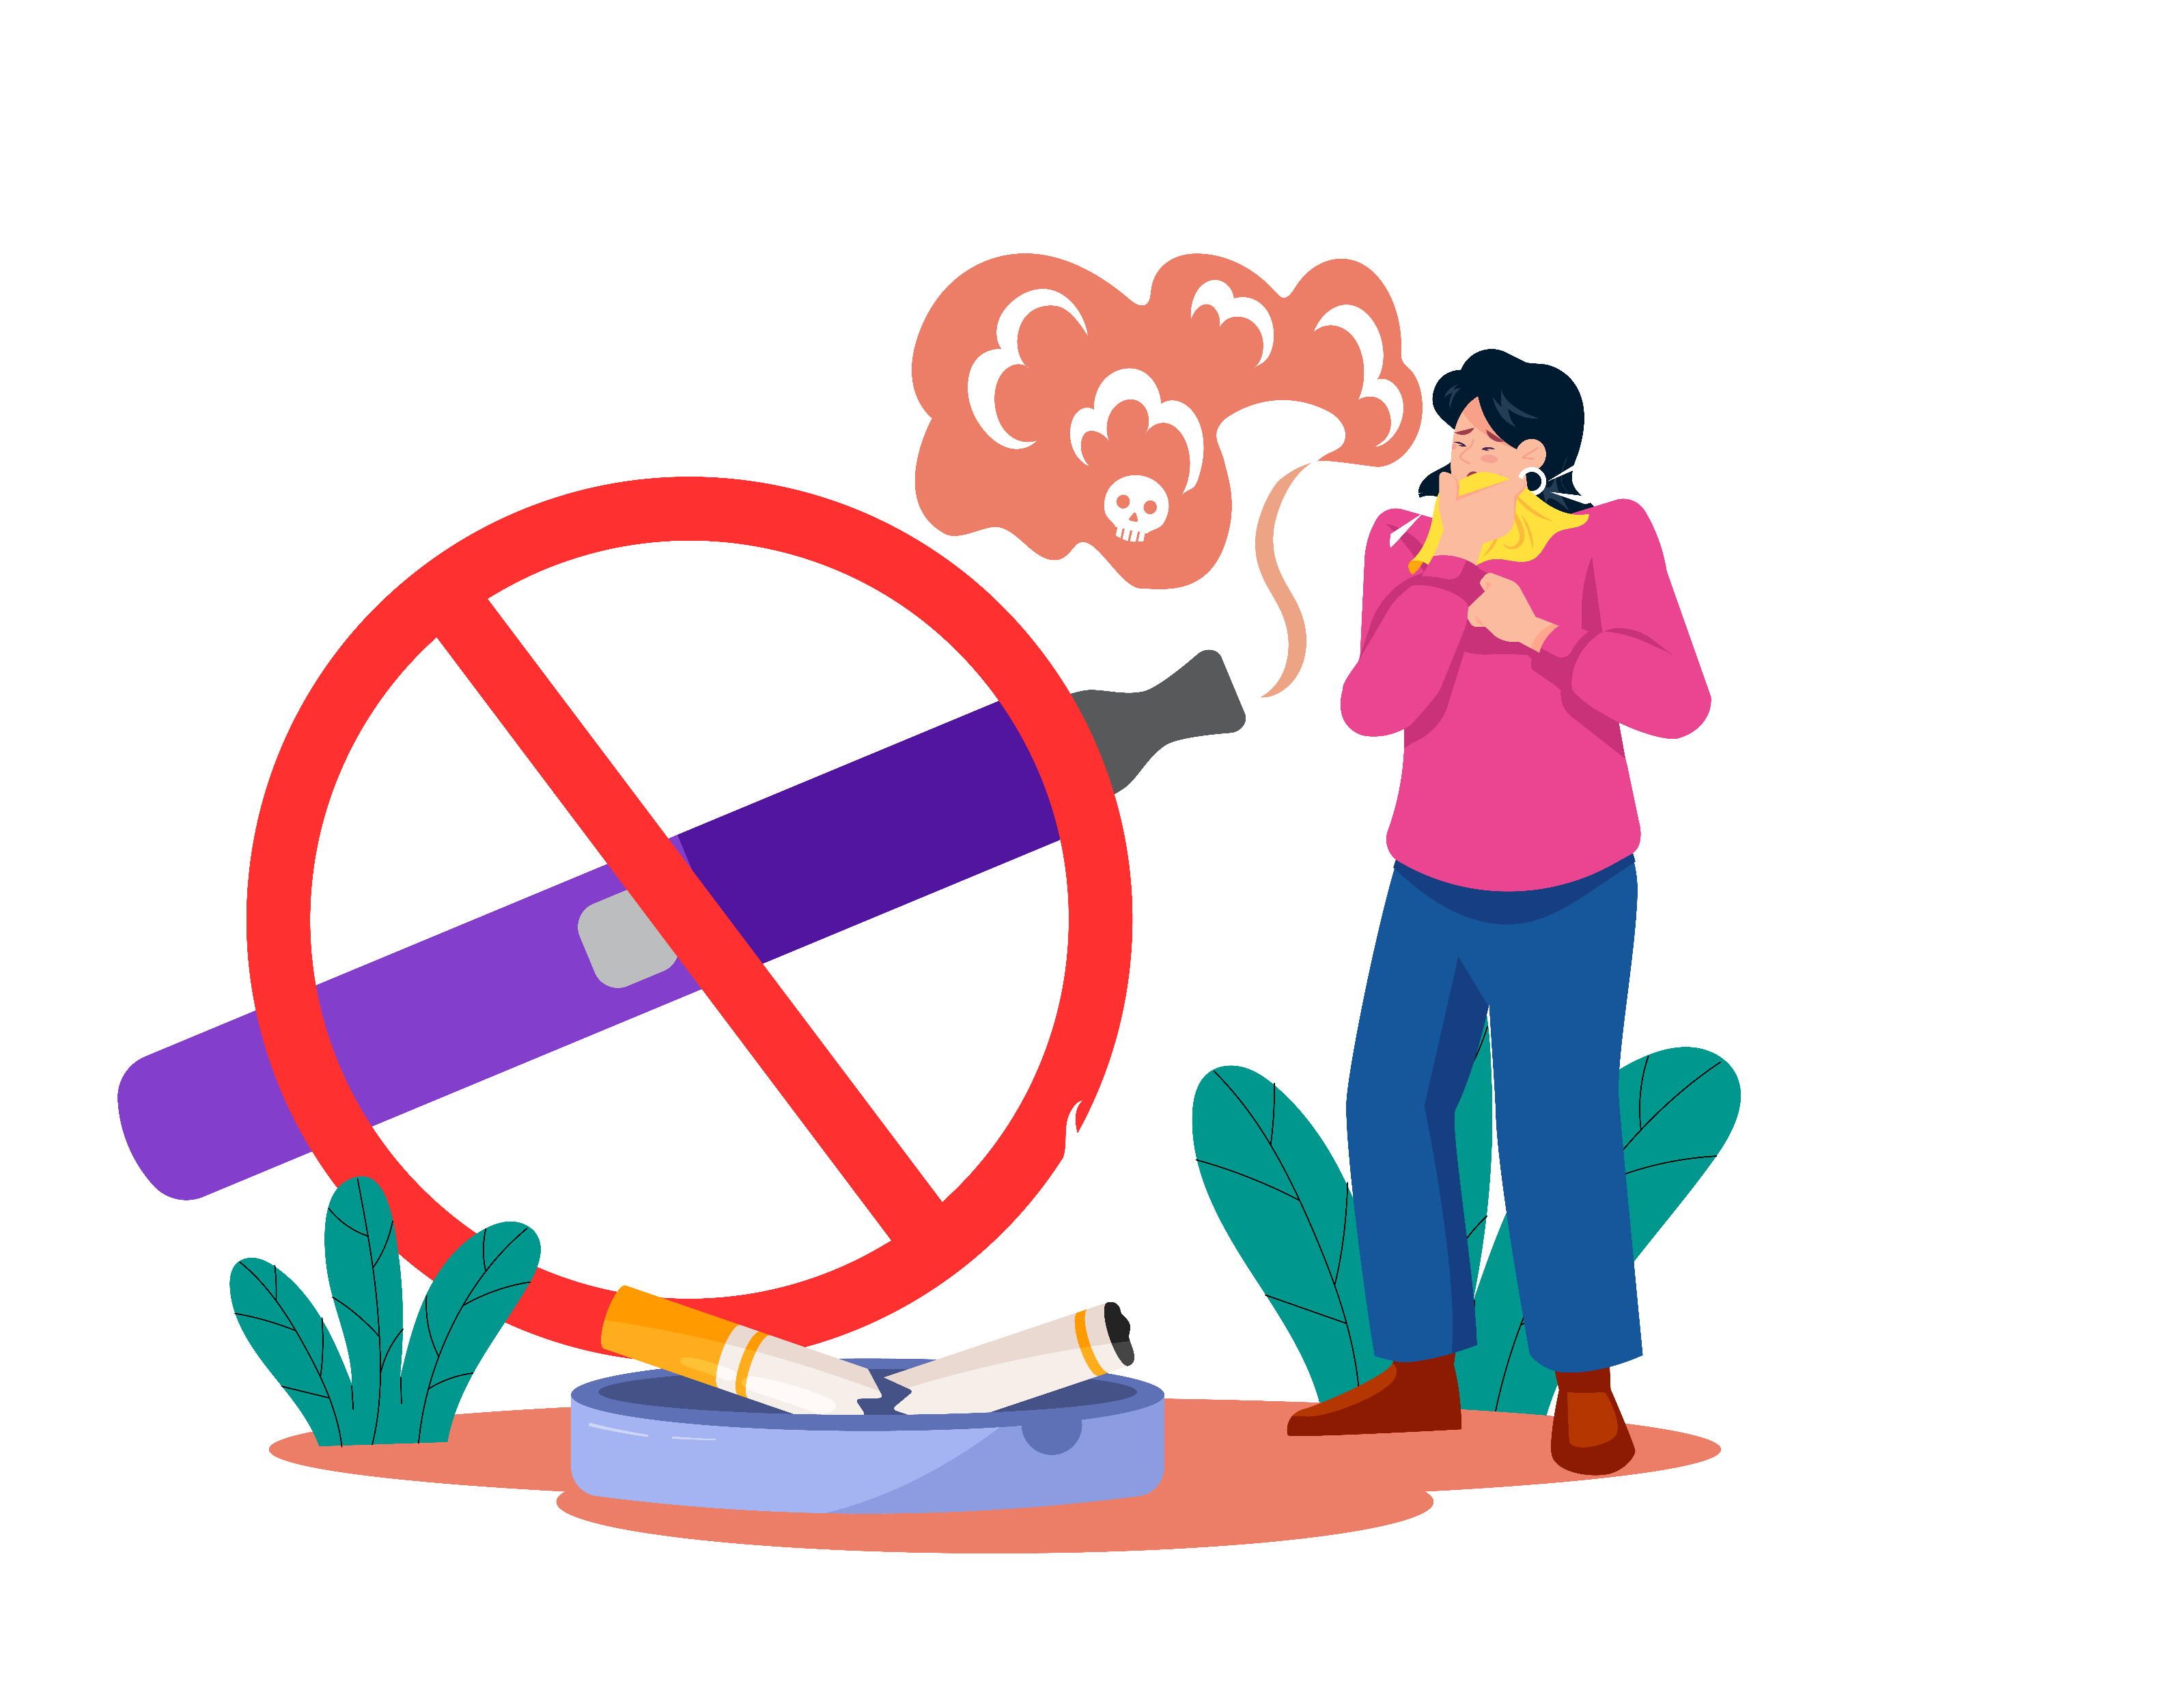
Quiz #5: If a friend offers you a vape, what’s the best choice?
Take it just once
Say “no thanks” and walk away
Try it to fit in
Notes:
(Correct: b – Say no and protect your health.)
Speaker Notes:
“If a friend offers you a vape, what’s the best choice?
A) Take it just once
B) Say ‘no thanks’ and walk away
C) Try it to fit in
The answer is B. Saying no and walking away keeps you in charge of your future.”

Slide 12
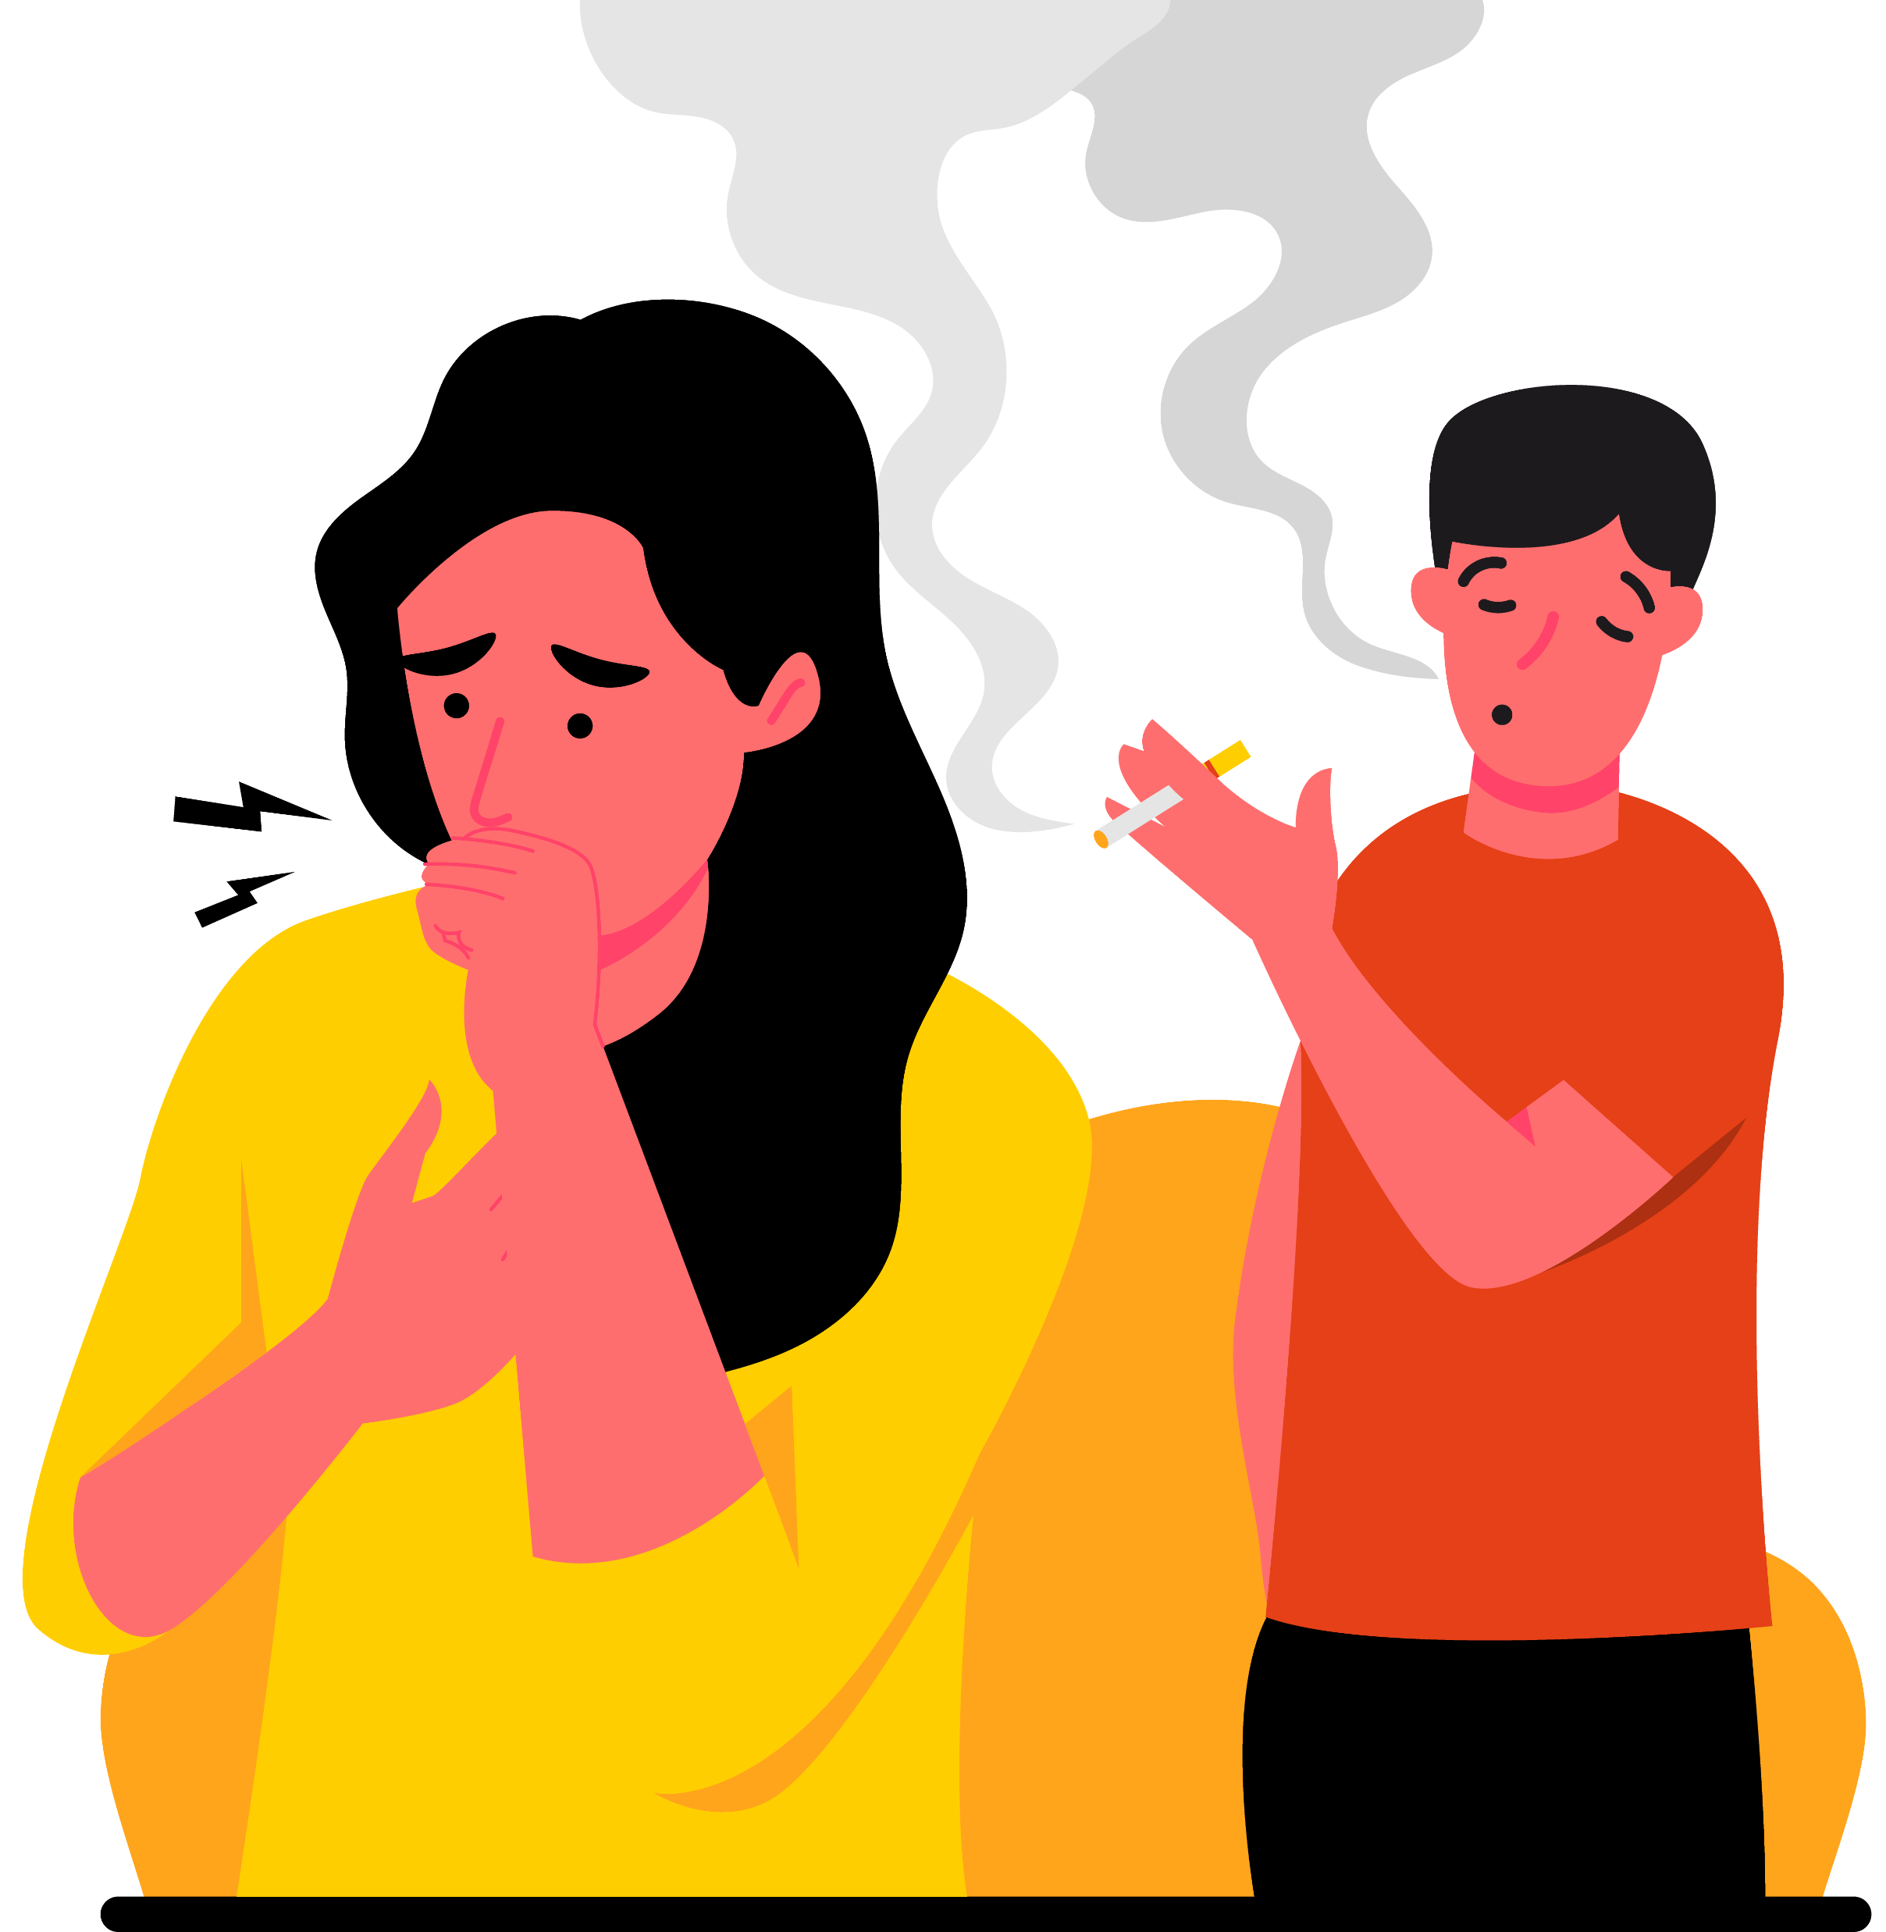
Wrap Up
Smoking and vaping hurt your heart, lungs, and brain.
You are stronger than peer pressure.
Protect your future: Clear the Air.
Notes:
Speaker Notes:
“Here’s the big takeaway: Smoking and vaping hurt your heart, lungs, and brain. You are stronger than peer pressure. Protect your health and your future by making the choice to Clear the Air.”

