Slide 1

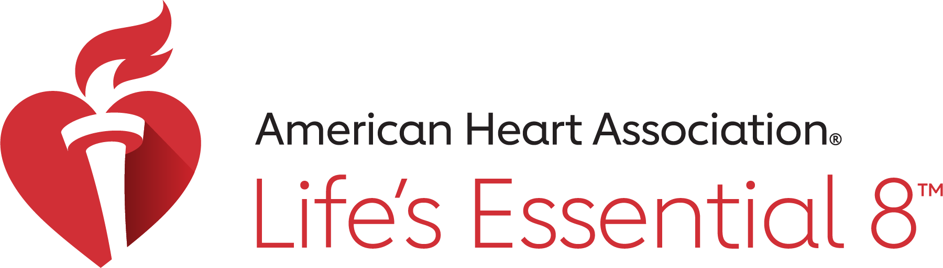
Don’t Be Pressured:
Understanding Blood Pressure
Keep your heart strong
Notes:
“Welcome everyone! Today we’re going to learn about something really important—blood pressure. We’ll talk about what it is, why it matters, and what we can do to keep our hearts strong and healthy.”

Slide 2
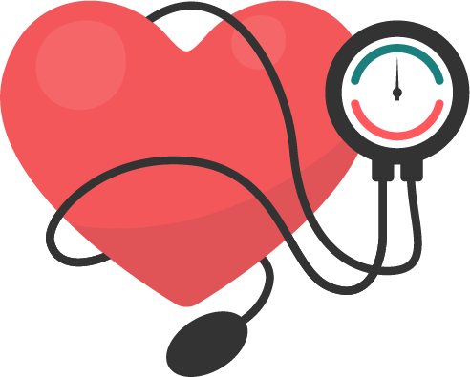
What is Blood Pressure?
Blood pressure = how strongly blood moves through your arteries
Like water moving through pipes in a house
Notes:
““Blood pressure is how strongly your blood pushes against the walls of your arteries, kind of like water moving through pipes in a house. If the pressure is just right, everything flows smoothly. But if it’s too high, it can cause problems.”

Slide 3
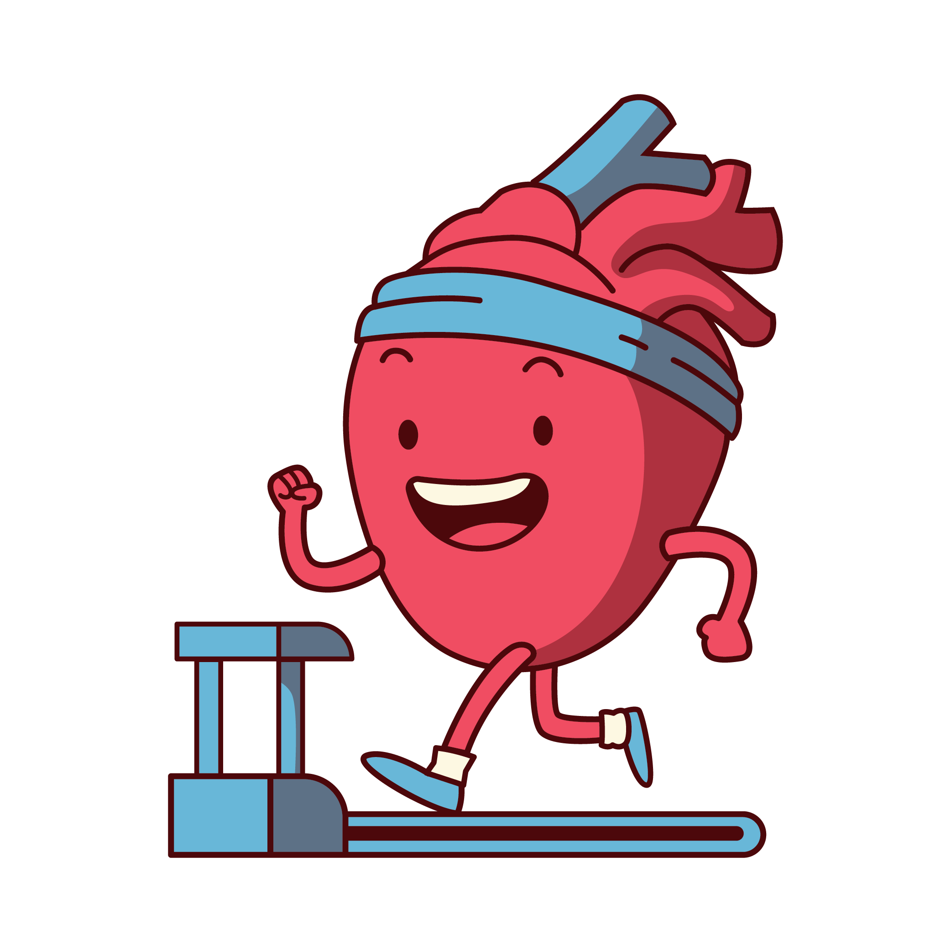
Why It’s Important
Blood carries oxygen and nutrients
Too much pressure = heart works harder
Can make the heart tired over time
Notes:
“Blood pressure matters because blood carries oxygen and nutrients to your body. But too much pressure makes your heart work harder, almost like running uphill all the time. Over time, that can make your heart tired and unhealthy.”

Slide 4
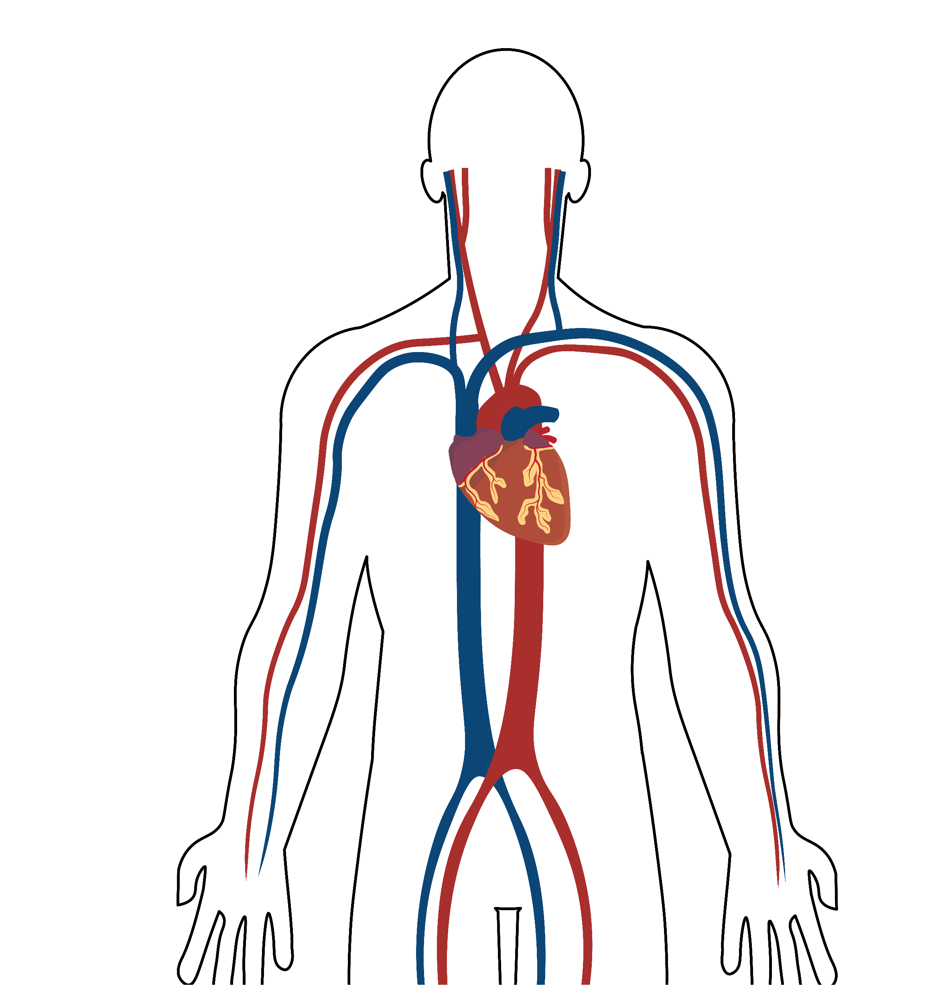
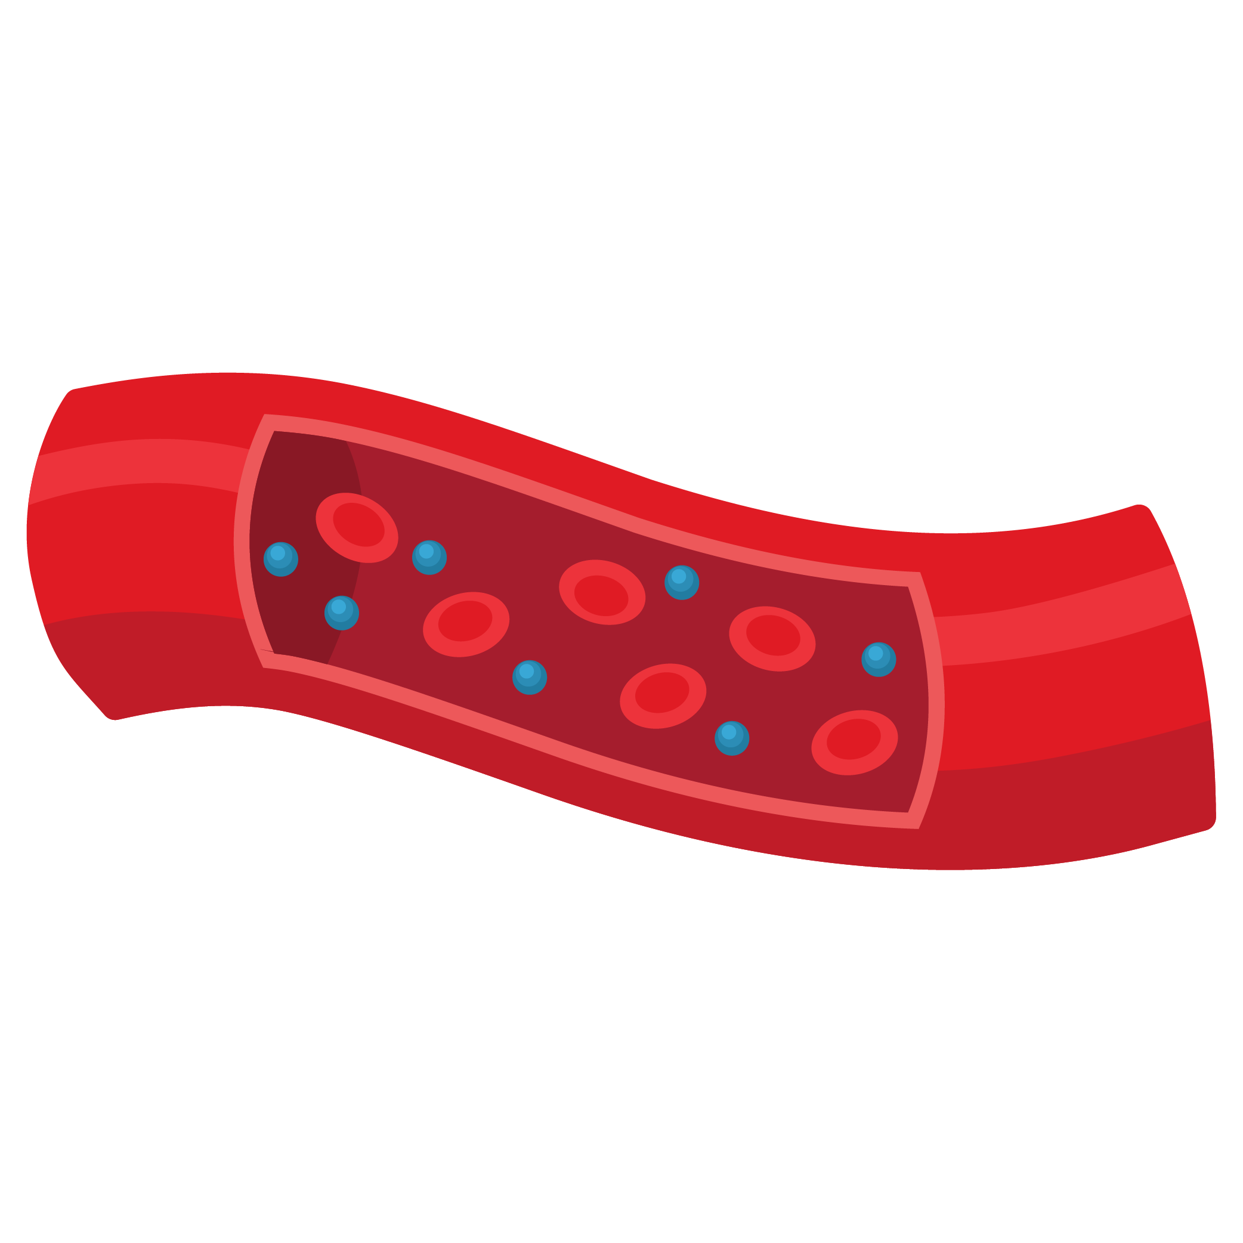
Quiz #1: Blood pressure is like:
Electricity in wires
Water in pipes
Air in a balloon
Notes:
Quick check! Blood pressure is like: a) Air in balloons, or b) Water in pipes? Yes! It’s like water moving through pipes.”
(Correct Answer: b – Water in pipes!)

Slide 5
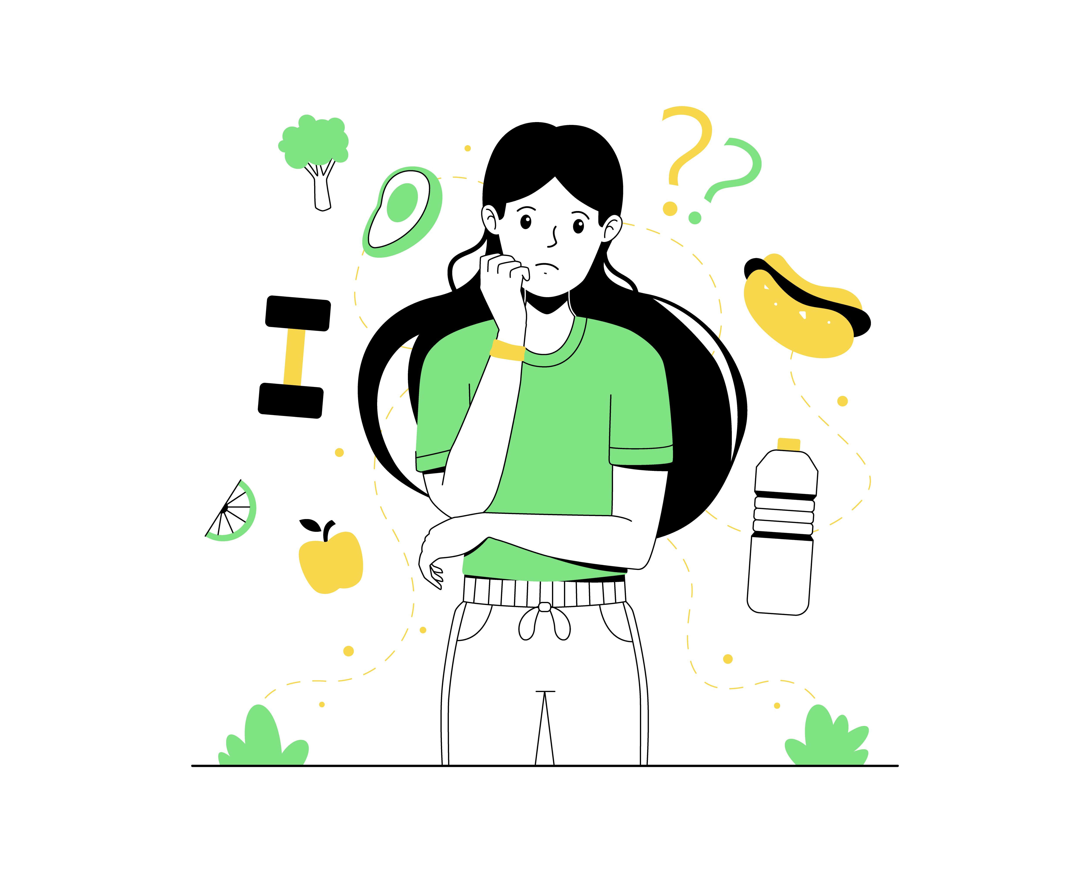
What Causes
High Blood
Pressure?
Too much salty or fatty food
Not enough exercise
Blood vessels get narrow (like a squished straw)
Notes:
“High blood pressure can happen for different reasons. Eating too many salty or fatty foods, not getting enough exercise, or when blood vessels get narrow—like when a straw is squished—can all raise your pressure.”

Slide 6
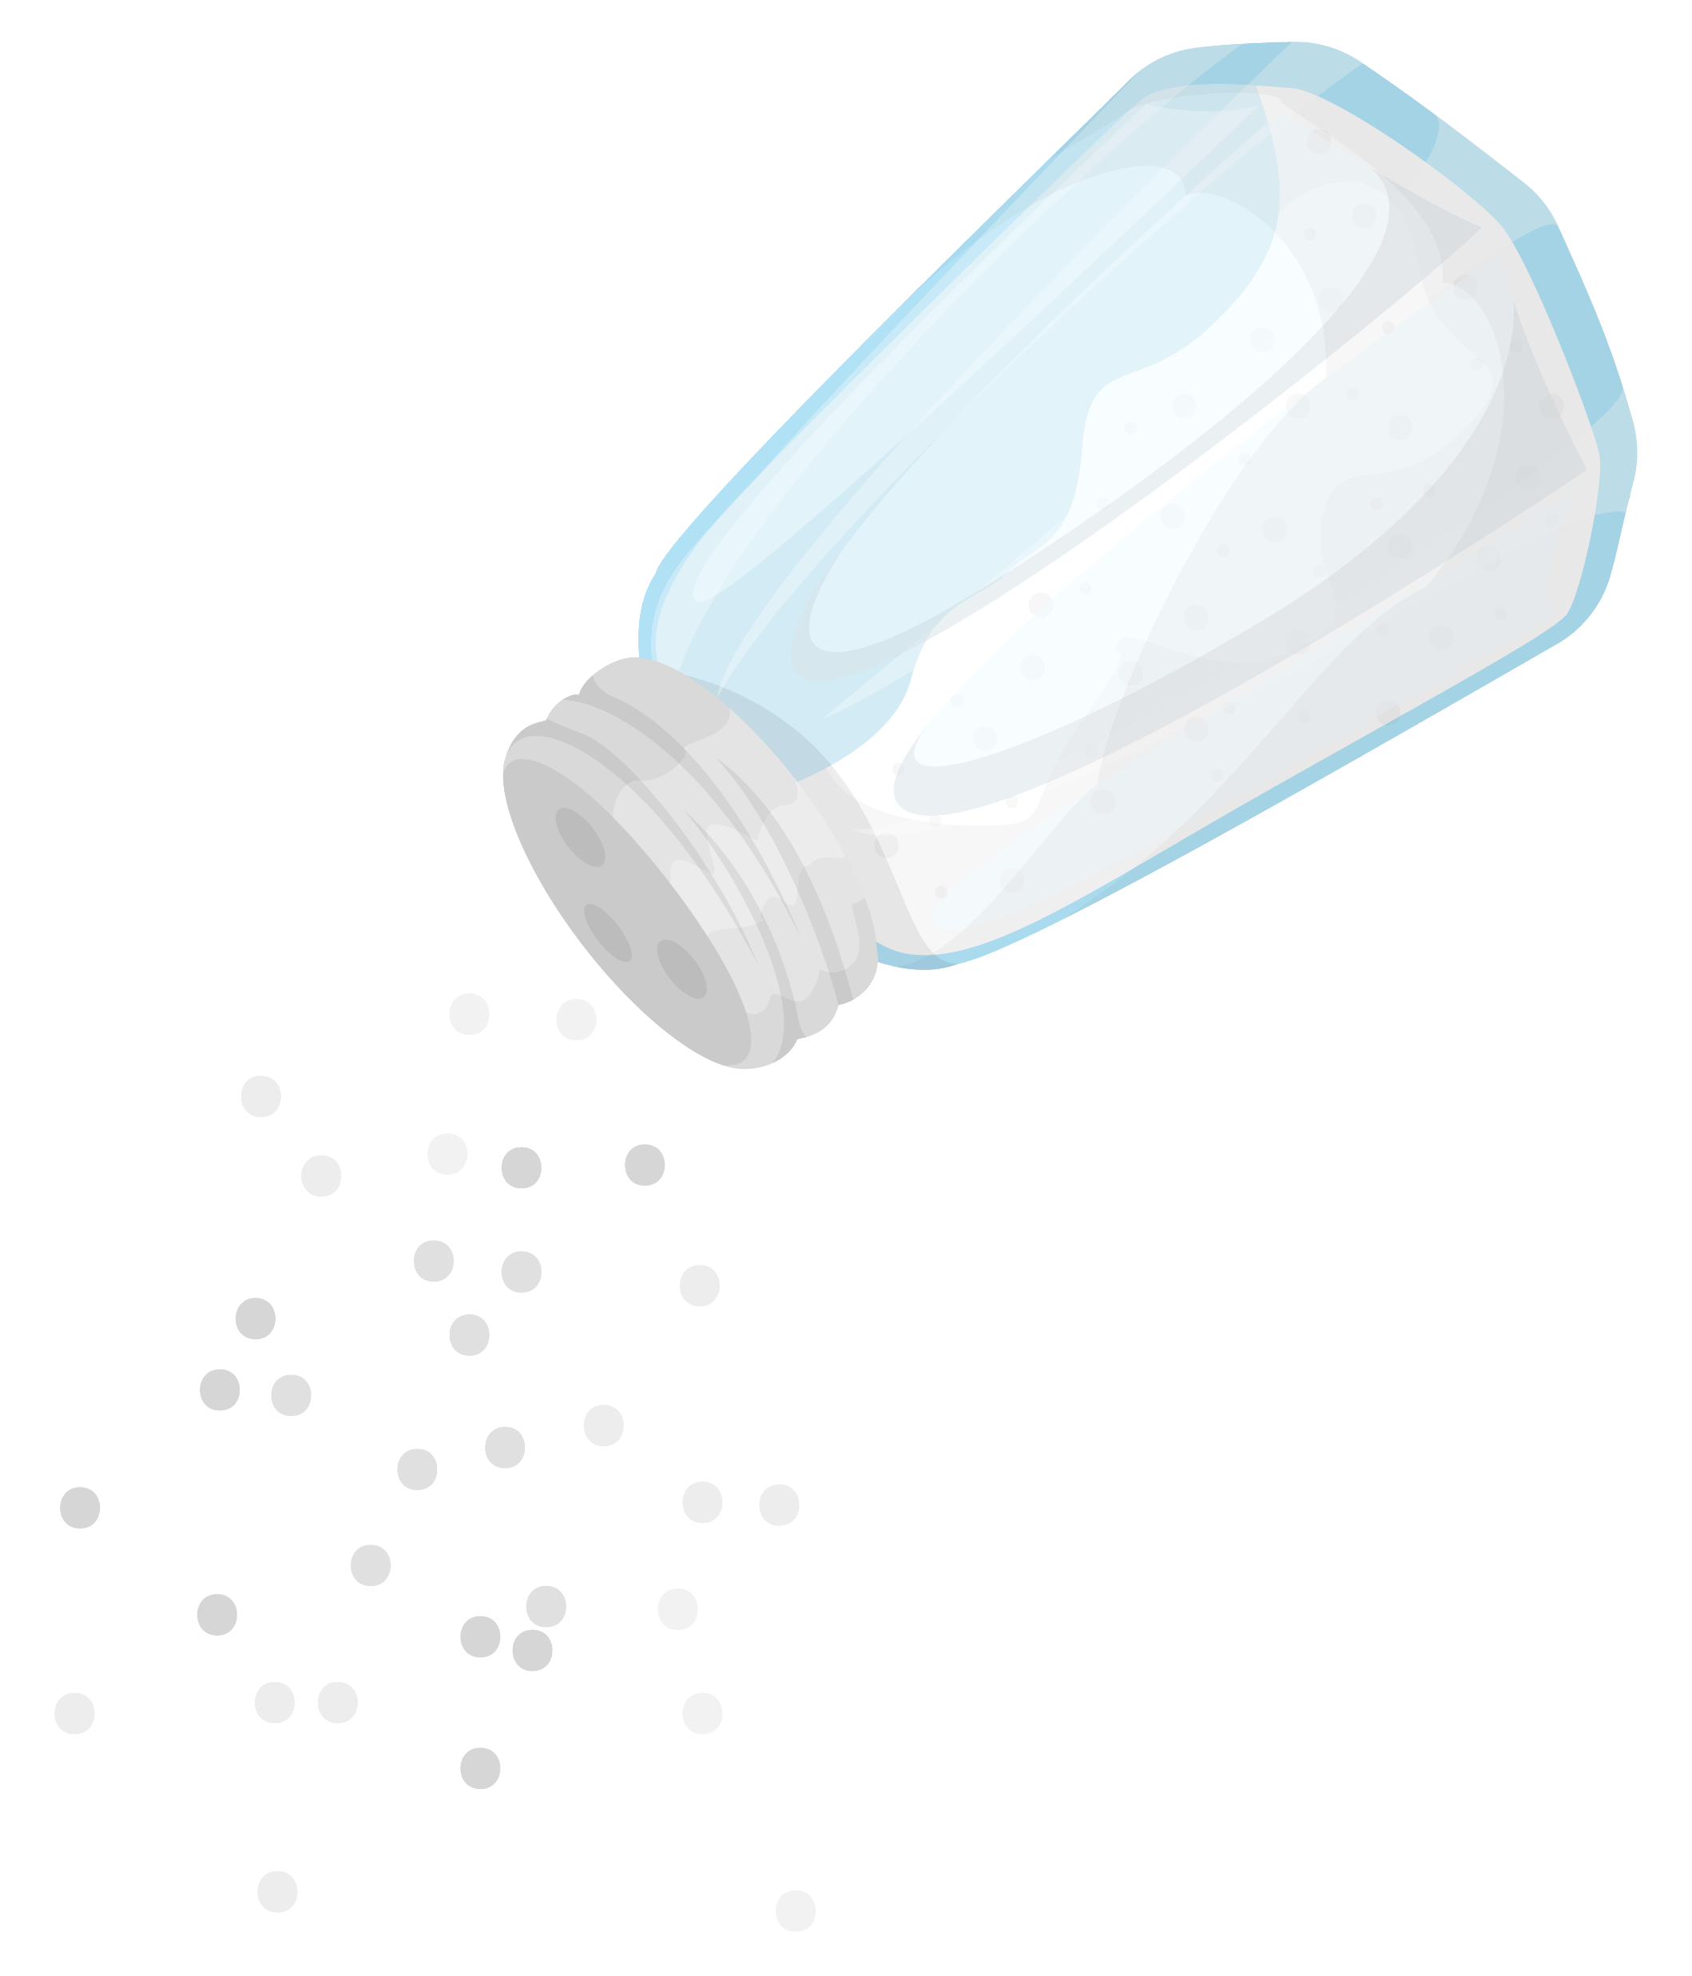
Quiz #2: Eating lots of salty snacks can raise your blood pressure.
True
False
Notes:
“True or false? Eating lots of salty snacks can raise your blood pressure. The answer is True! Too much salt makes your body hold onto water, which makes your heart pump harder.”
Answer: True)

Slide 7
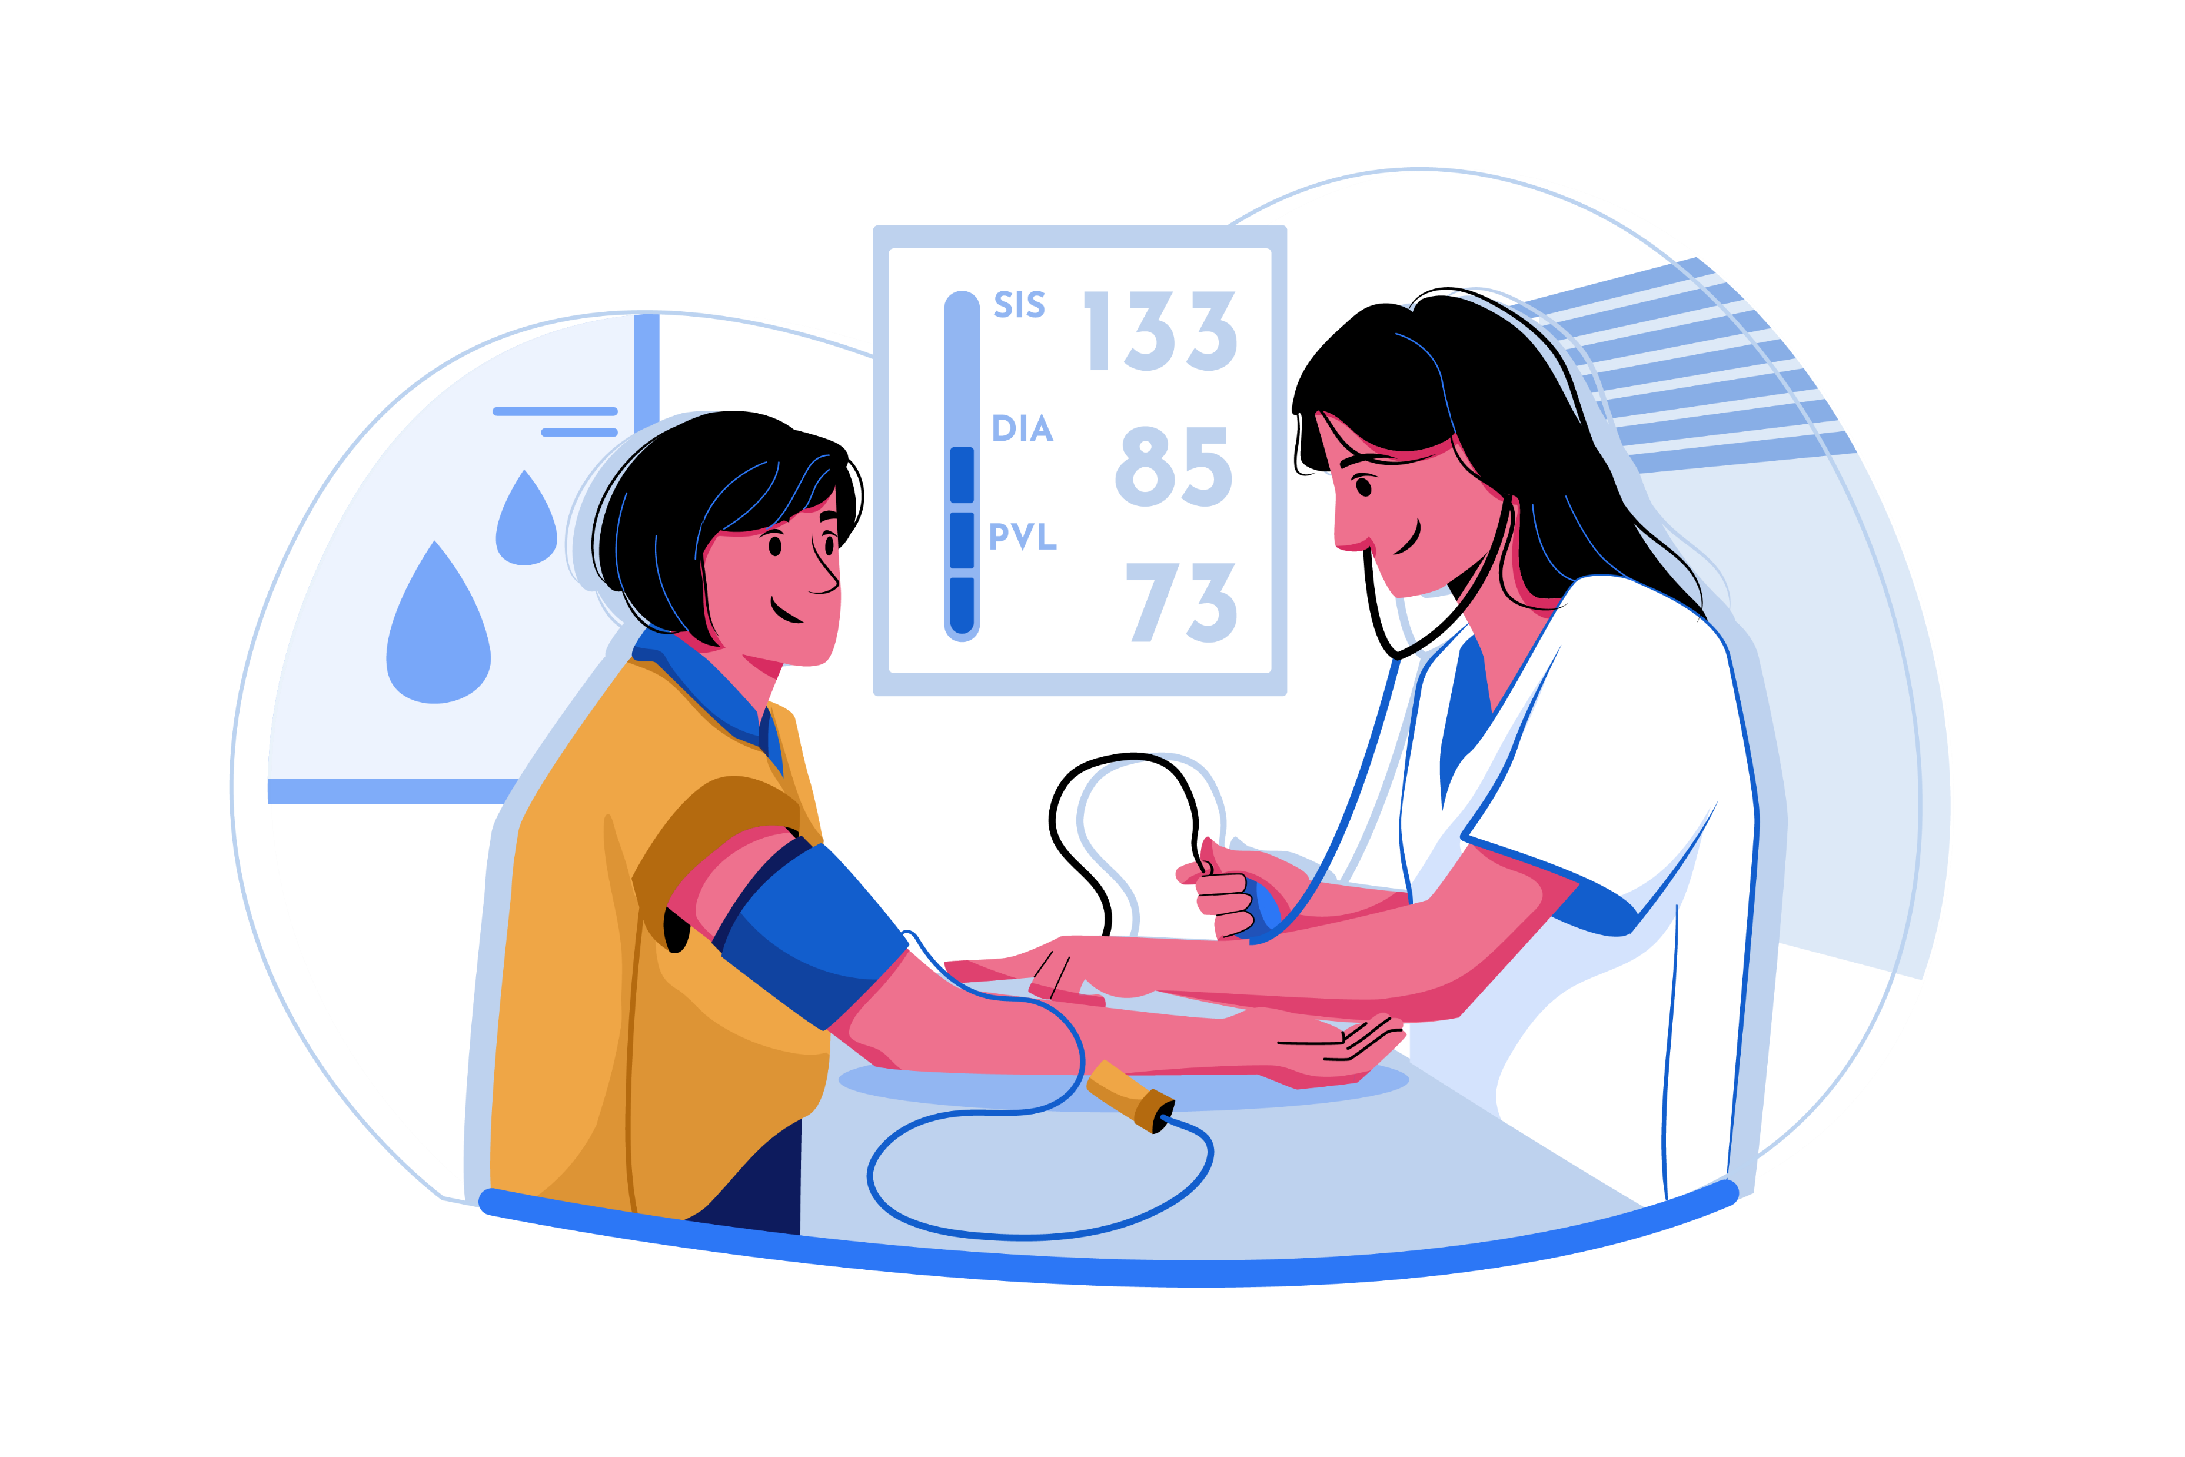
Understanding Readings
Two numbers: Systolic (top) / Diastolic (bottom)
Example: 117/76 mm Hg
Systolic = when heart beats
Diastolic = when heart rests
Notes:
“When we measure blood pressure, we see two numbers: systolic on top and diastolic on the bottom. For example, 117 over 76. The top number shows pressure when your heart beats, and the bottom shows pressure when your heart rests.”

Slide 8
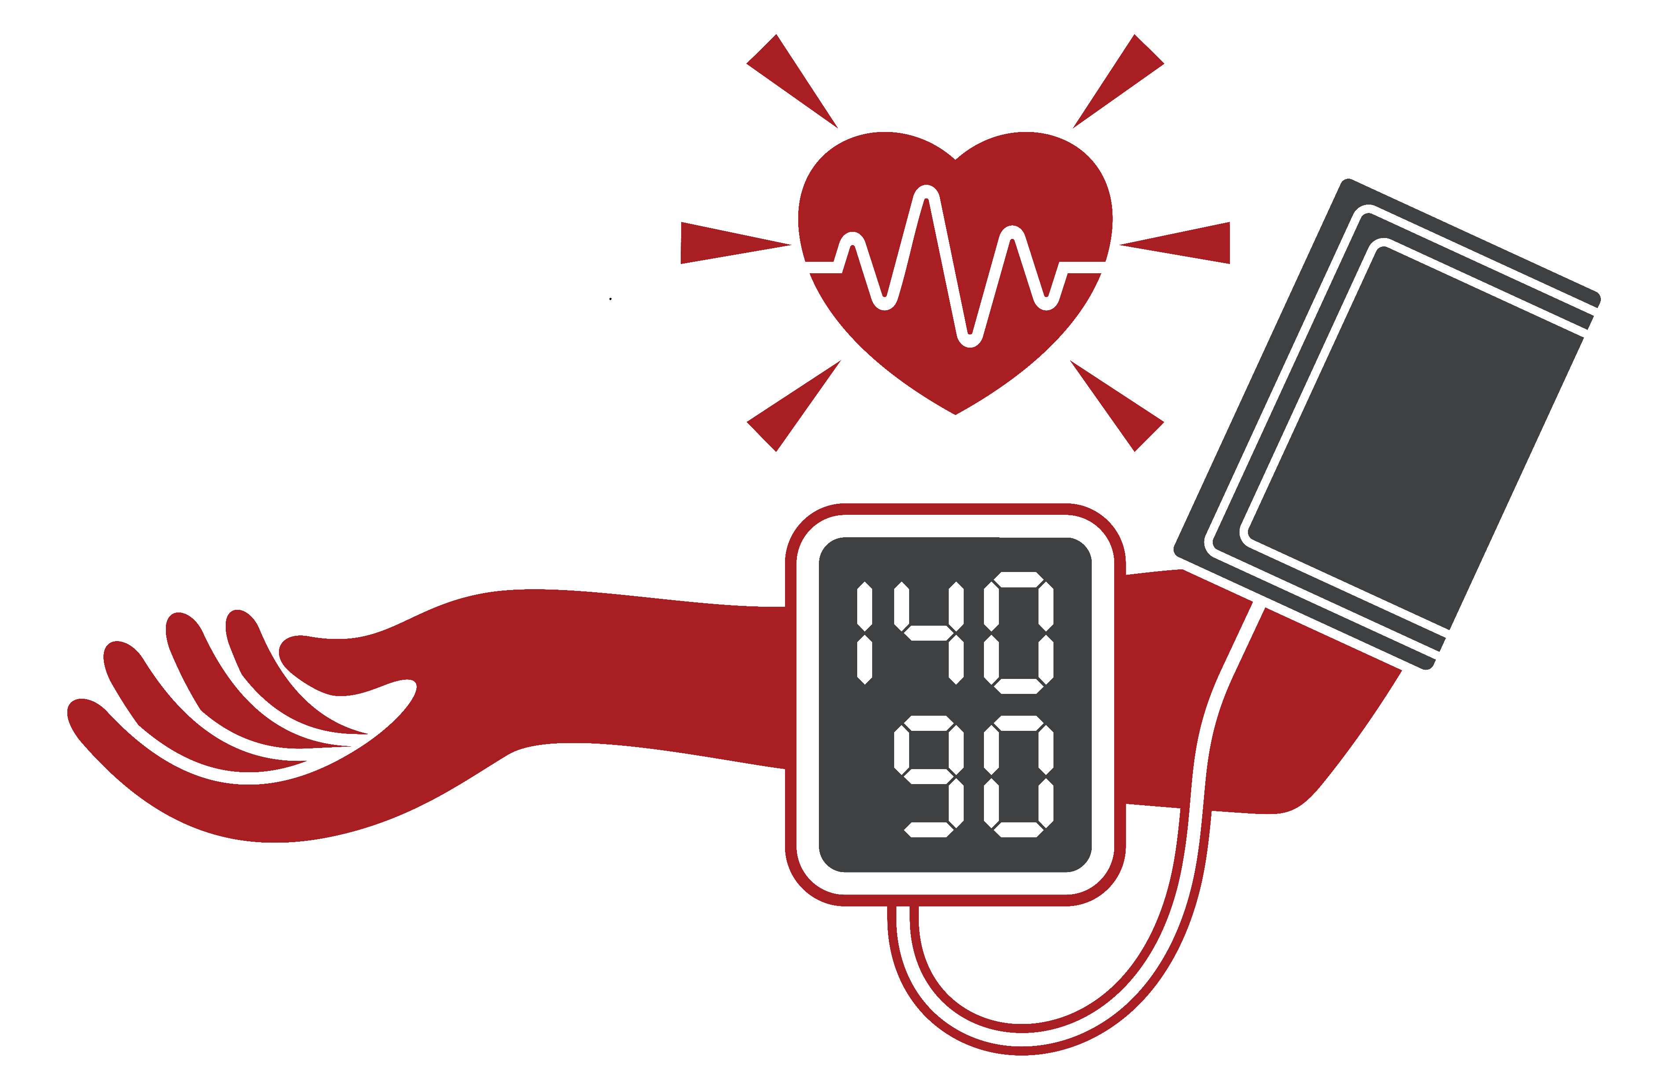
Quiz #3: Which number is higher?
Systolic
Diastolic
Notes:
“Which number is usually higher, systolic or diastolic? That’s right—the systolic number is higher.”
(Correct Answer: a – Systolic is the top and usually higher.)

Slide 9
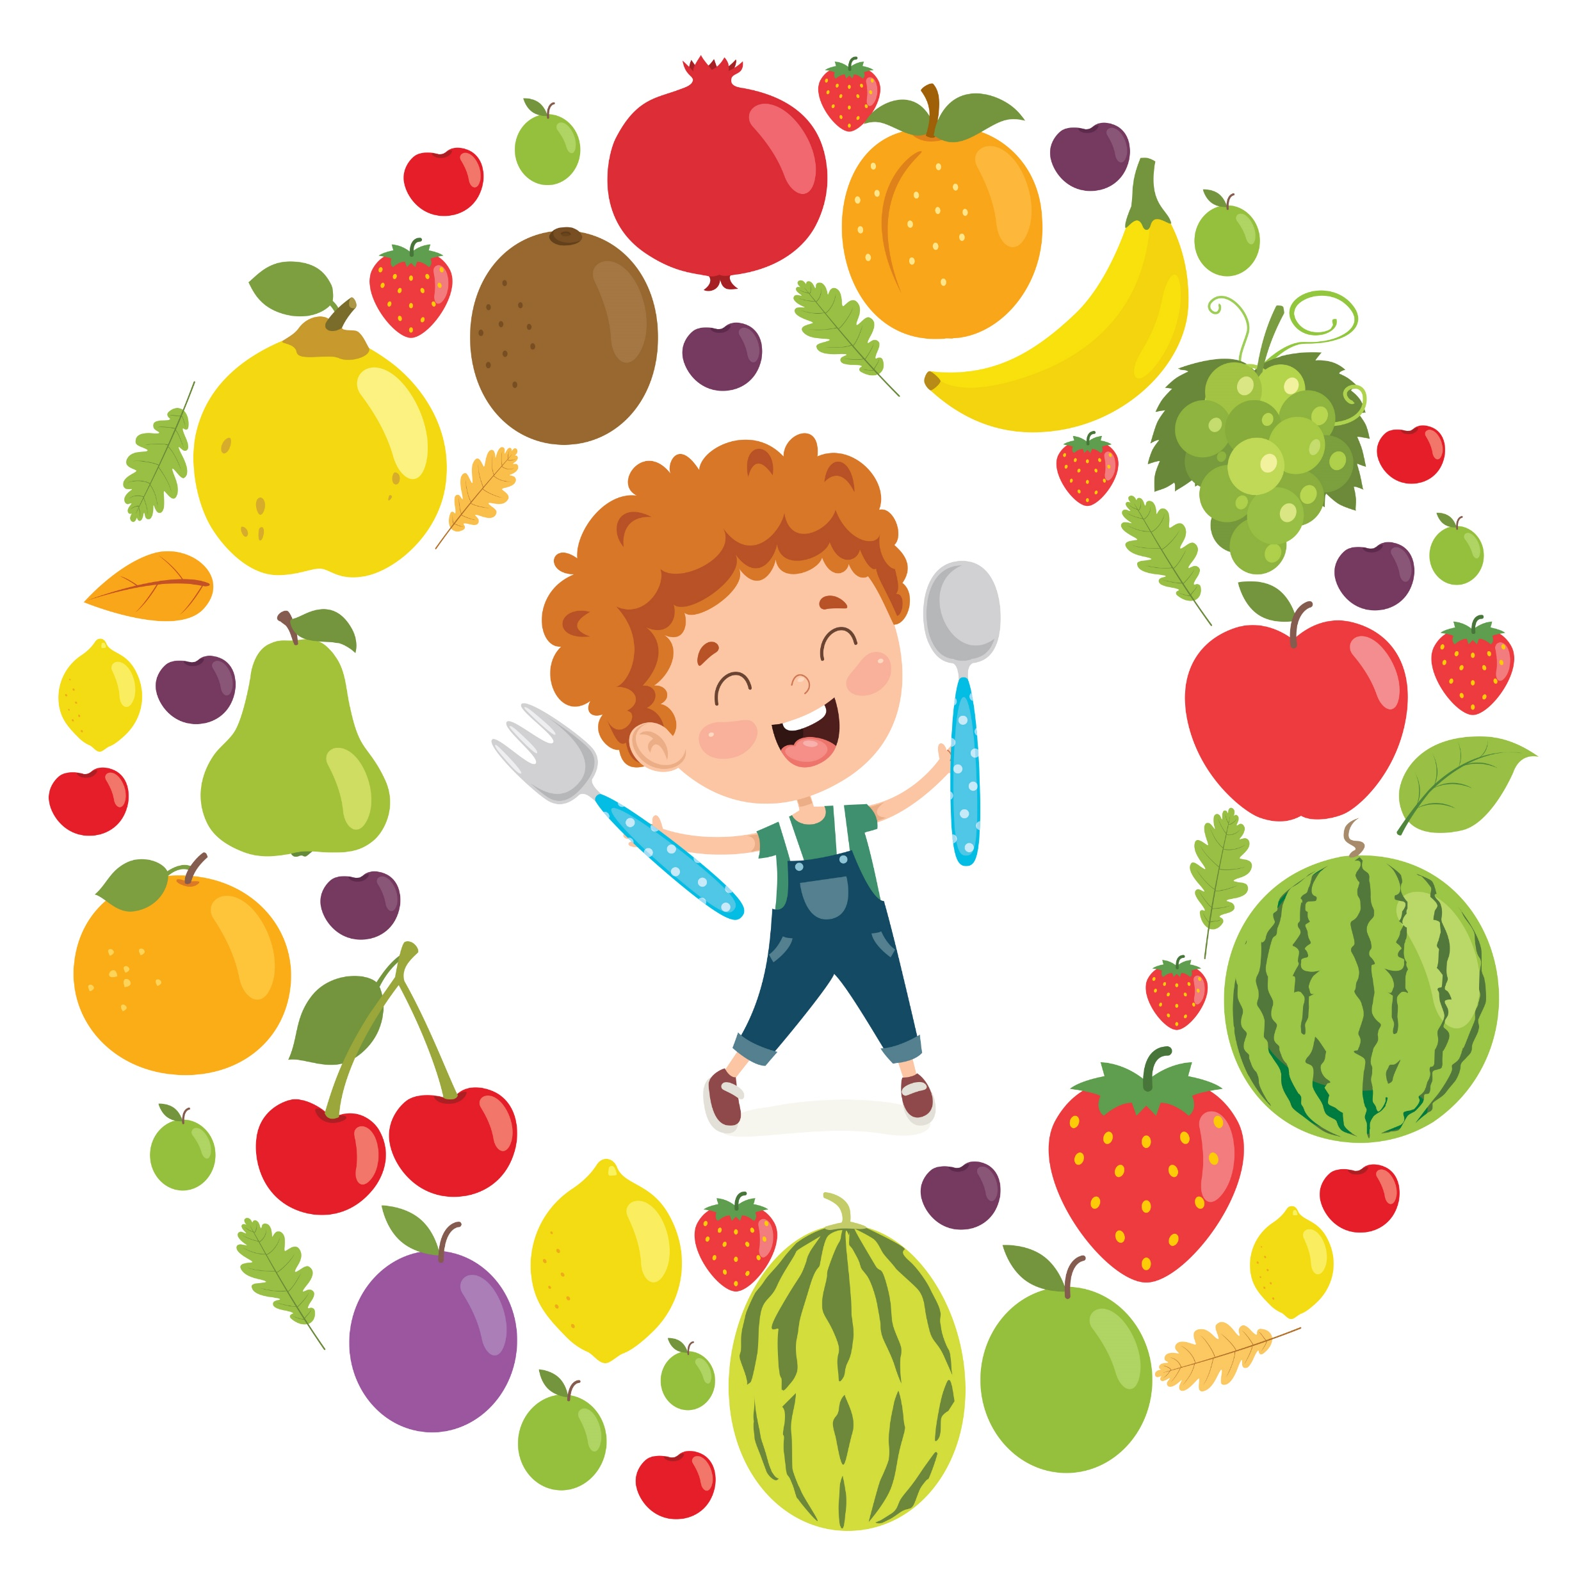
Healthy Habits
for Blood Pressure
Eat fruits, veggies, and whole grains
Move your body every day
Limit salty snacks, fast food, and sodas
Notes:
“We can keep blood pressure healthy with good habits: eat fruits, veggies, and whole grains, move your body every day, and limit salty snacks, fast food, and sodas. Small choices add up to a strong heart.”

Slide 10
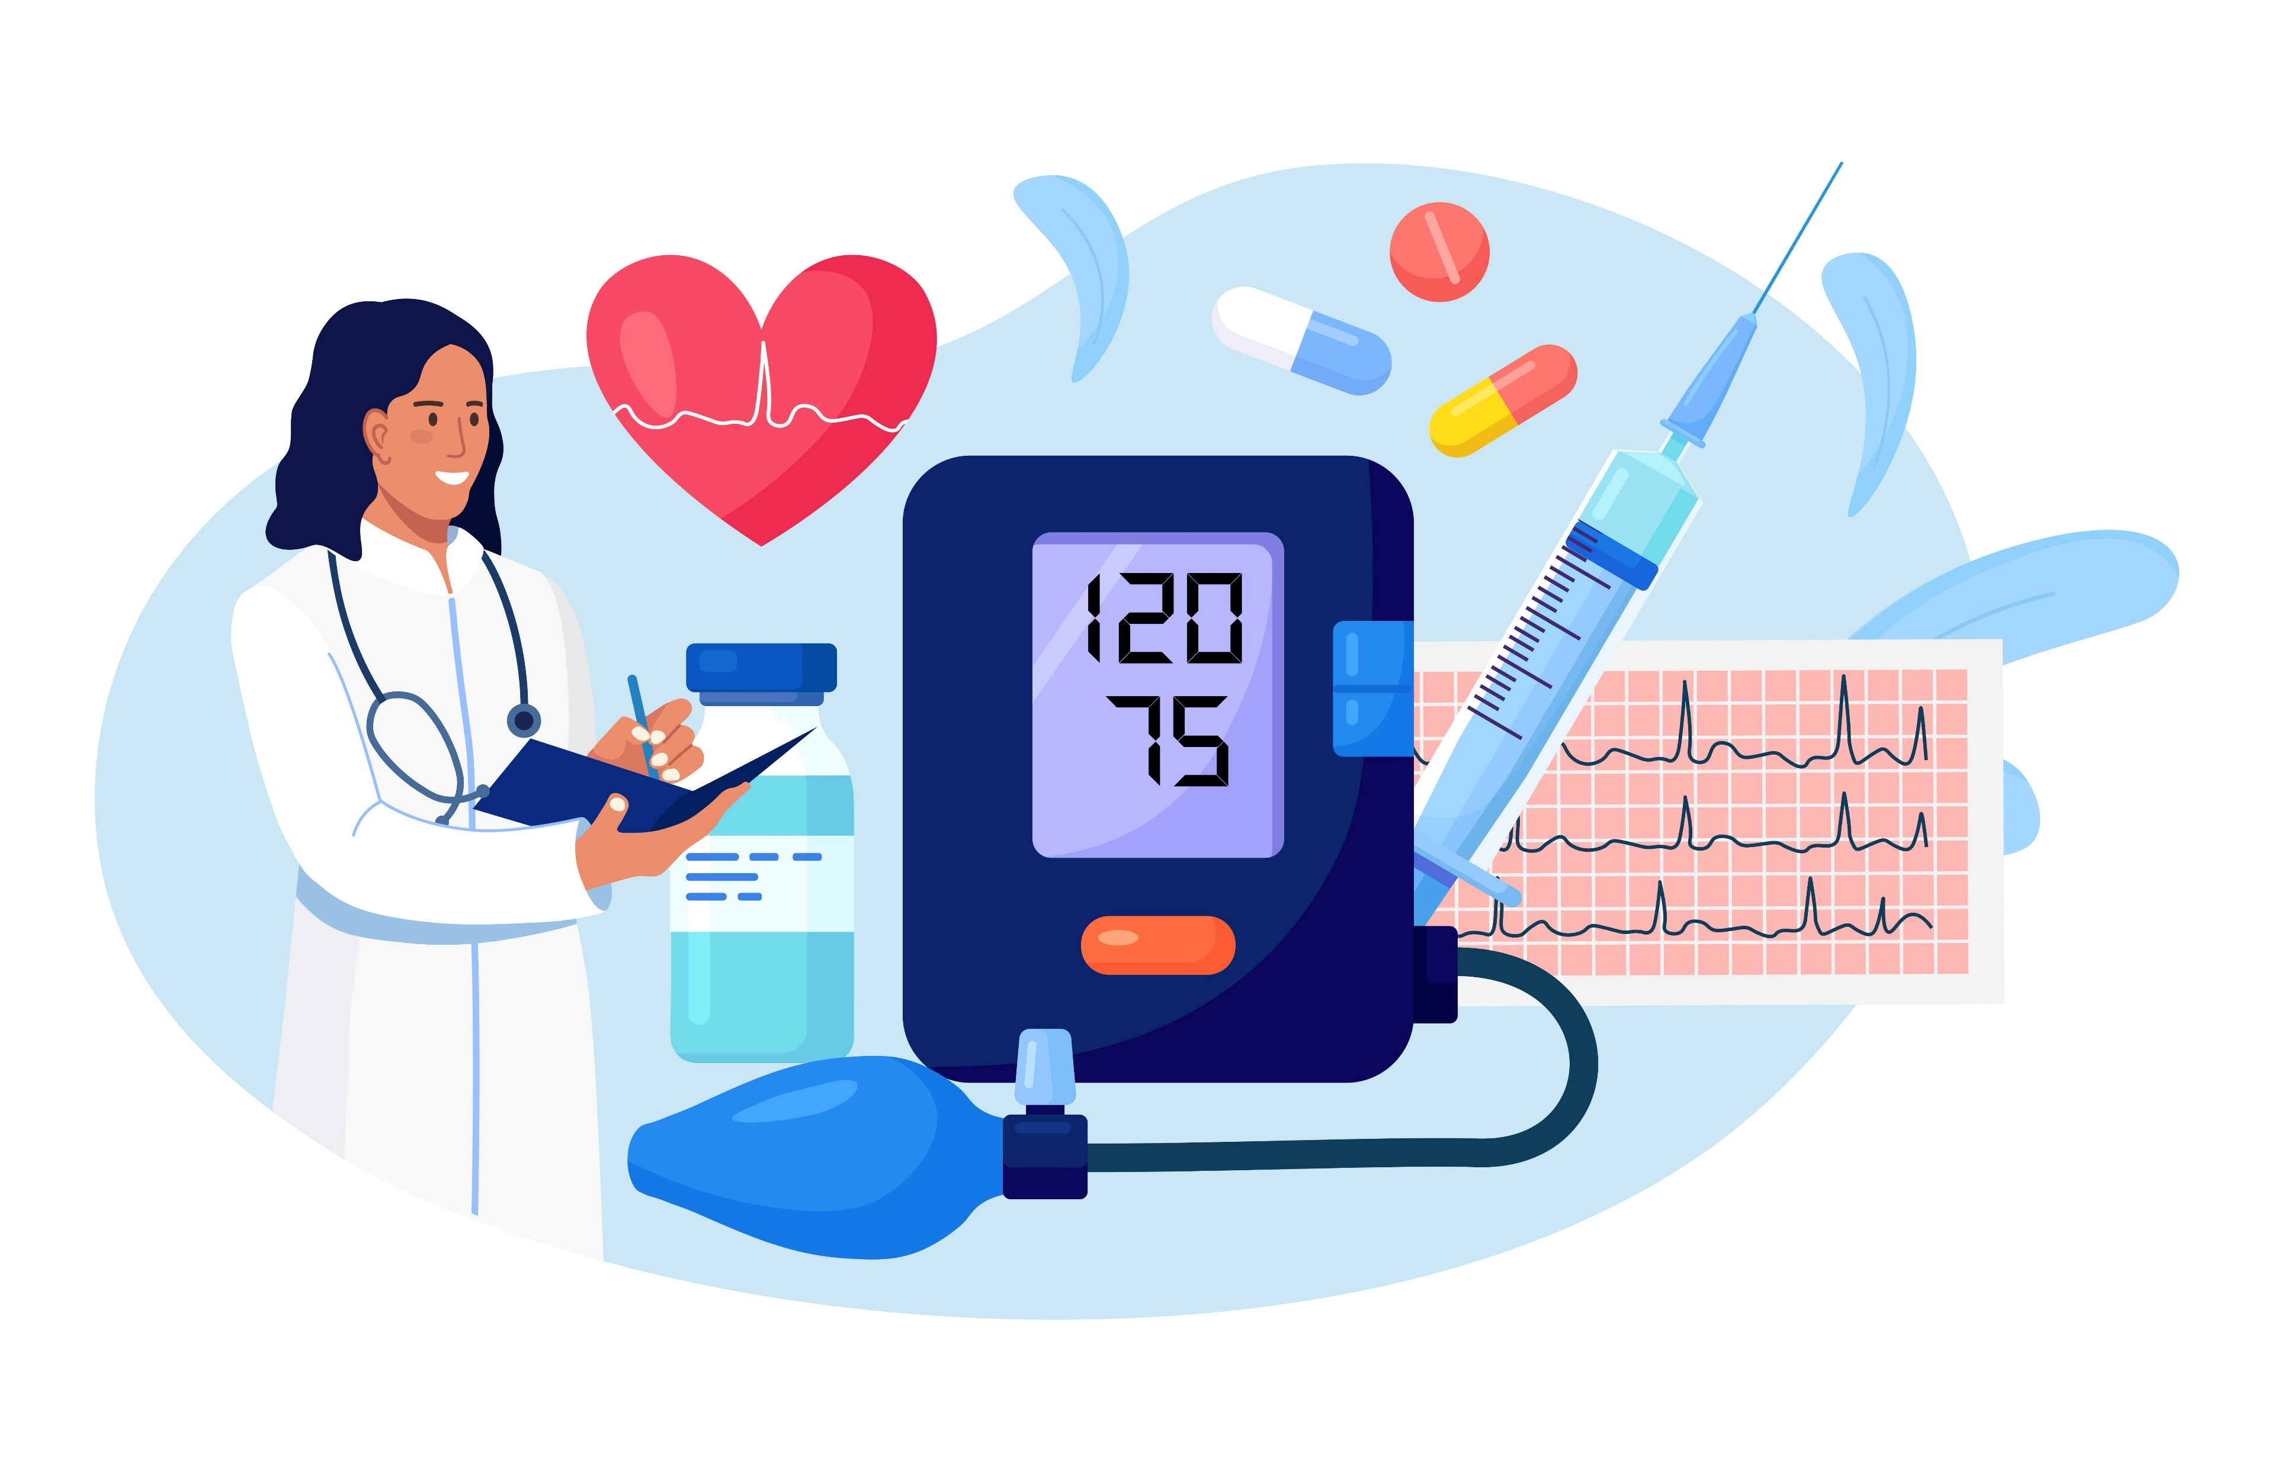
Quiz #4: Fill in the blank: High blood pressure makes your heart work ______.
Easier
Harder
Slower
Notes:
“Fill in the blank: High blood pressure makes your heart work… harder. That’s why healthy choices matter so much.”
(Correct Answer: b – Harder!)

Slide 11
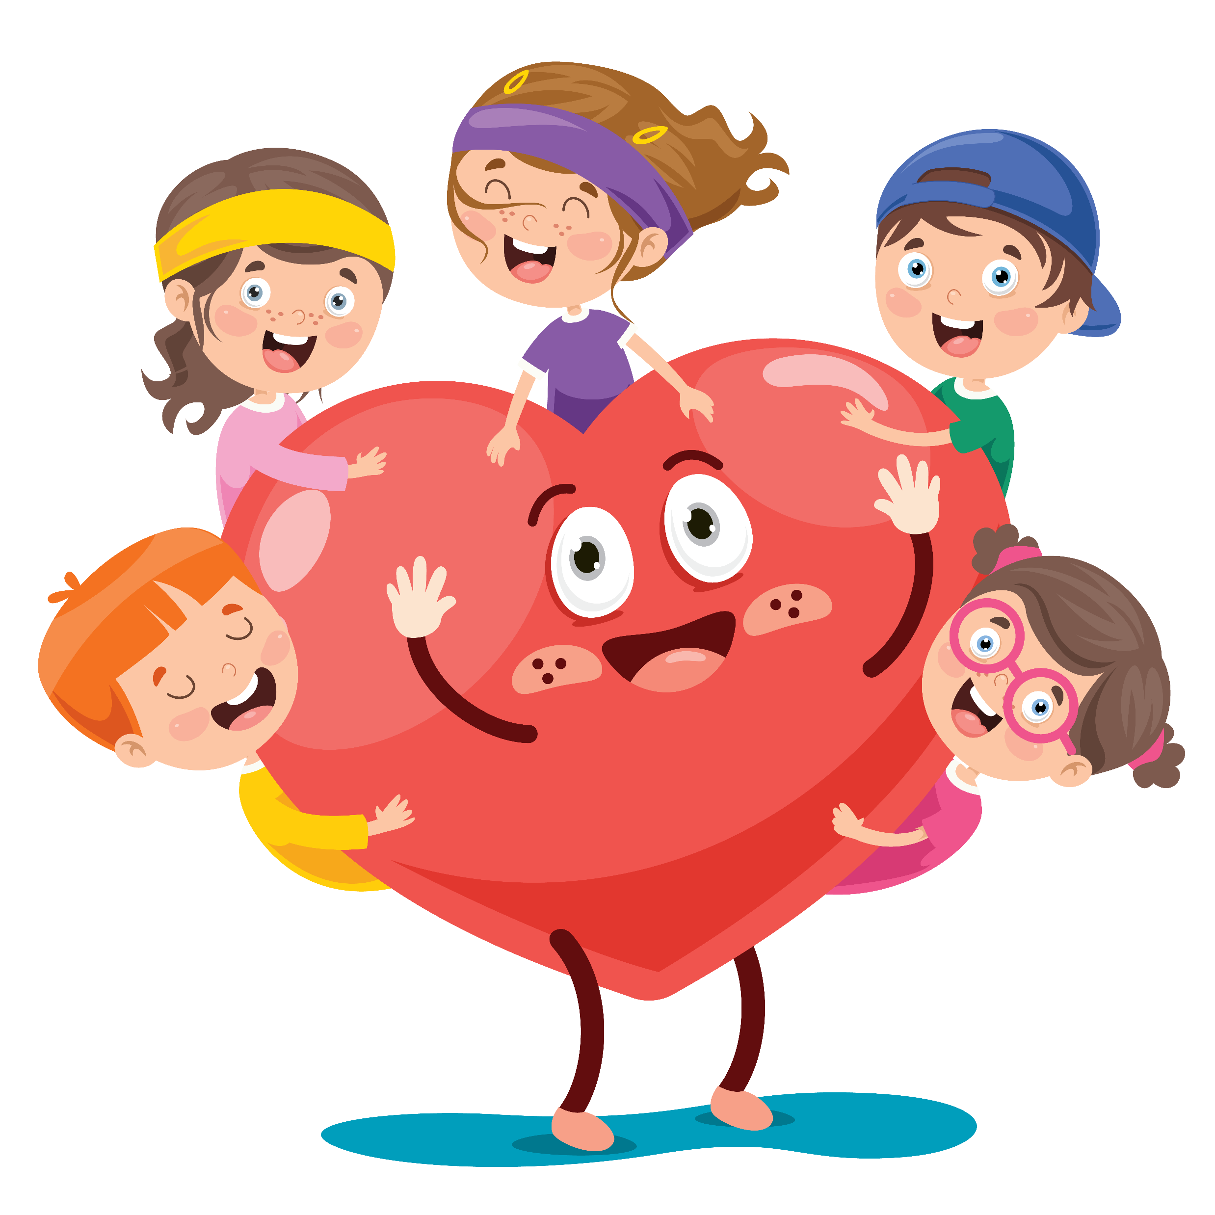
Why It Matters
for You
Even kids can have high blood pressure
Healthy choices now protect your heart for the future
Notes:
“Blood pressure isn’t just for adults—kids need to take care of it too. Did you know kids can have high blood pressure too? That’s why building healthy habits now helps protect your heart for the future. The earlier we start, the stronger and healthier we stay. Did you know that you can have your blood pressure checked at age 3?””

Slide 12
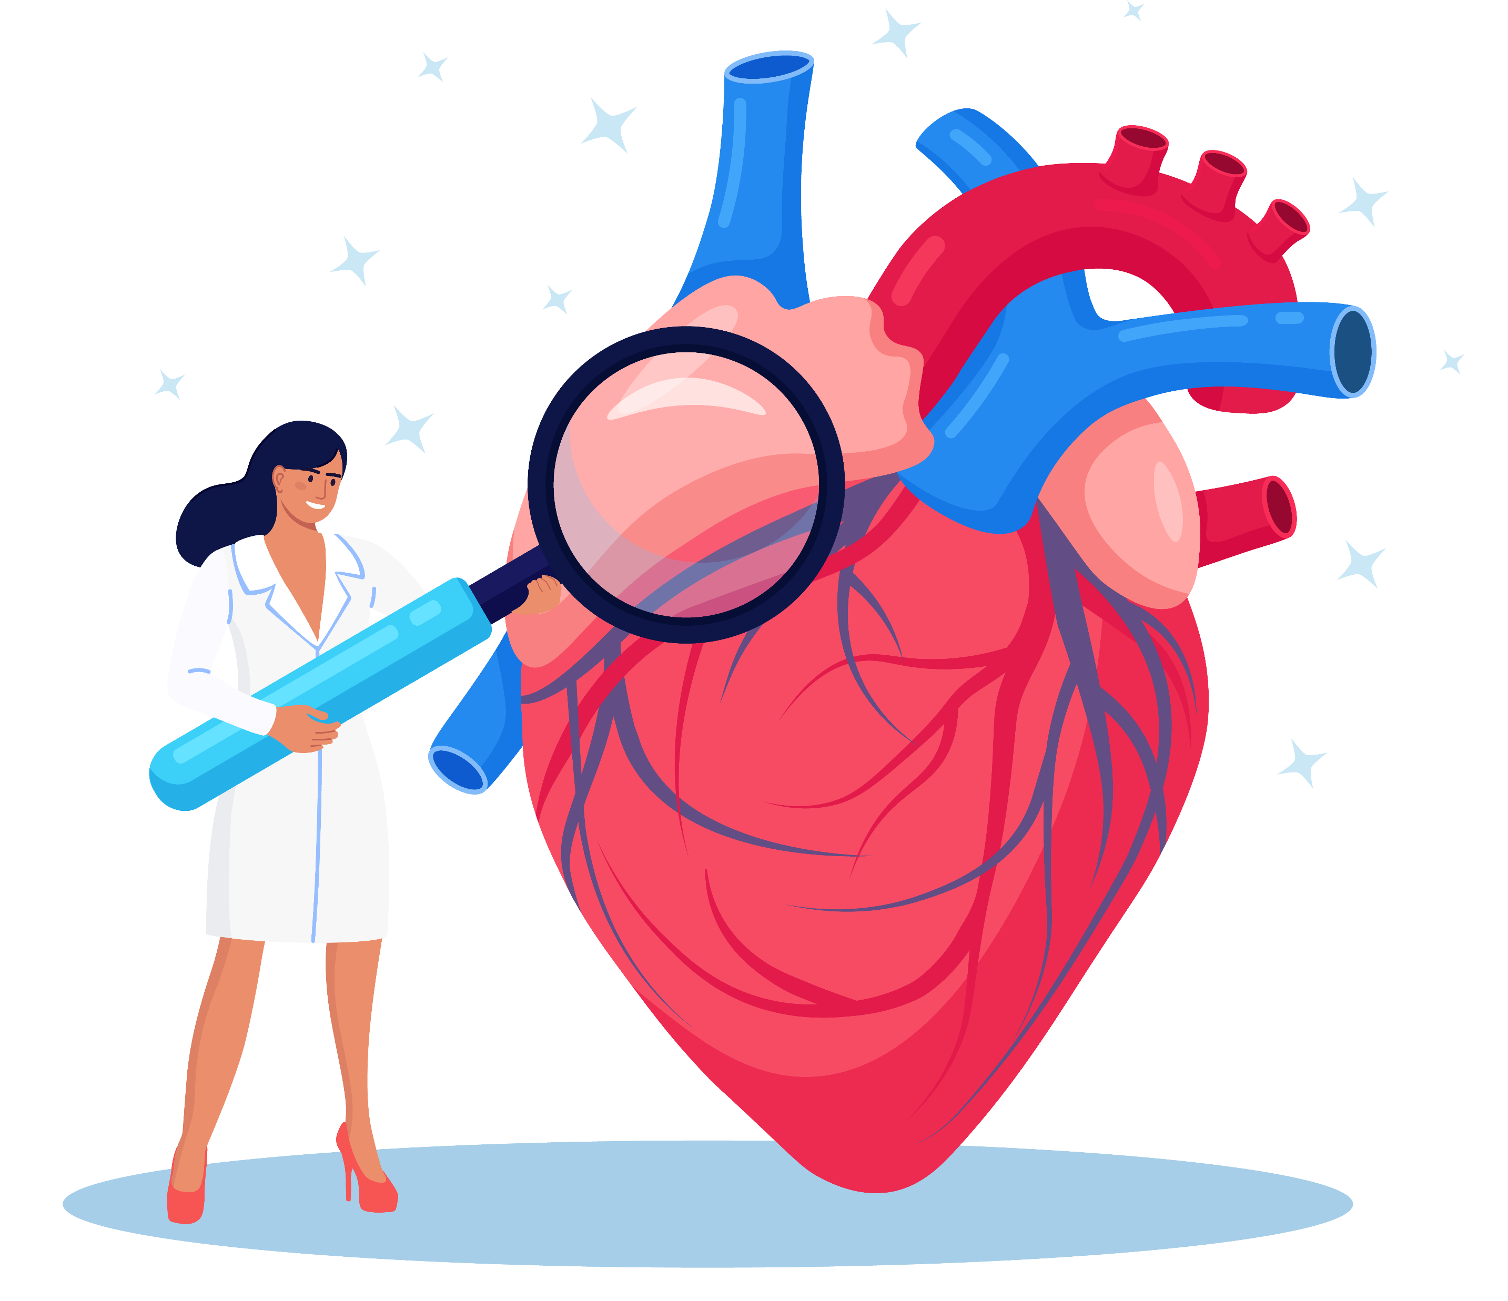
Wrap Up
Blood pressure = blood moving through vessels
Too much pressure = unhealthy for your heart
Healthy food + exercise = strong heart, strong future
Notes:
“Let’s review: Blood pressure is how blood moves through your vessels. Too much pressure is not healthy for your heart. The good news is—healthy foods and daily activity keep your heart strong for the future. You have the power to make heart-healthy choices every day!”

