Slide 1


Sleep Tight:
Powering Up with Rest
Sleep is your body’s superpower
Notes:
“Today we’re learning about cholesterol. Think of it as tiny workers in your body—some are helpful, but too many can cause problems.”

Slide 2
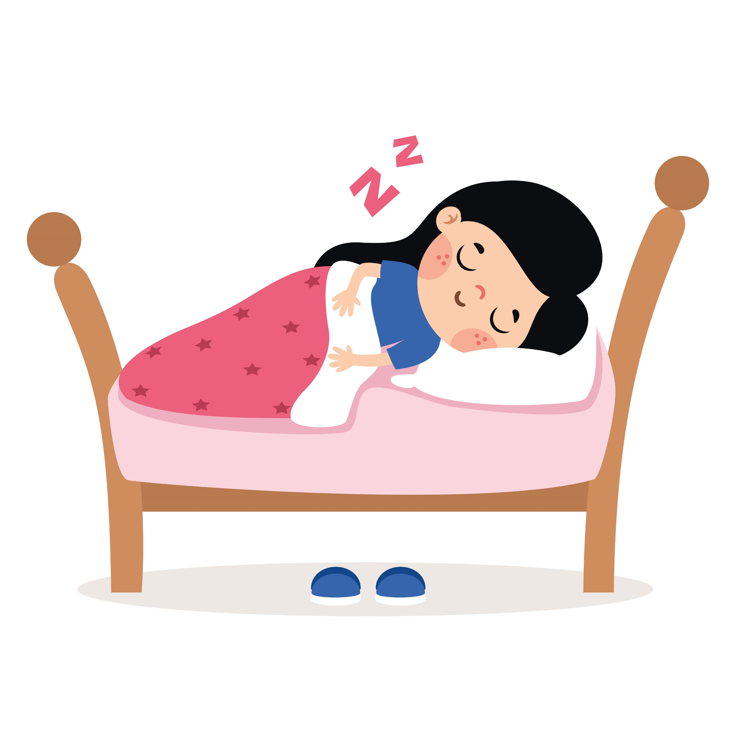
Why Sleep Matters
Restores energy
Helps you focus and learn better
Boosts mood and keeps you feeling good
Notes:
“Think of sleep like filling up your energy tank—it gets you ready for a new day.”

Slide 3
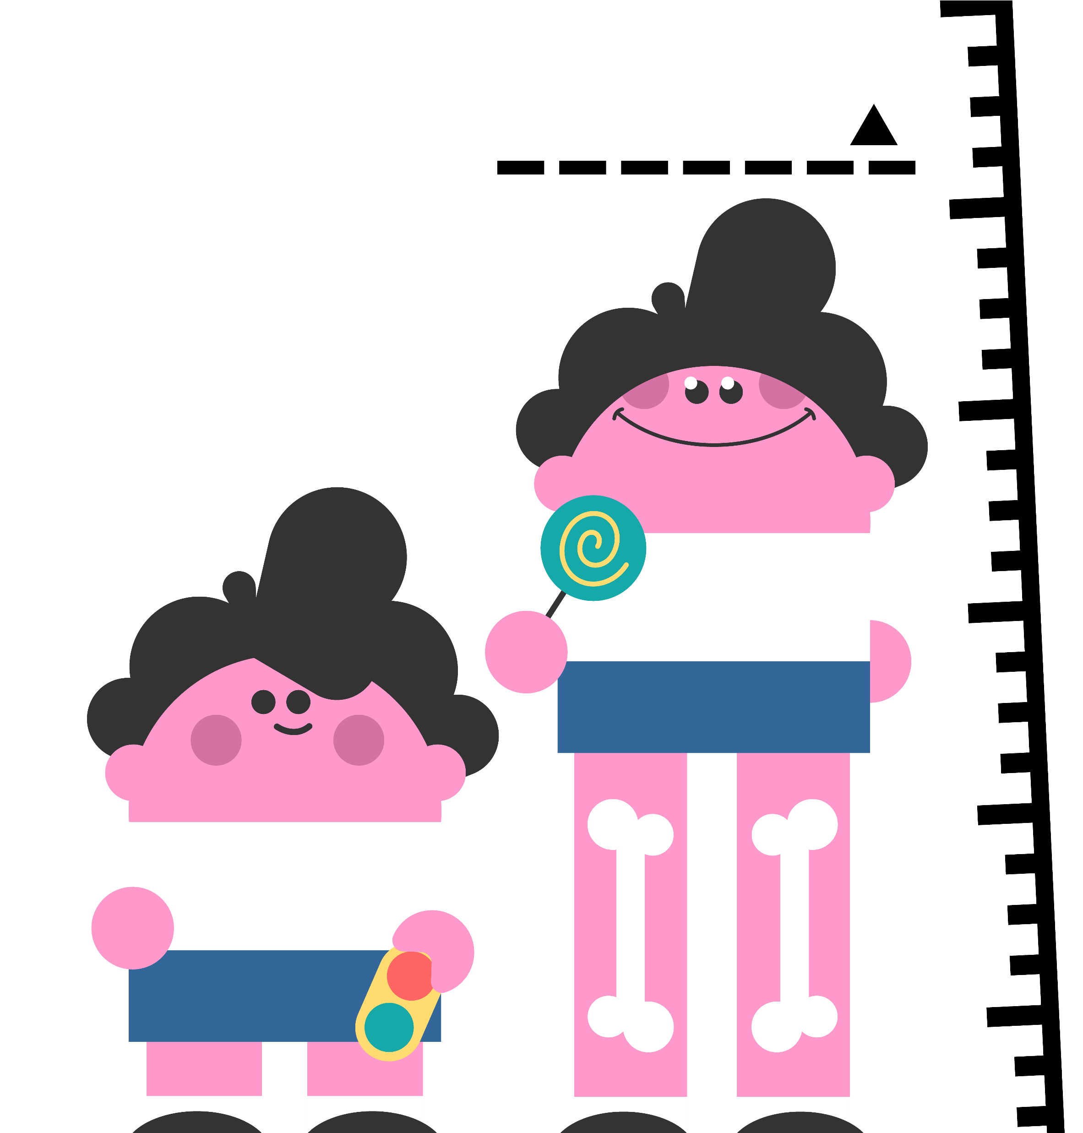
Growing Power
Muscles and bones grow stronger while you sleep
Sleep helps you stay healthy, just like water helps plants grow
Notes:
“Your body works hard at night to help you grow and stay strong.”

Slide 4
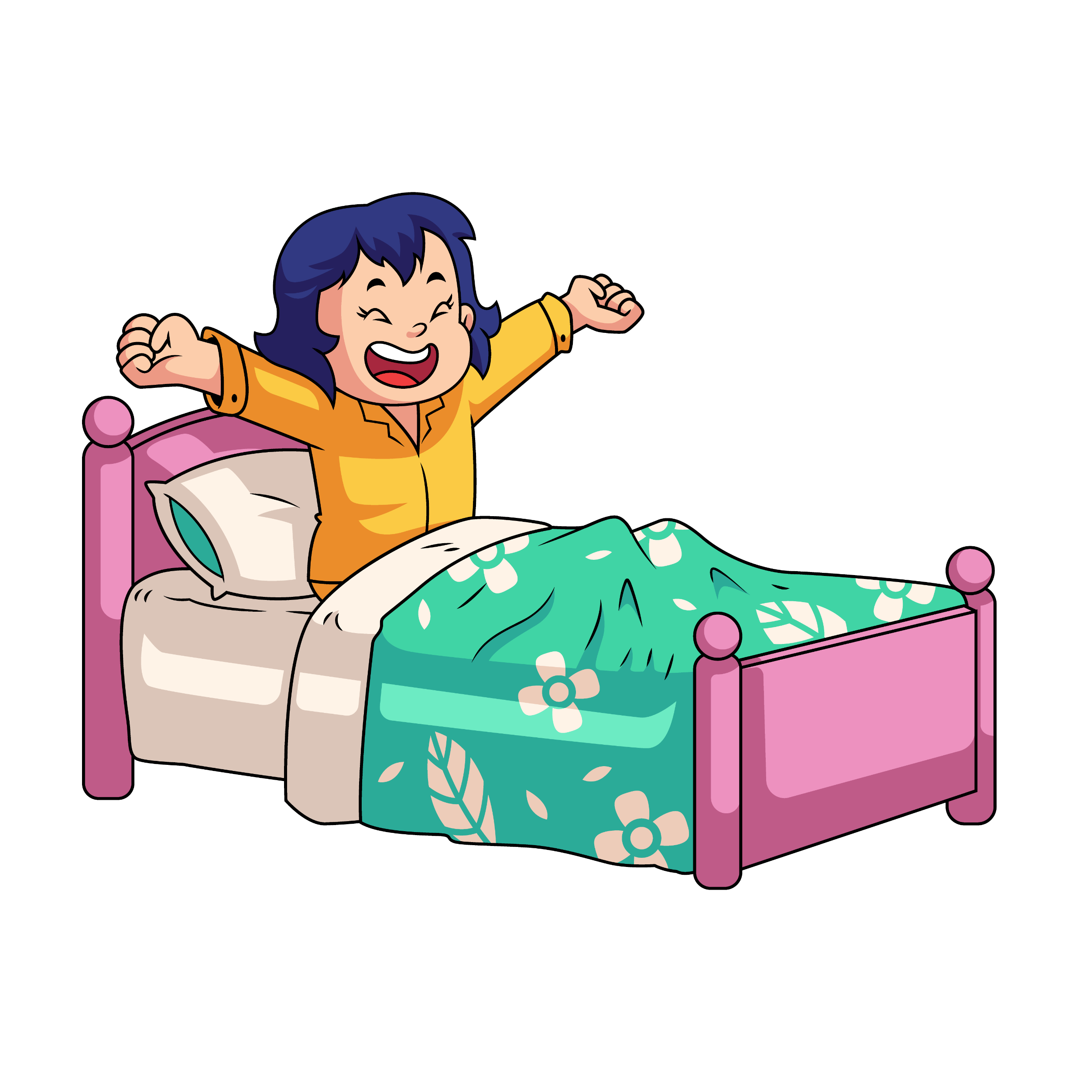
Quiz #1: What happens while you sleep?
Your body shuts down completely
Your muscles and bones grow stronger
Nothing important
Notes:
(Correct: b – Your body grows and recharges while you sleep!)

Slide 5
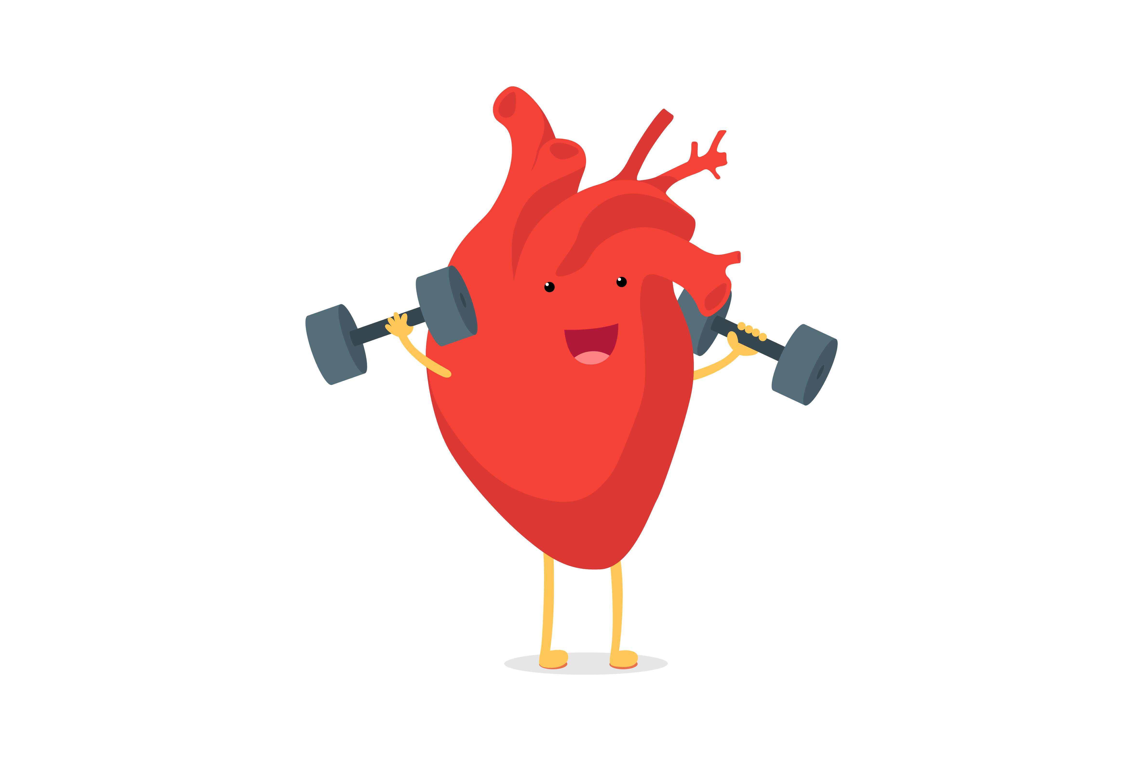
Sleep & Heart Health
Kids who don’t get enough sleep risk high blood pressure and obesity
Sleep keeps your heart healthy and strong
Notes:
“Too little sleep is like making your heart run a marathon every day—it gets tired!”

Slide 6
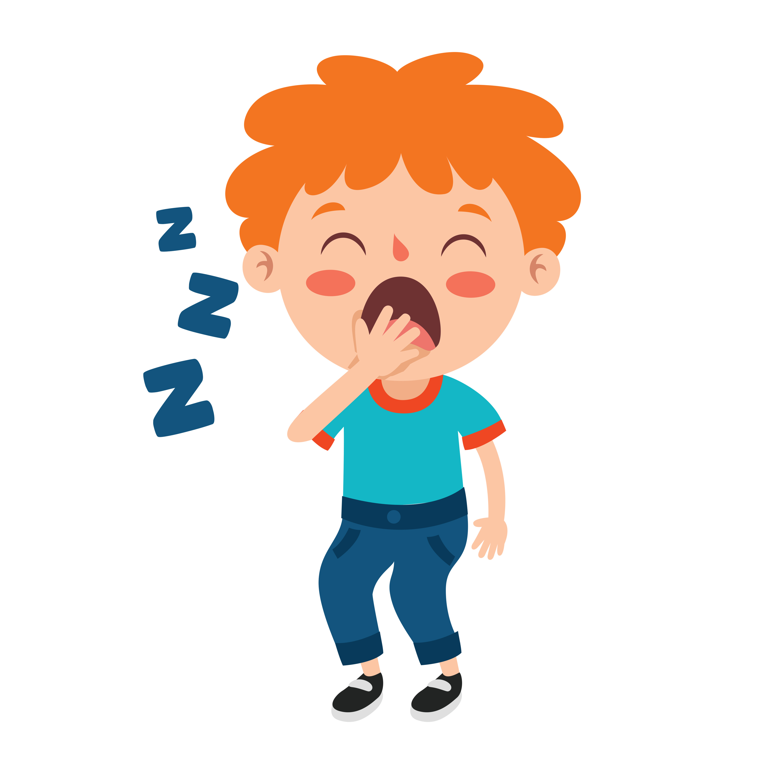
How Much Sleep Do You Need?
6–12 year-olds: 9–12 hours per night
13–18 year-olds: 8–10 hours per night
Notes:
“Middle and high schoolers need more sleep than most people think. 8–10 hours is the sweet spot.”

Slide 7
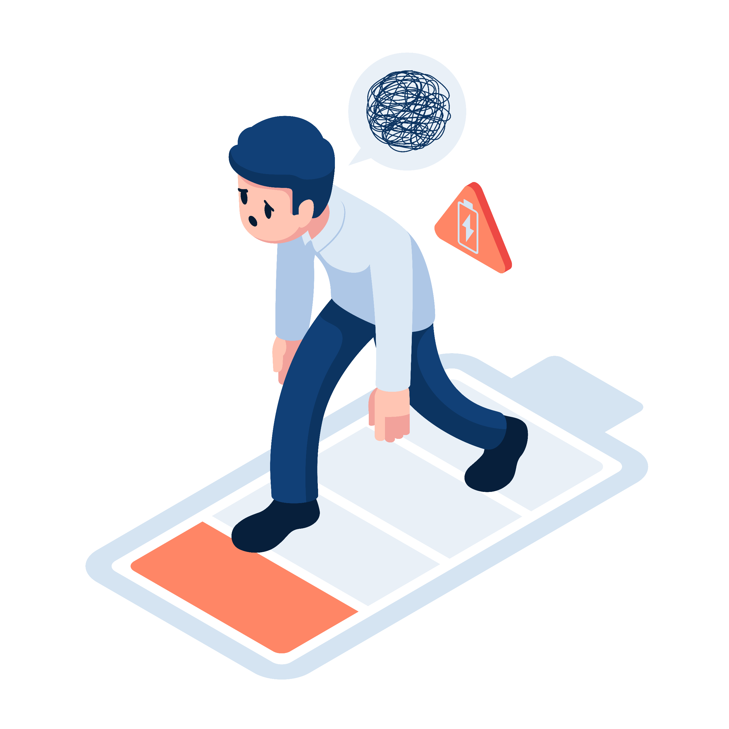
Quiz #2: Teens only need 5 hours of sleep per night.
True
False
Notes:
(Answer: False – Teens need 8–10 hours!)

Slide 8
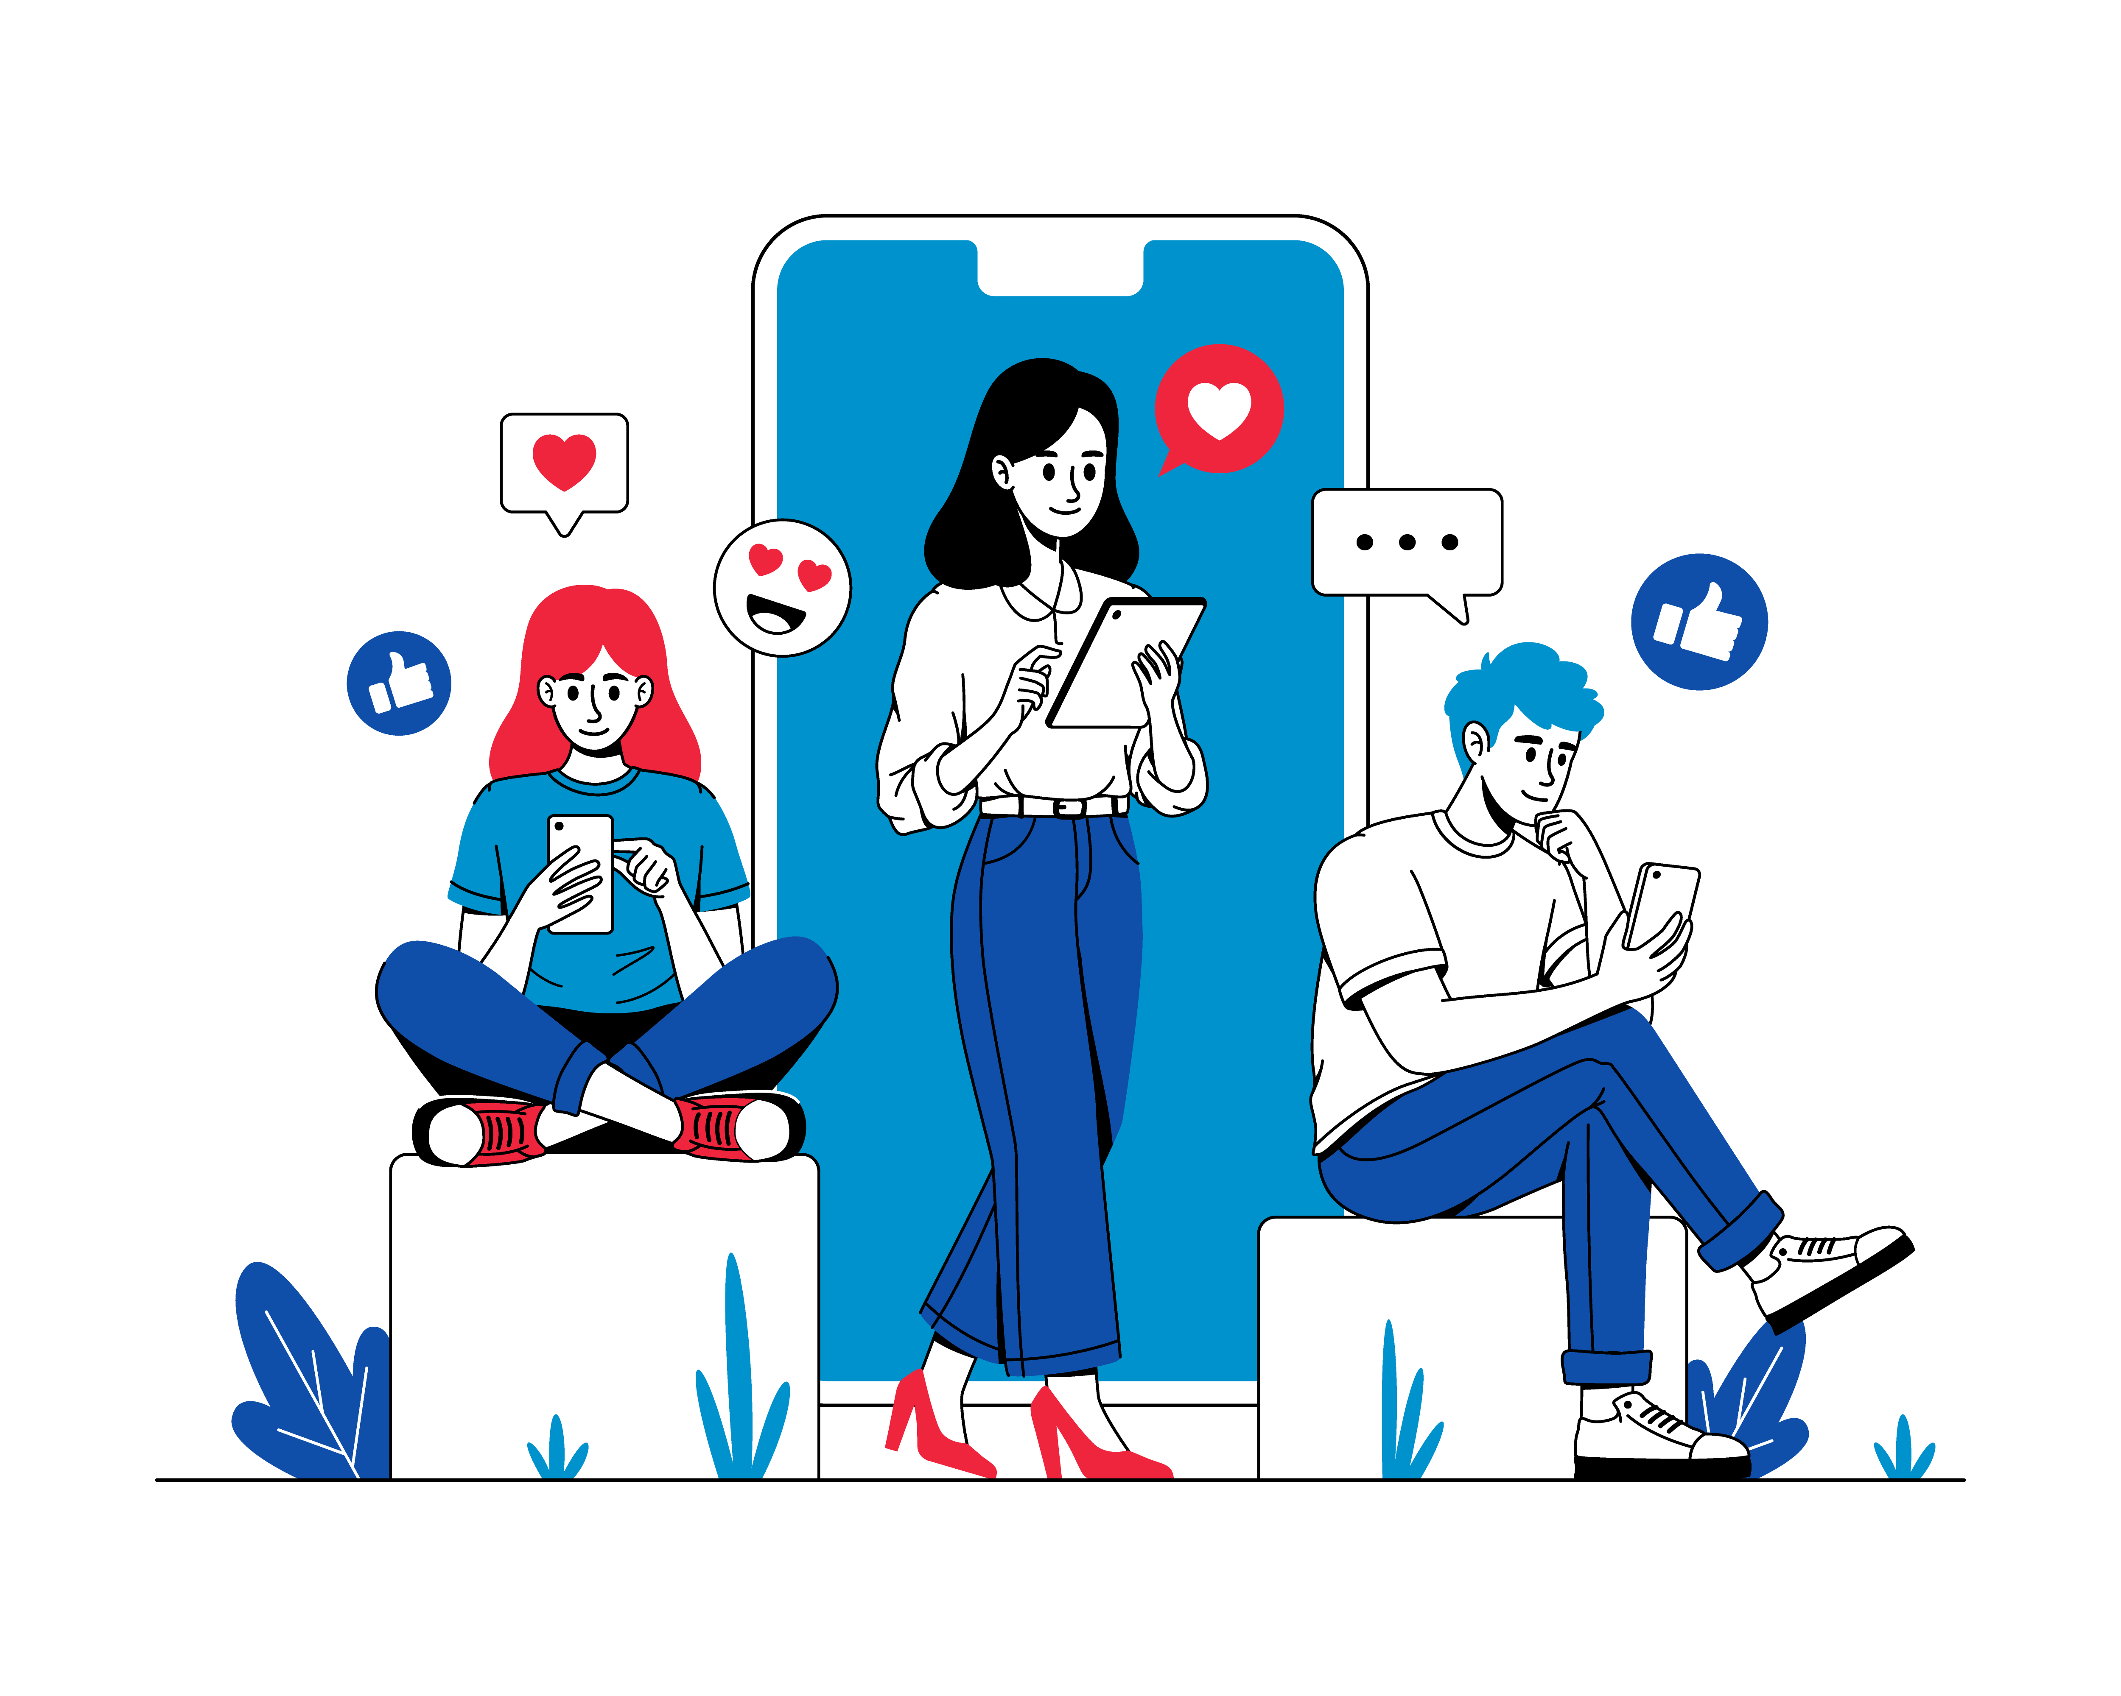
Barriers to Sleep
Phones, tablets, and TVs keep our brains awake
Bright screens confuse our body clocks
Notes:
“Scrolling before bed is like shining a flashlight in your eyes—it tricks your brain into staying awake.”

Slide 9
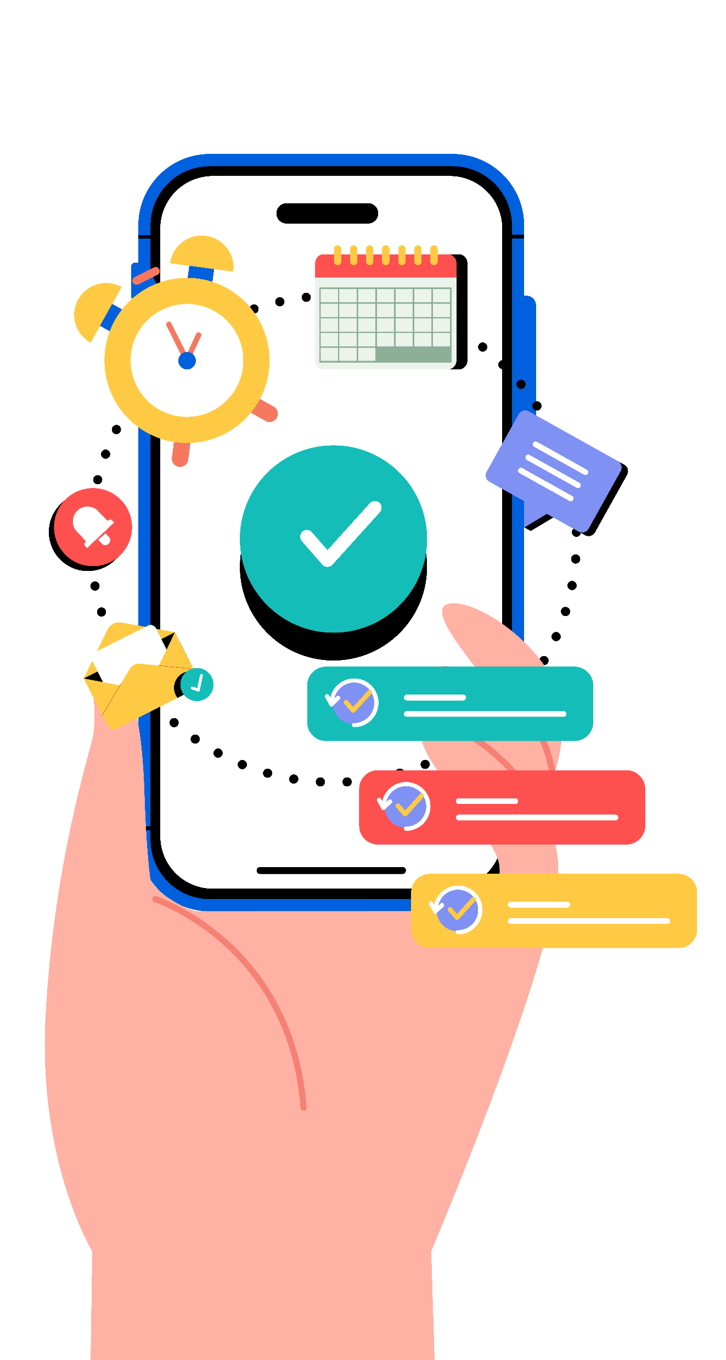
Quiz #3: What should you do with your phone before bed?
Keep it next to you on full brightness
Put it on “Do Not Disturb” or outside your room
Scroll until you fall asleep
Notes:
*(Correct: b – Phones should rest too!) *

Slide 10
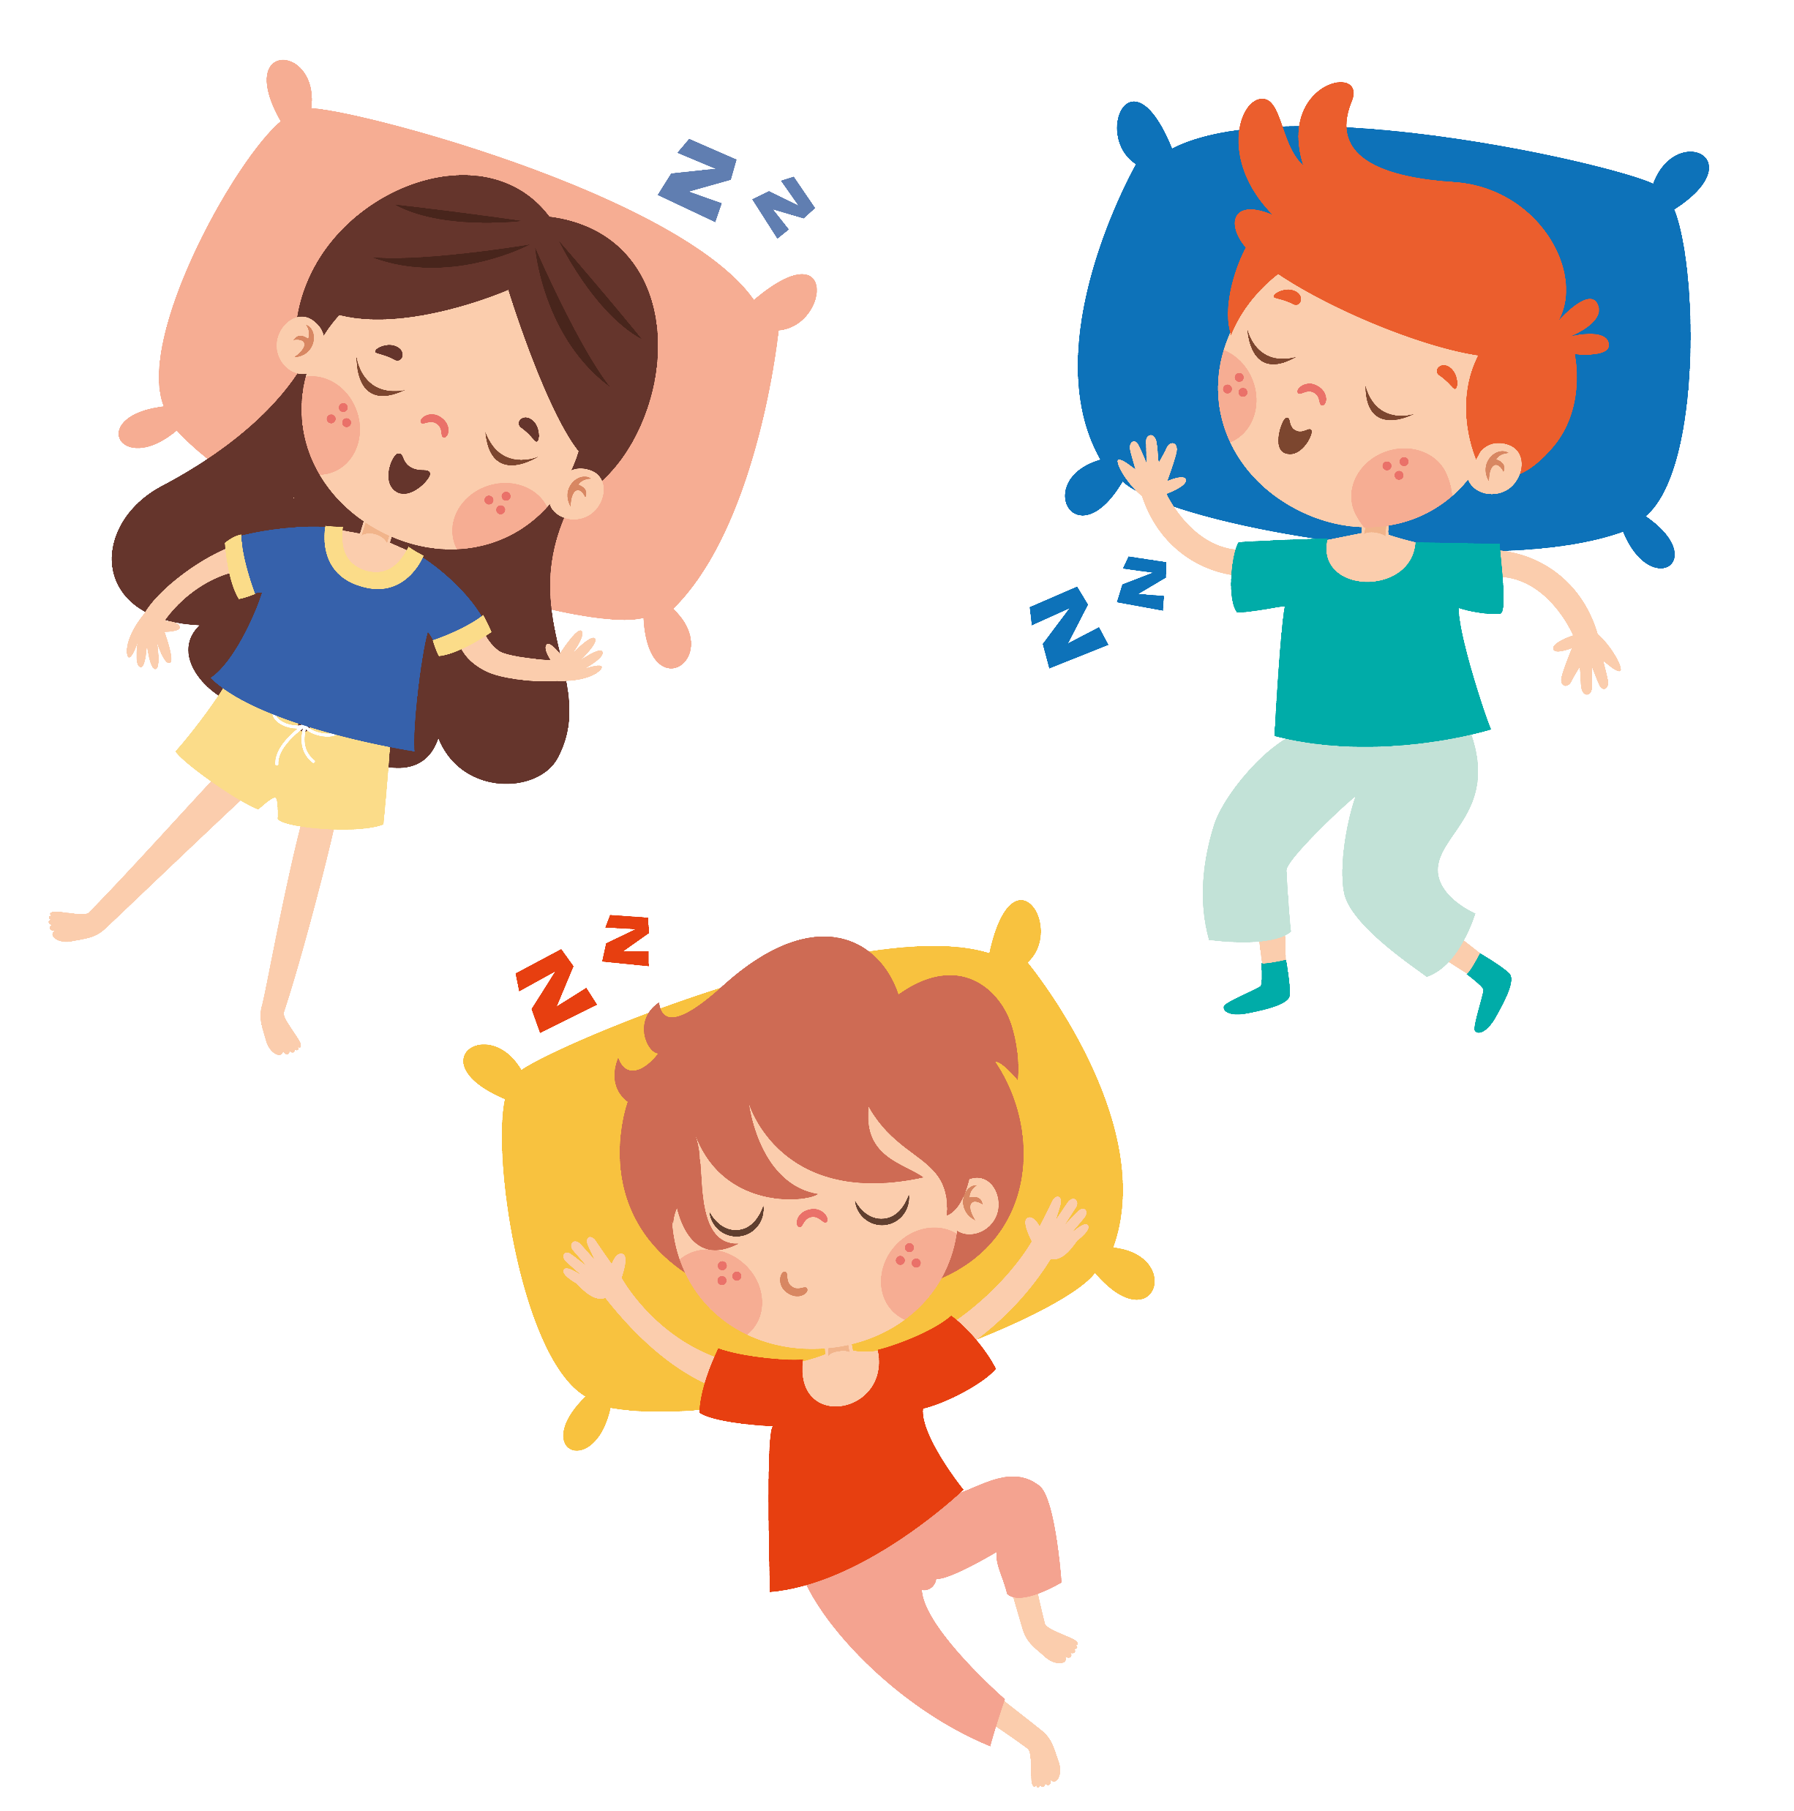
Healthy Sleep Habits
Set a bedtime alarm to remind you to unplug
Dim your screens if you must use them
Create a quiet, dark room for sleep
Notes:
“Good sleep habits are called ‘sleep hygiene.’ Think of it as giving your body a bedtime routine.”

Slide 11
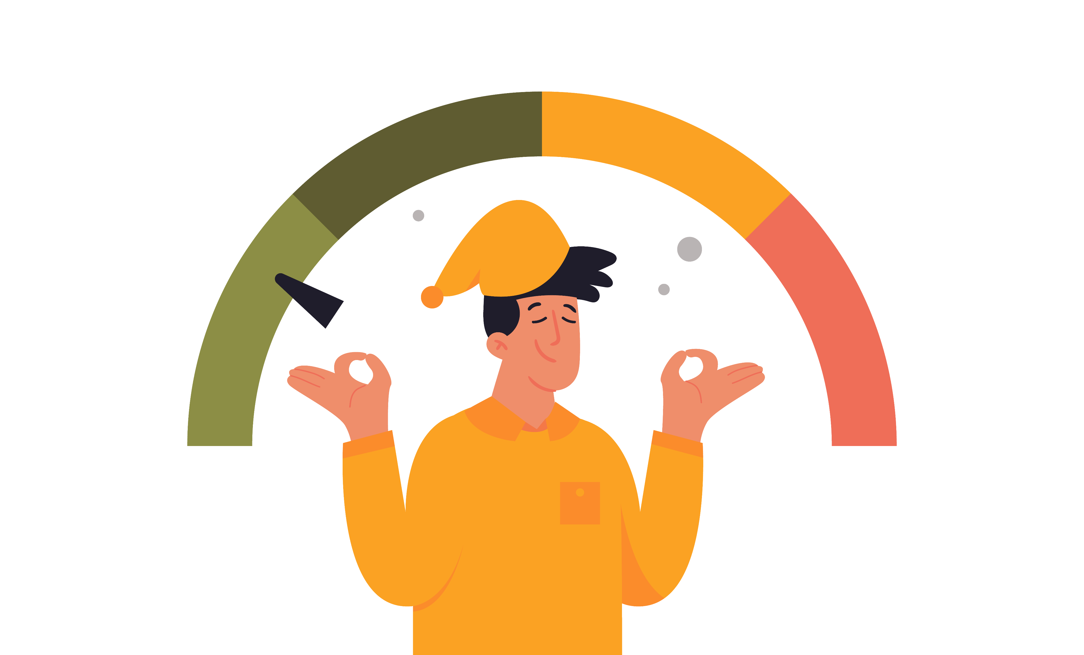
Quiz #4: Fill in the blank: Sleep is like ______ for your body.
Fuel
A video game
A phone charger
Notes:
(Correct: c – Sleep is like charging your phone, but for your body and brain!)

Slide 12
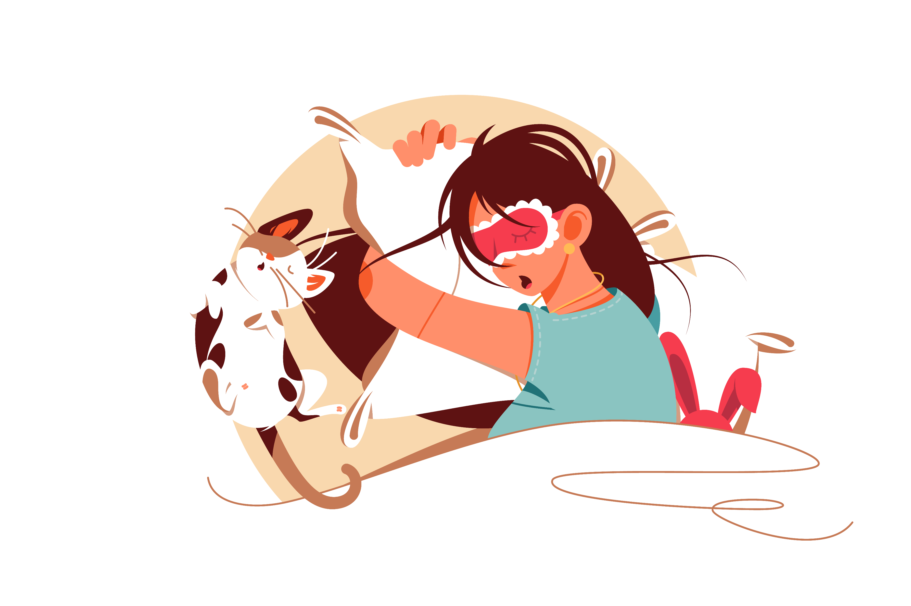
Wrap Up
Sleep = energy, growth, and health
Aim for 8–10 hours every night
Power up your body with good sleep!
Notes:
“Your body needs rest just like your phone needs a charge. The more consistent your sleep, the stronger and healthier you’ll be.”

