Slide 1


Super Fuel:
How Food Powers Your Body
Presented by the American Heart Association & NFL PLAY 60
Notes:
“Hi everyone! Today we’re going to talk about food—not just any food, but how the food you eat is like super fuel for your body. Just like a car needs the right kind of gas to run, your body needs the right kind of food to play, learn, and grow.”

Slide 2
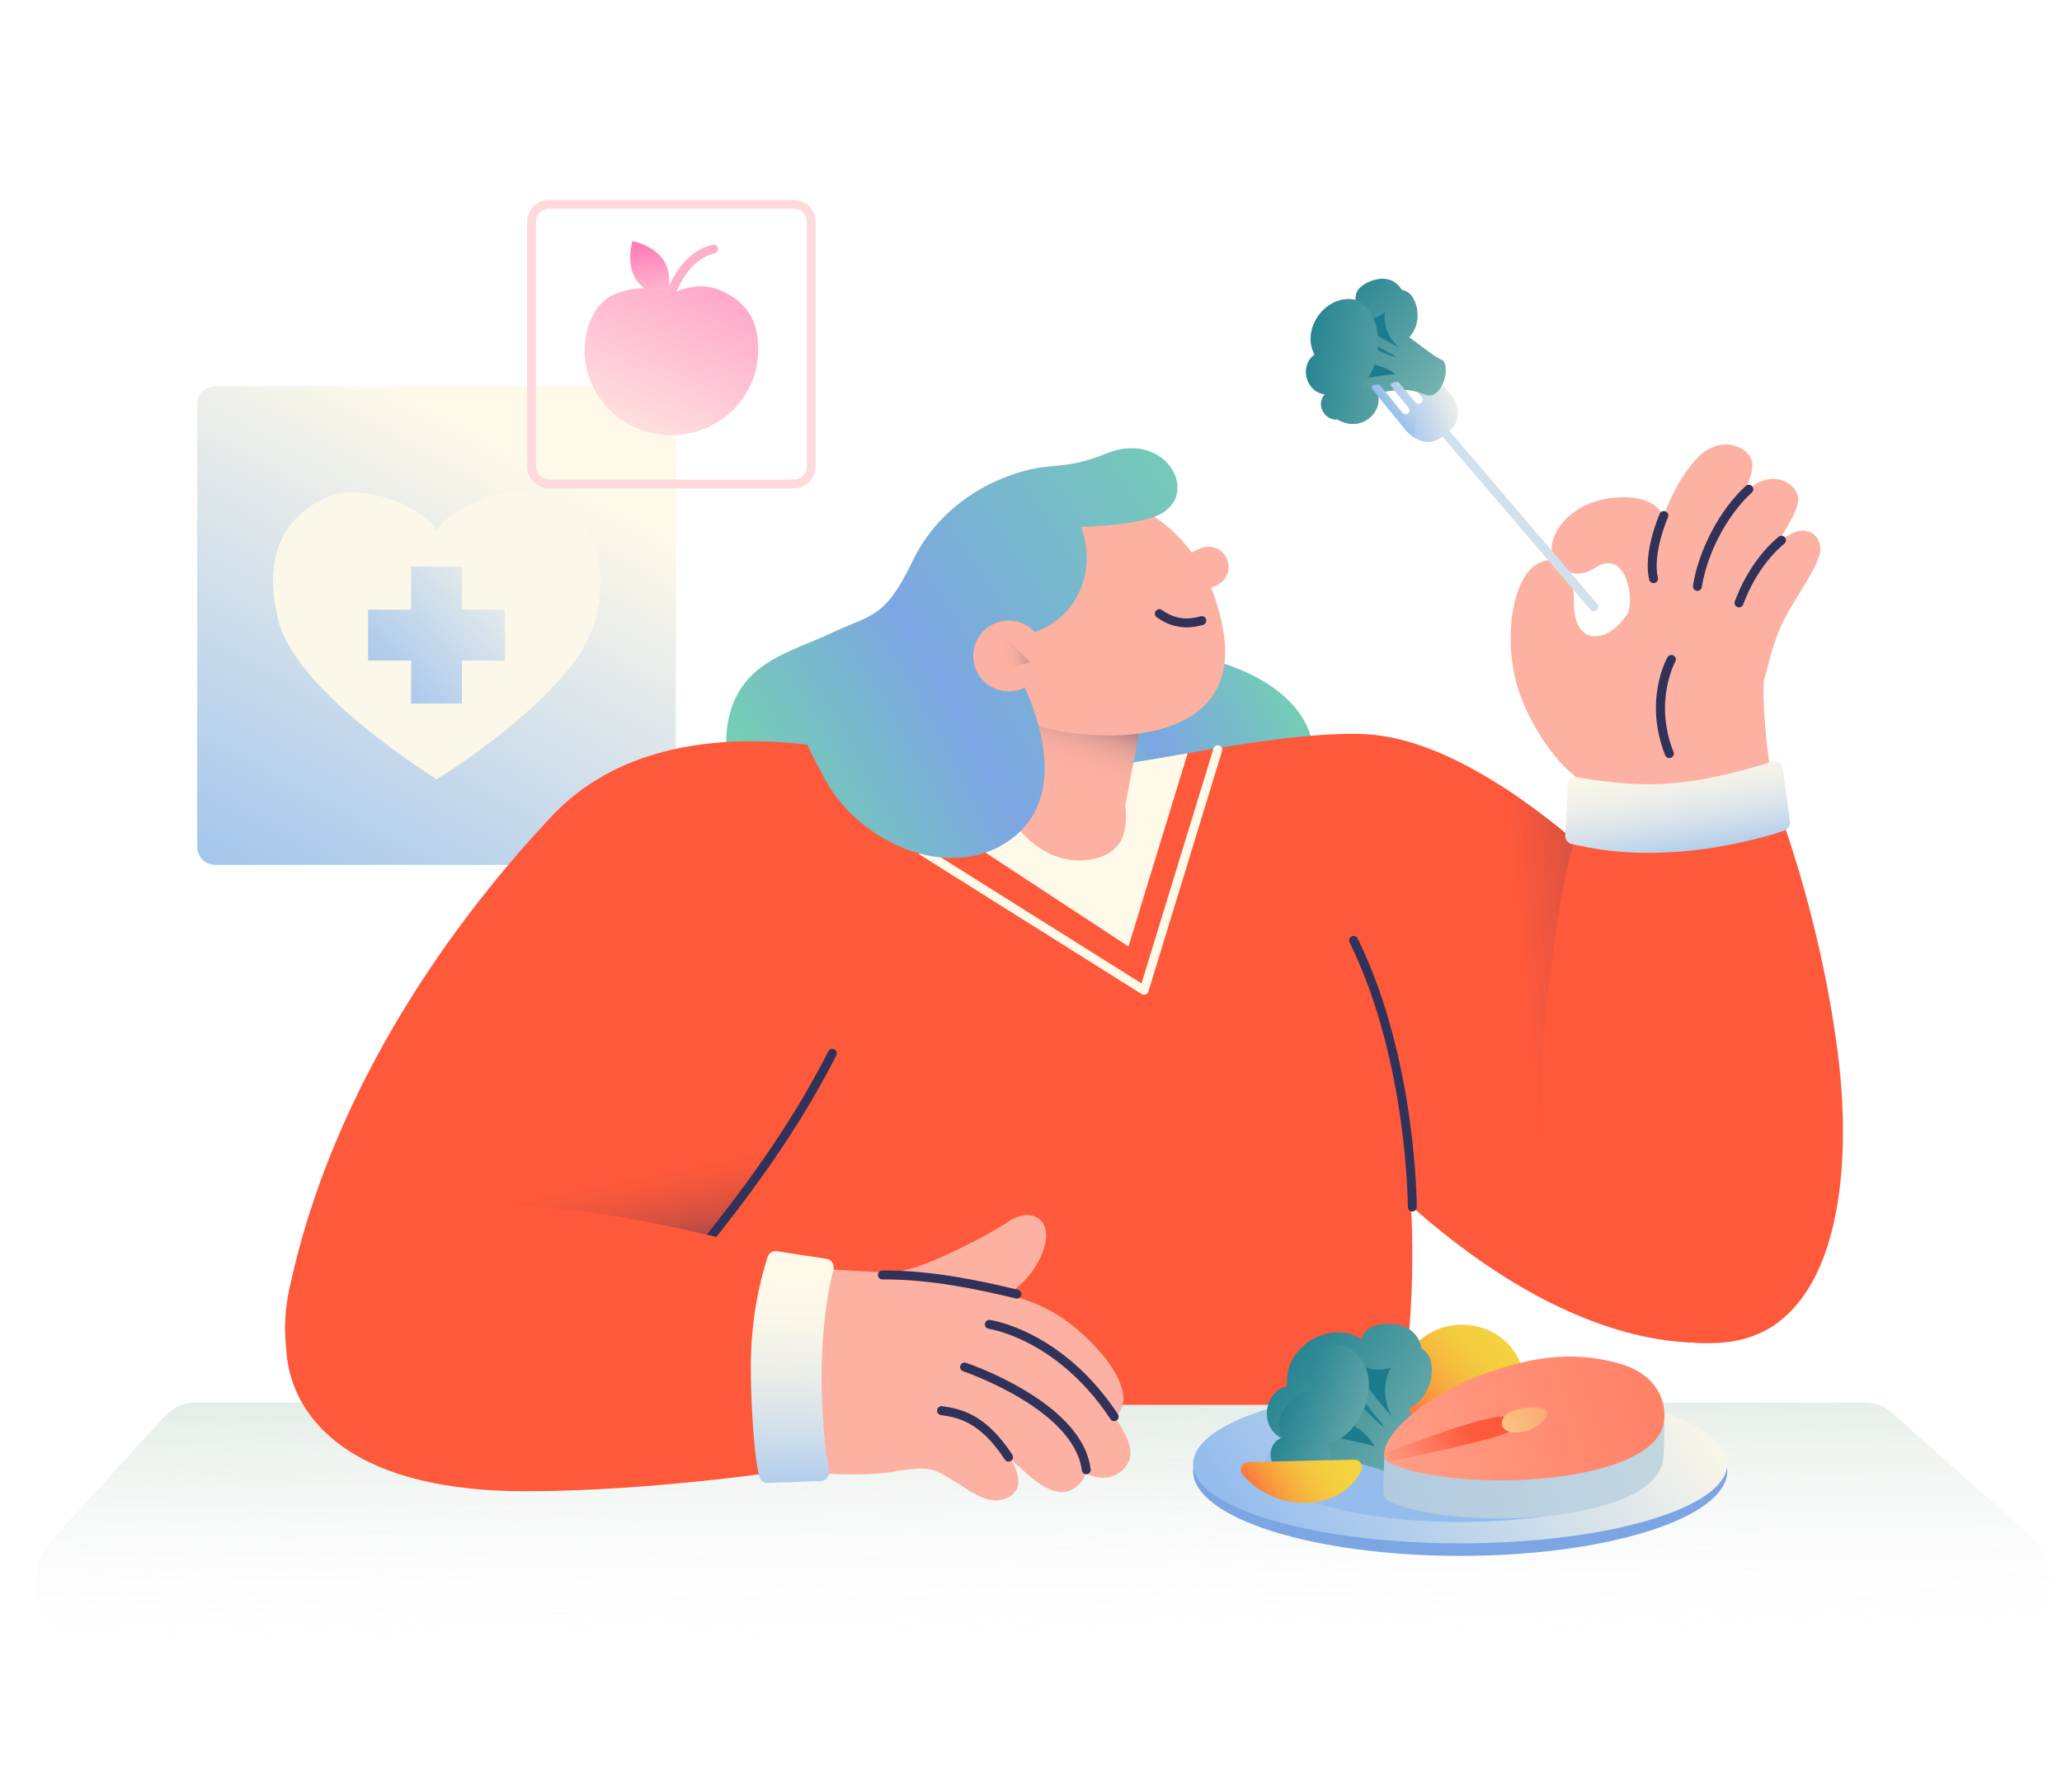
Why Food Matters
Food gives us energy for school, sports, and play.
Eating healthy helps us feel good and be our best selves.
Balance is key: It’s okay to enjoy a treat sometimes.
Notes:
“Food gives us the energy to do everything—school, sports, and fun with friends. Eating healthy also helps us feel our best. But remember—balance is the key! You can enjoy a treat sometimes, but the most important thing is making healthy choices most of the time.”

Slide 3
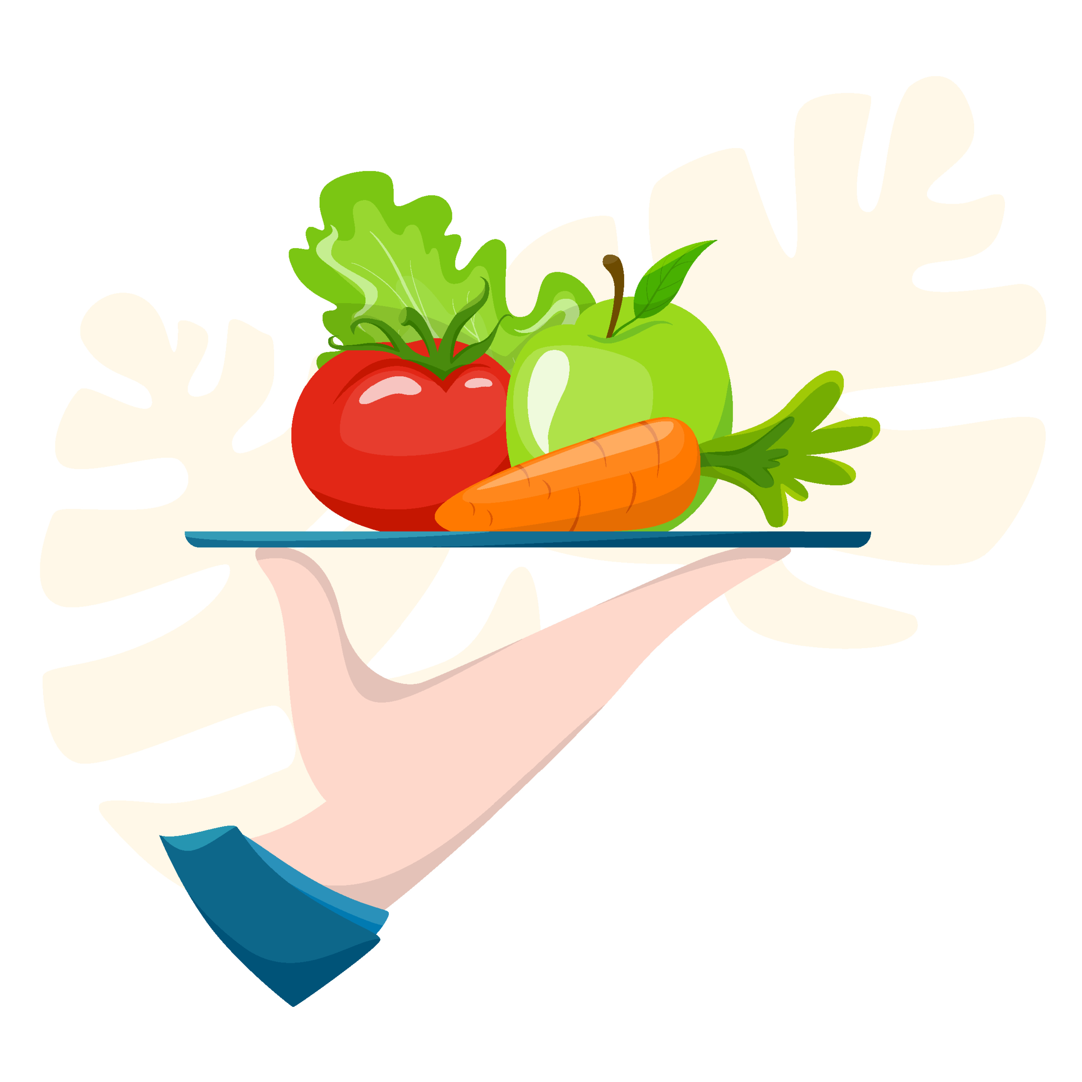
Build a Healthy Plate
Enjoy: fruits, vegetables, whole grains, beans, lean proteins, fish.
Limit: soda, chips, fried foods, sweets.
Avoid: trans fats, like those in fried snacks and packaged baked goods.
Notes:
“Think of your plate as a rainbow—more colors usually means healthier foods.”

Slide 4
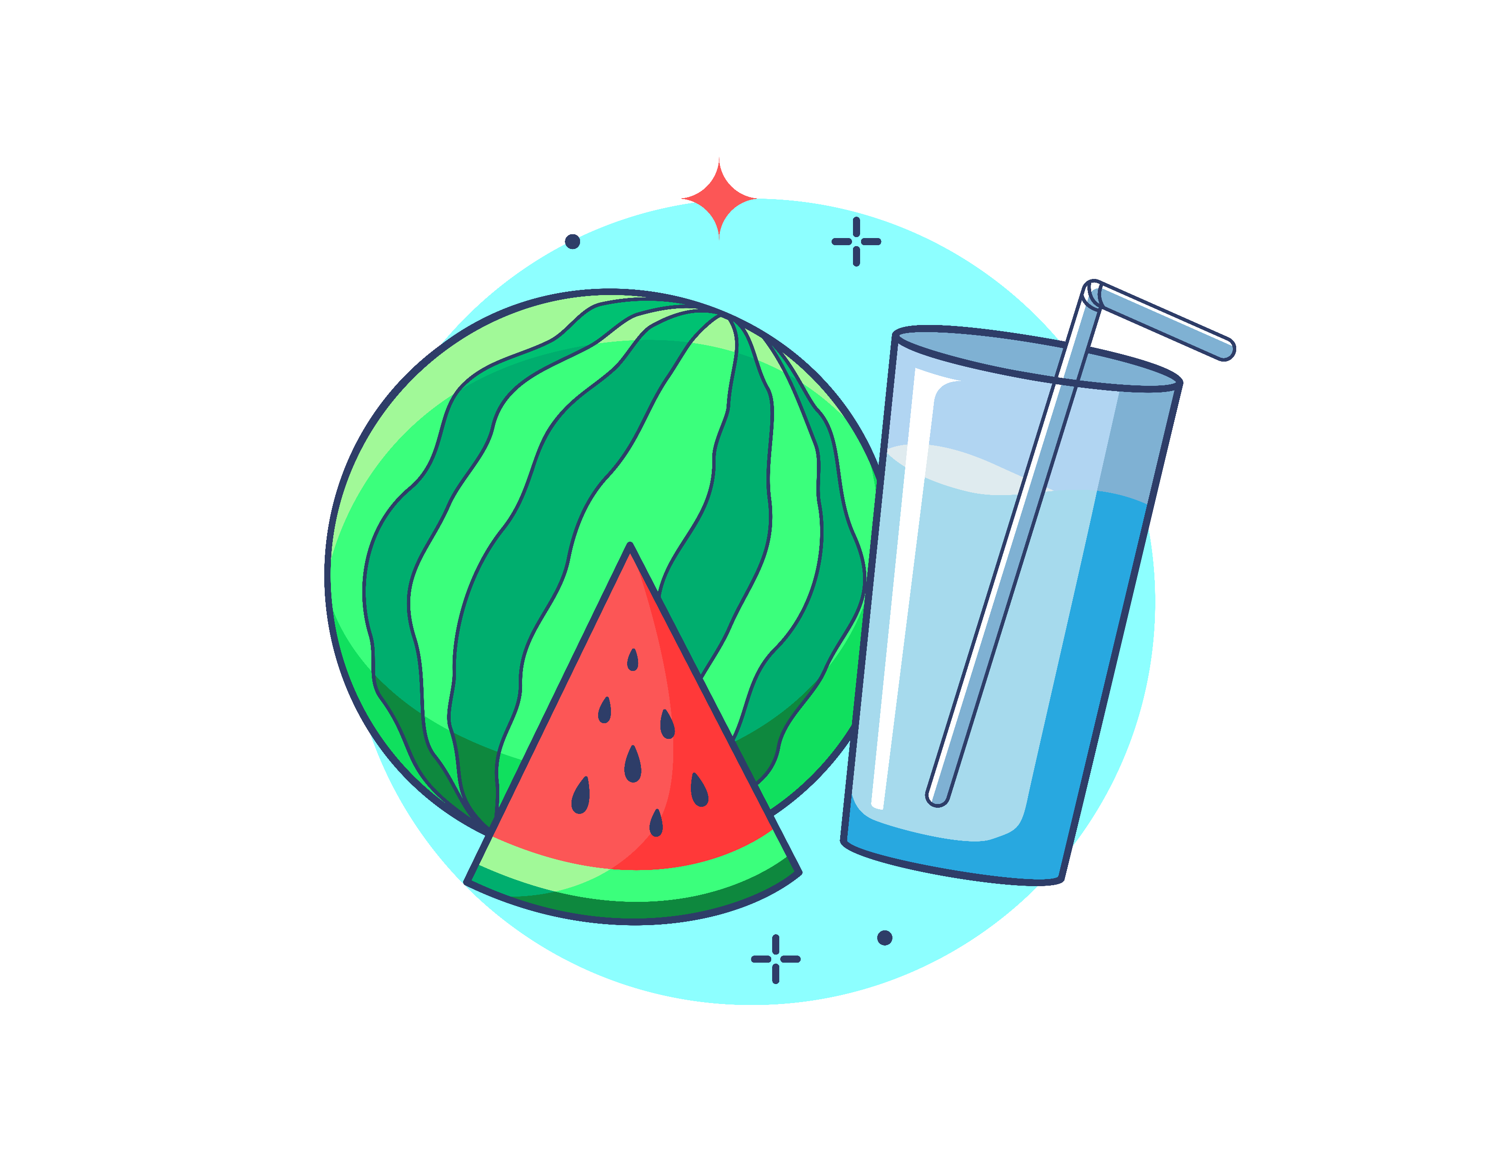
Quiz #1: Which is the best snack choice?
Chips & soda
Fruit & water
Candy & juice
Notes:
Quiz #1: “Which is the best snack choice?
a) Chips & soda
b) Fruit & water
c) Candy & energy drink
[Pause for answers.]
(Correct Answer: b – Fruit & water give energy without too much sugar or salt.)

Slide 5
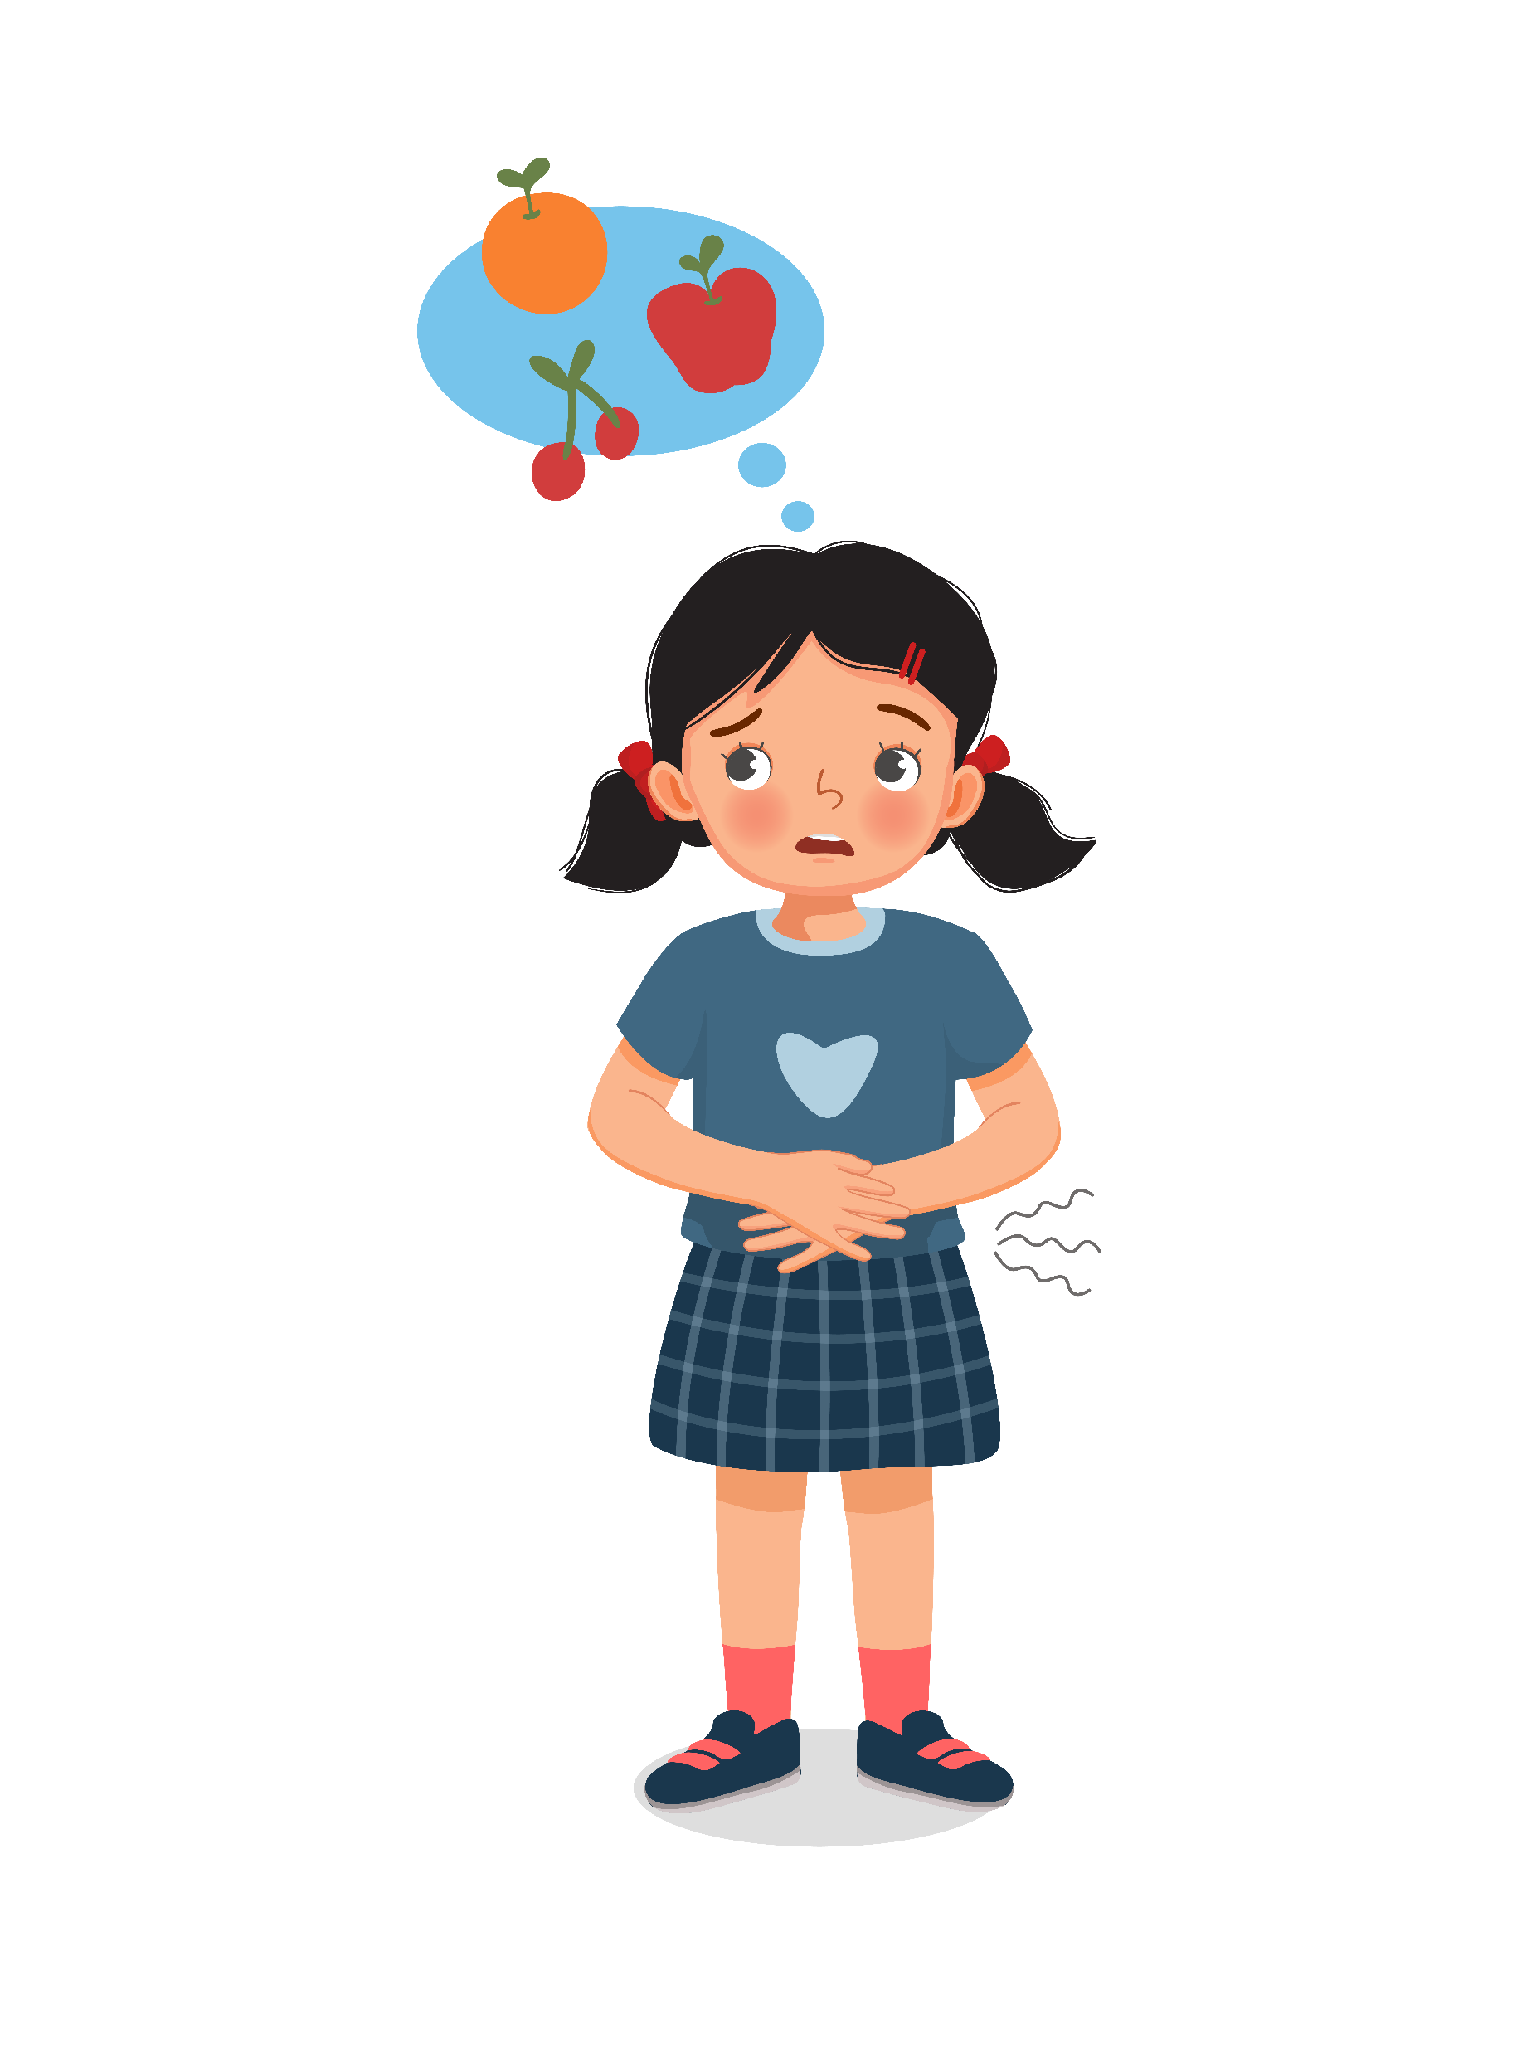
Listening to Your Body
Eat when you’re hungry, stop when you’re full.
Notice if you’re eating because of boredom or stress.
Notes:
“Our bodies are smart! They tell us when we’re hungry and when we’re full. The key is listening. Eat when you’re hungry, stop when you feel satisfied—not stuffed. Sometimes people eat because they’re bored, sad, or stressed, but that’s not what our bodies really need

Slide 6
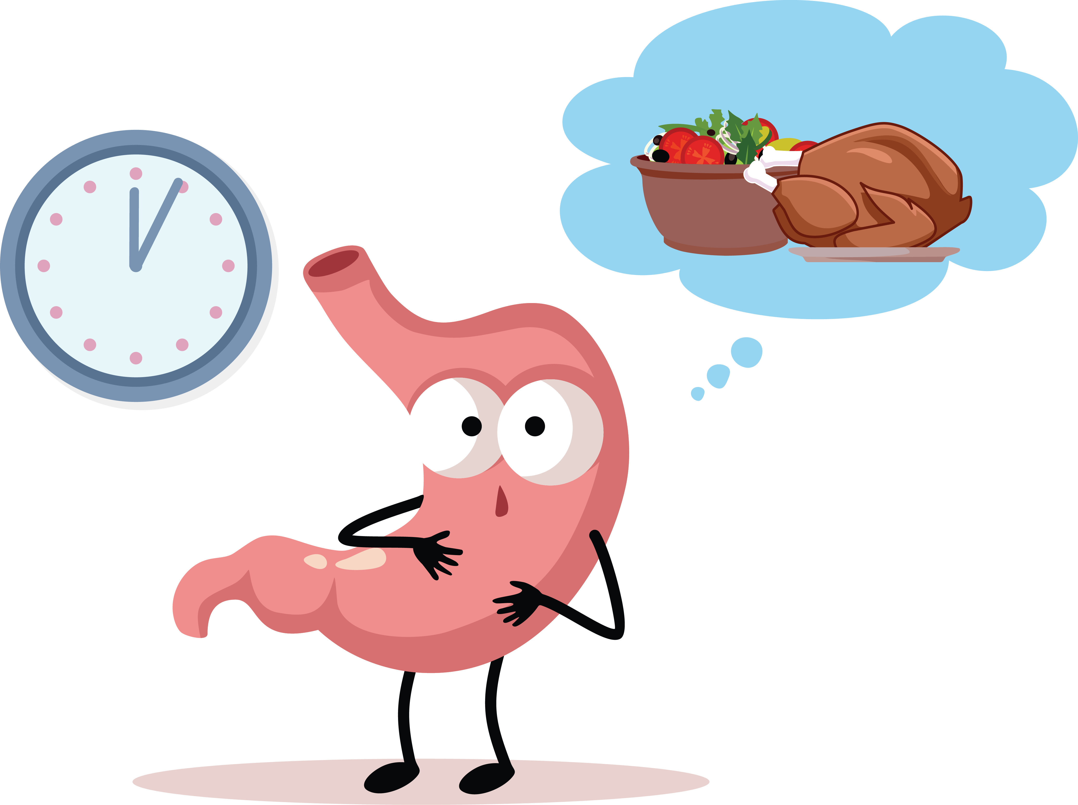
Quiz #2: It’s healthy to eat until you feel stuffed.
True
False
Notes:
“True or False: It’s healthy to eat until you feel stuffed.
[Pause for answers.]
The answer is False! Eating until you’re stuffed can make your body uncomfortable and tired.”

Slide 7
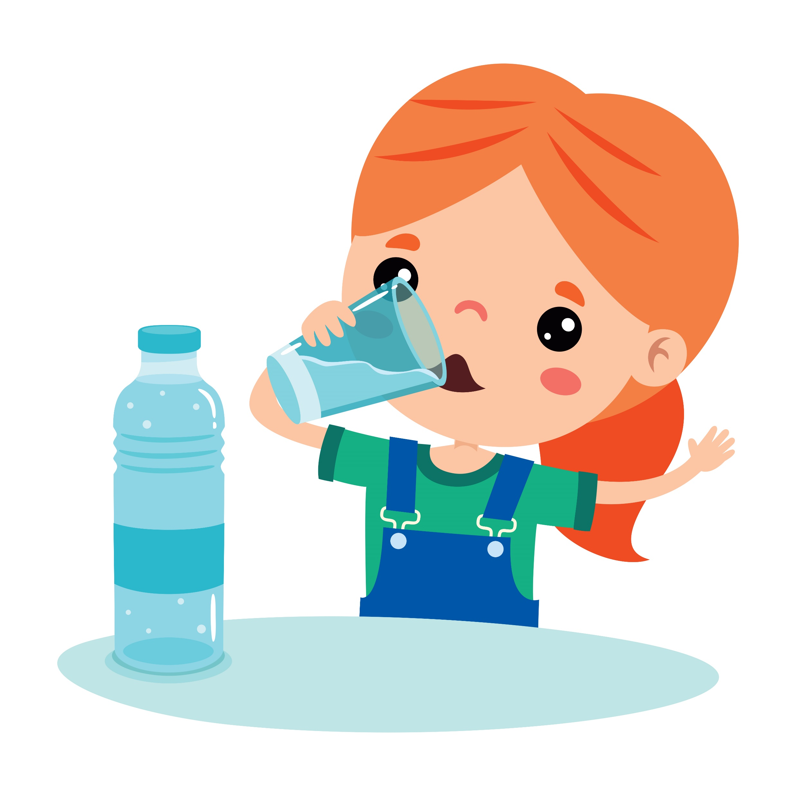
Drinks Matter Too
Sugary drinks like soda, sweet tea, and flavored milk add extra sugar.
Best choices: water and low-fat milk.
Notes:
“Your body needs water like a plant needs rain. Sugary drinks don’t help—it’s like giving a plant soda instead of water.”

Slide 8

Quiz #3:
Which drink is the healthiest?
Sports drink
Soda
Water
Notes:
“Which drink is the healthiest?
a) Soda
b) Juice
c) Water
[Pause for answers.]
The answer is c—water!”

Slide 9
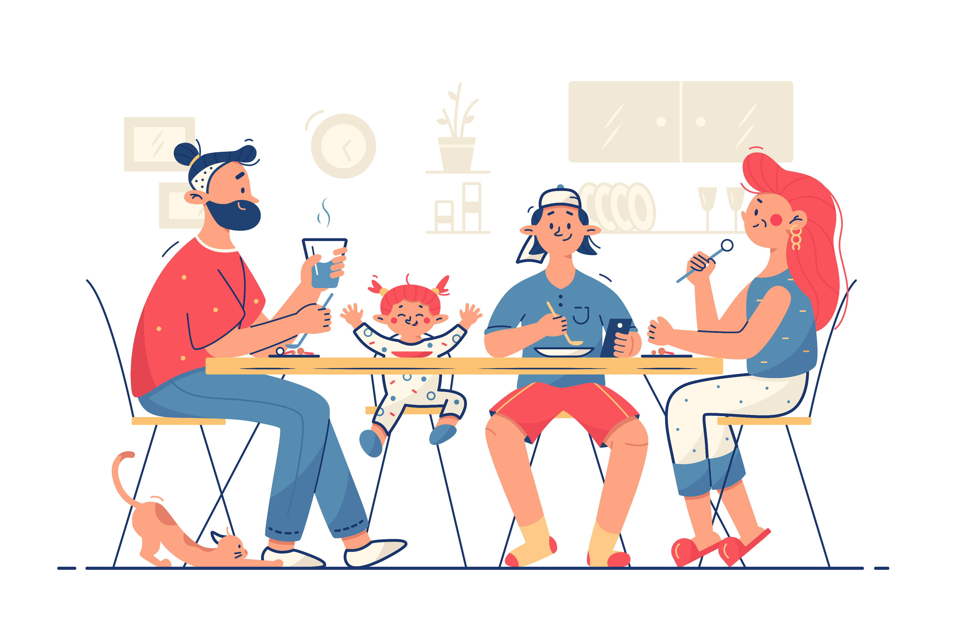
Family & Fun
Make meals together.
Try new recipes (recipes.heart.org).
Eating together makes meals more fun and healthy.
Notes:
“Healthy eating is more fun when you do it together. Make meals with your family, try new recipes, or look up fun ideas at recipes.heart.org. Eating together also helps everyone slow down, talk, and enjoy meals more.”

Slide 10




Tips for Everyday
Choices
Swap candy for fruit.
Choose baked over fried.
Add one new veggie to dinner this week.
Notes:
“Healthy choices don’t have to be complicated. Small steps add up! Here are some easy swaps:
Choose fruit instead of candy.
Pick baked foods instead of fried.
Add one new veggie to dinner this week.
These little changes make a big difference for your heart and your body.”

Slide 11
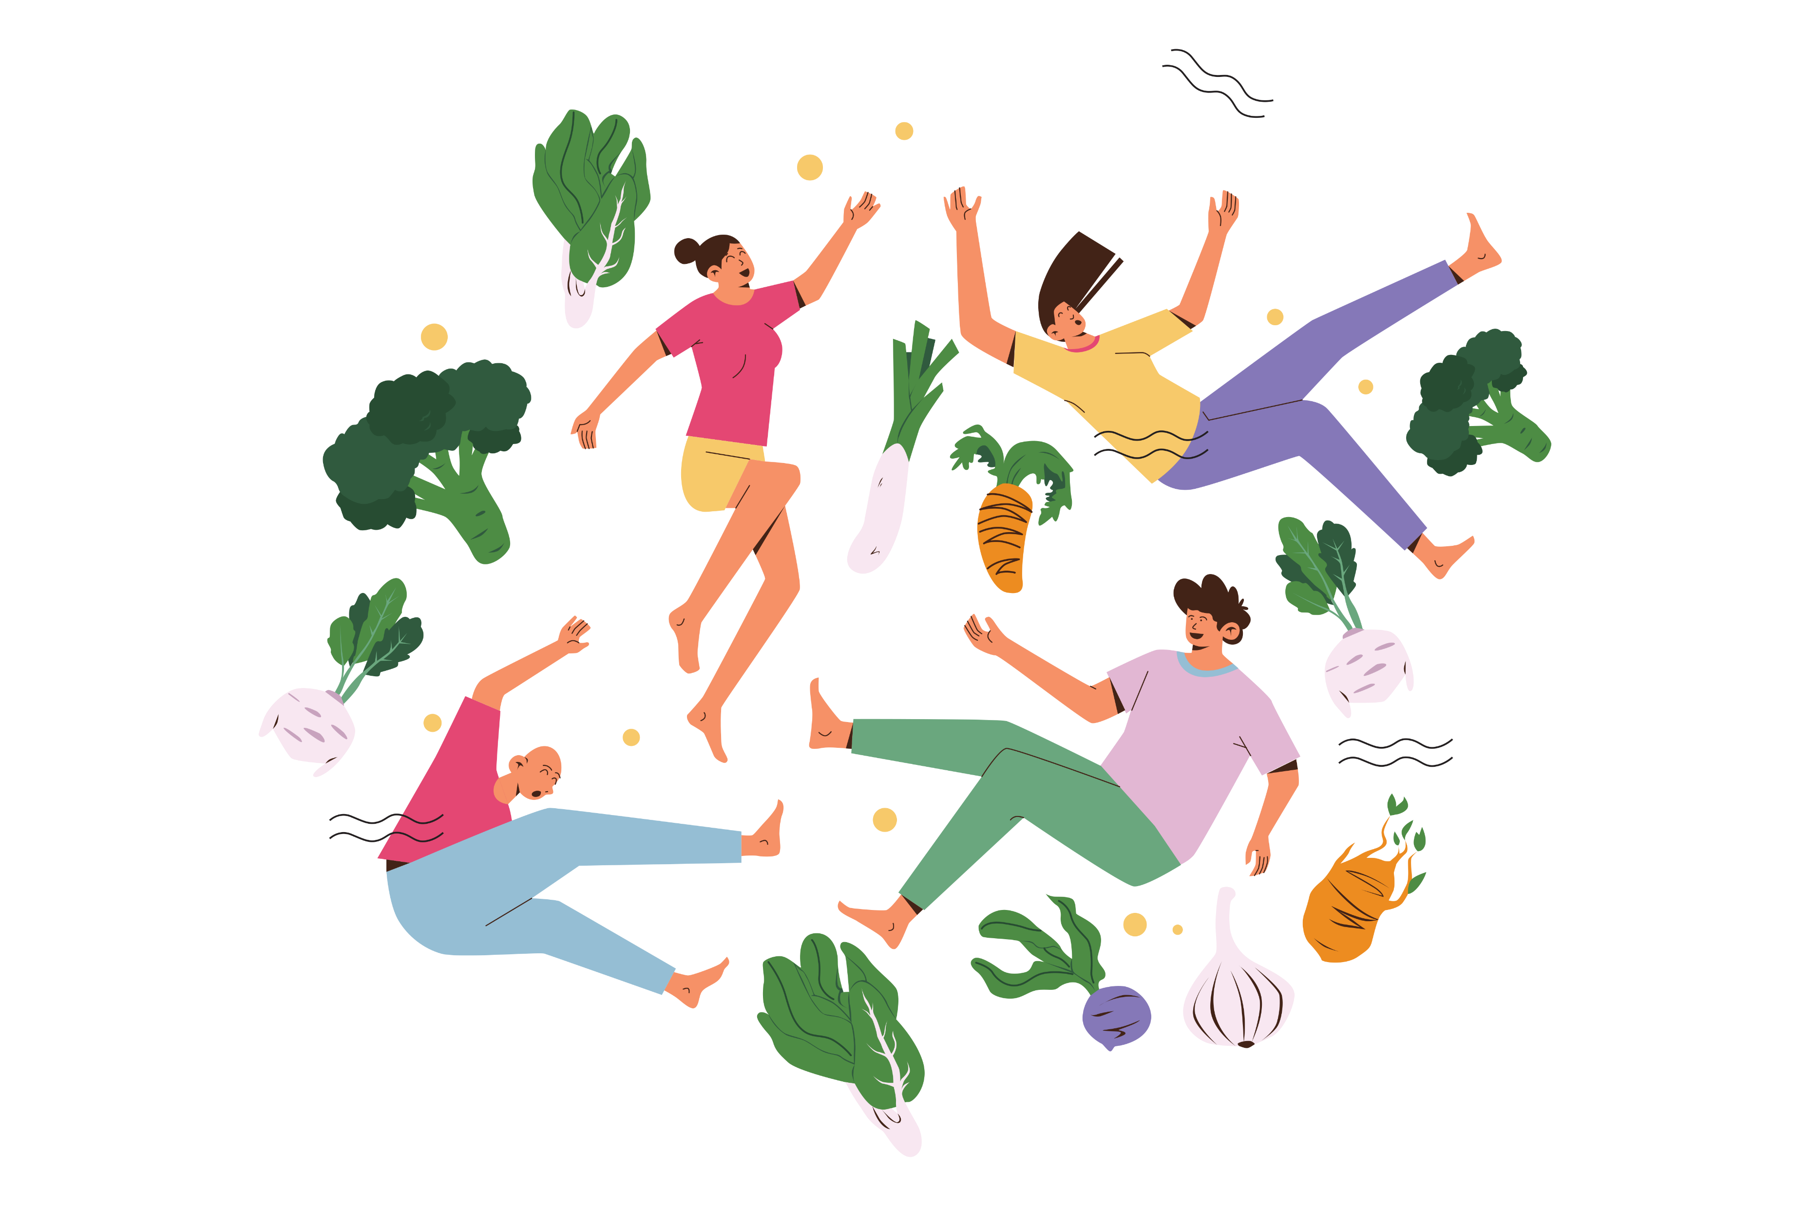
Quiz #4: Fill in the blank: Eating healthy is about ______.
Being perfect
Balance
Never having treats
Notes:
“Fill in the blank: Eating healthy is about ______.
a) Eating only vegetables
b) Balance
c) Never eating treats
[Pause for answers.]
The correct answer is b—balance!”

Slide 12
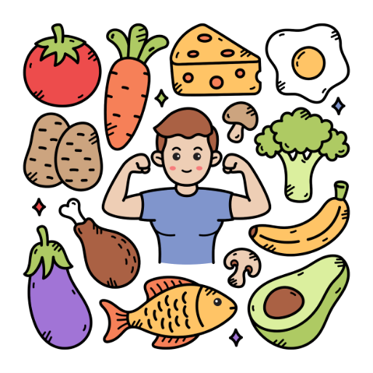
Wrap Up
Healthy eating = Super fuel for your body.
Balance, listen to your body, and drink water.
You have the power to choose foods that keep you strong!
Notes:
“Let’s wrap it up. Healthy eating is super fuel for your body.
Remember:
Balance what you eat.
Listen to your body when it’s hungry or full.
Drink water—it’s the best fuel.
You have the power to make choices that keep you strong, healthy, and ready to take on anything. Thanks for joining me for this Super Fuel talk

