Slide 1

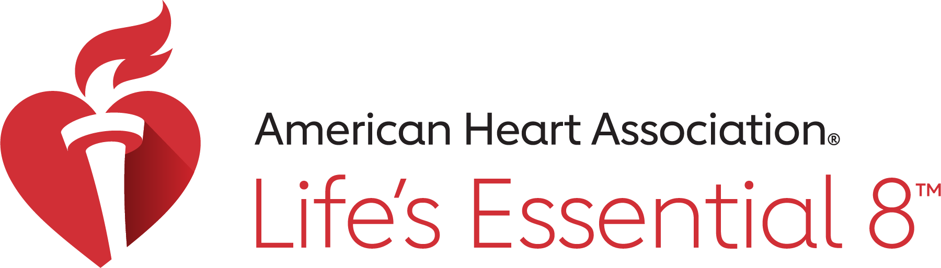
Sweet Talk:
What Sugar Does in Your Body
Fuel your body the healthy way
Notes:
“Hi everyone! Today we’re going to have a little ‘sweet talk’ about sugar. We all know sugar tastes good, but did you know too much sugar can actually cause big problems in your body? Let’s learn how sugar works, where it hides, and how to make smart choices.”

Slide 2
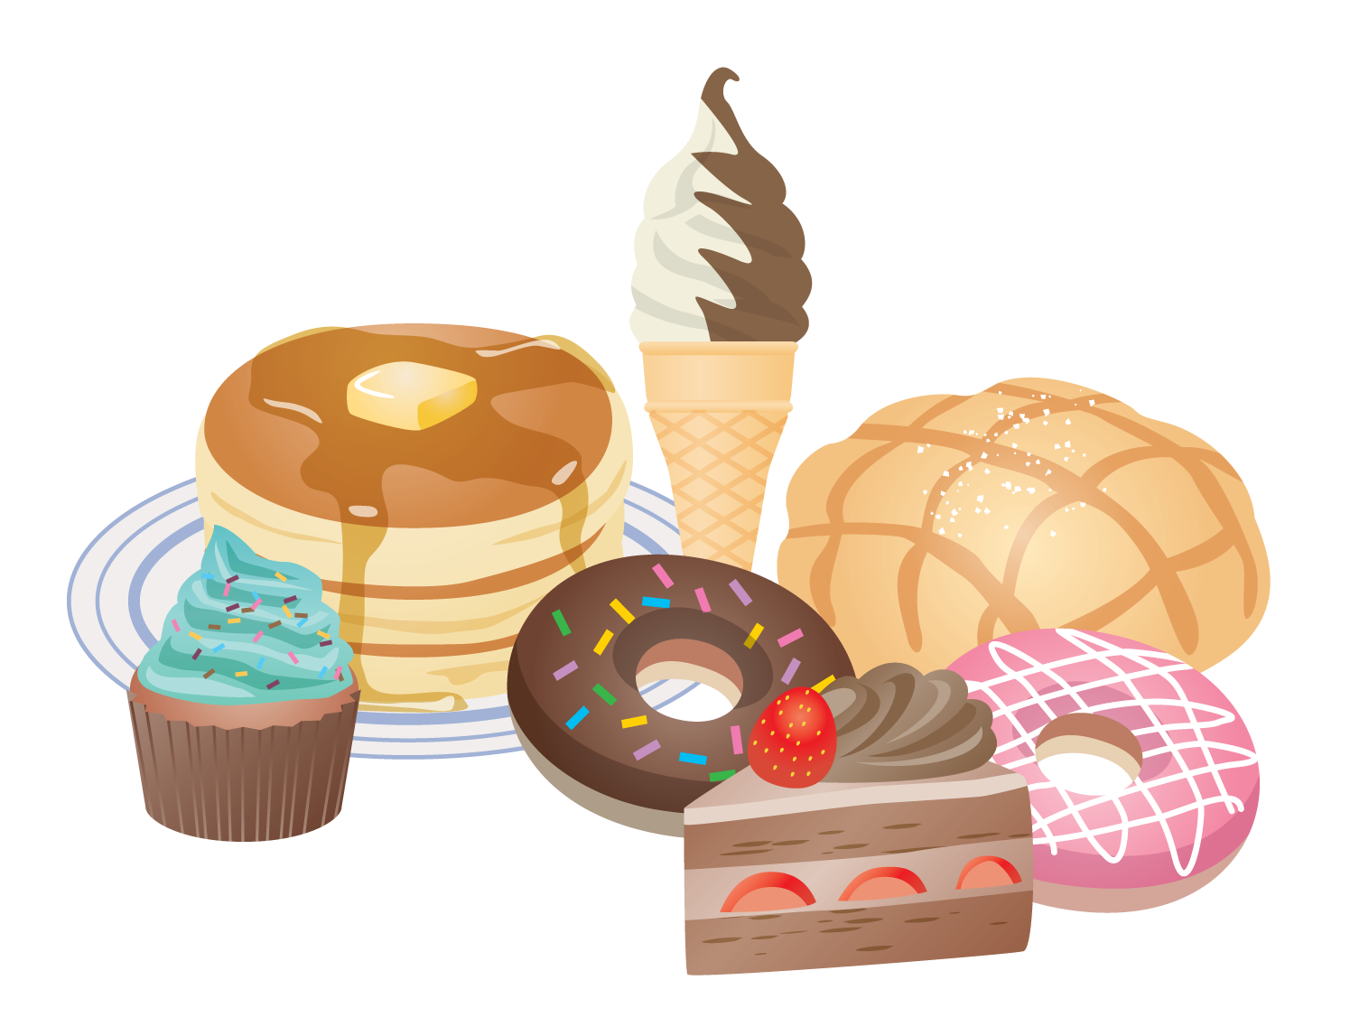
Where Sugar Hides
Candy, cakes, cookies = sugar
Also in bread, pasta, rice, potatoes
Too much sugar hurts blood vessels, liver, and kidneys
Notes:
“Most people think sugar is just in candy, cookies, or soda. But sugar is sneaky! It can also be in bread, pasta, rice, even potatoes. When we eat too much, it can hurt our blood vessels, liver, and kidneys. So it’s important to know where sugar hides.”

Slide 3
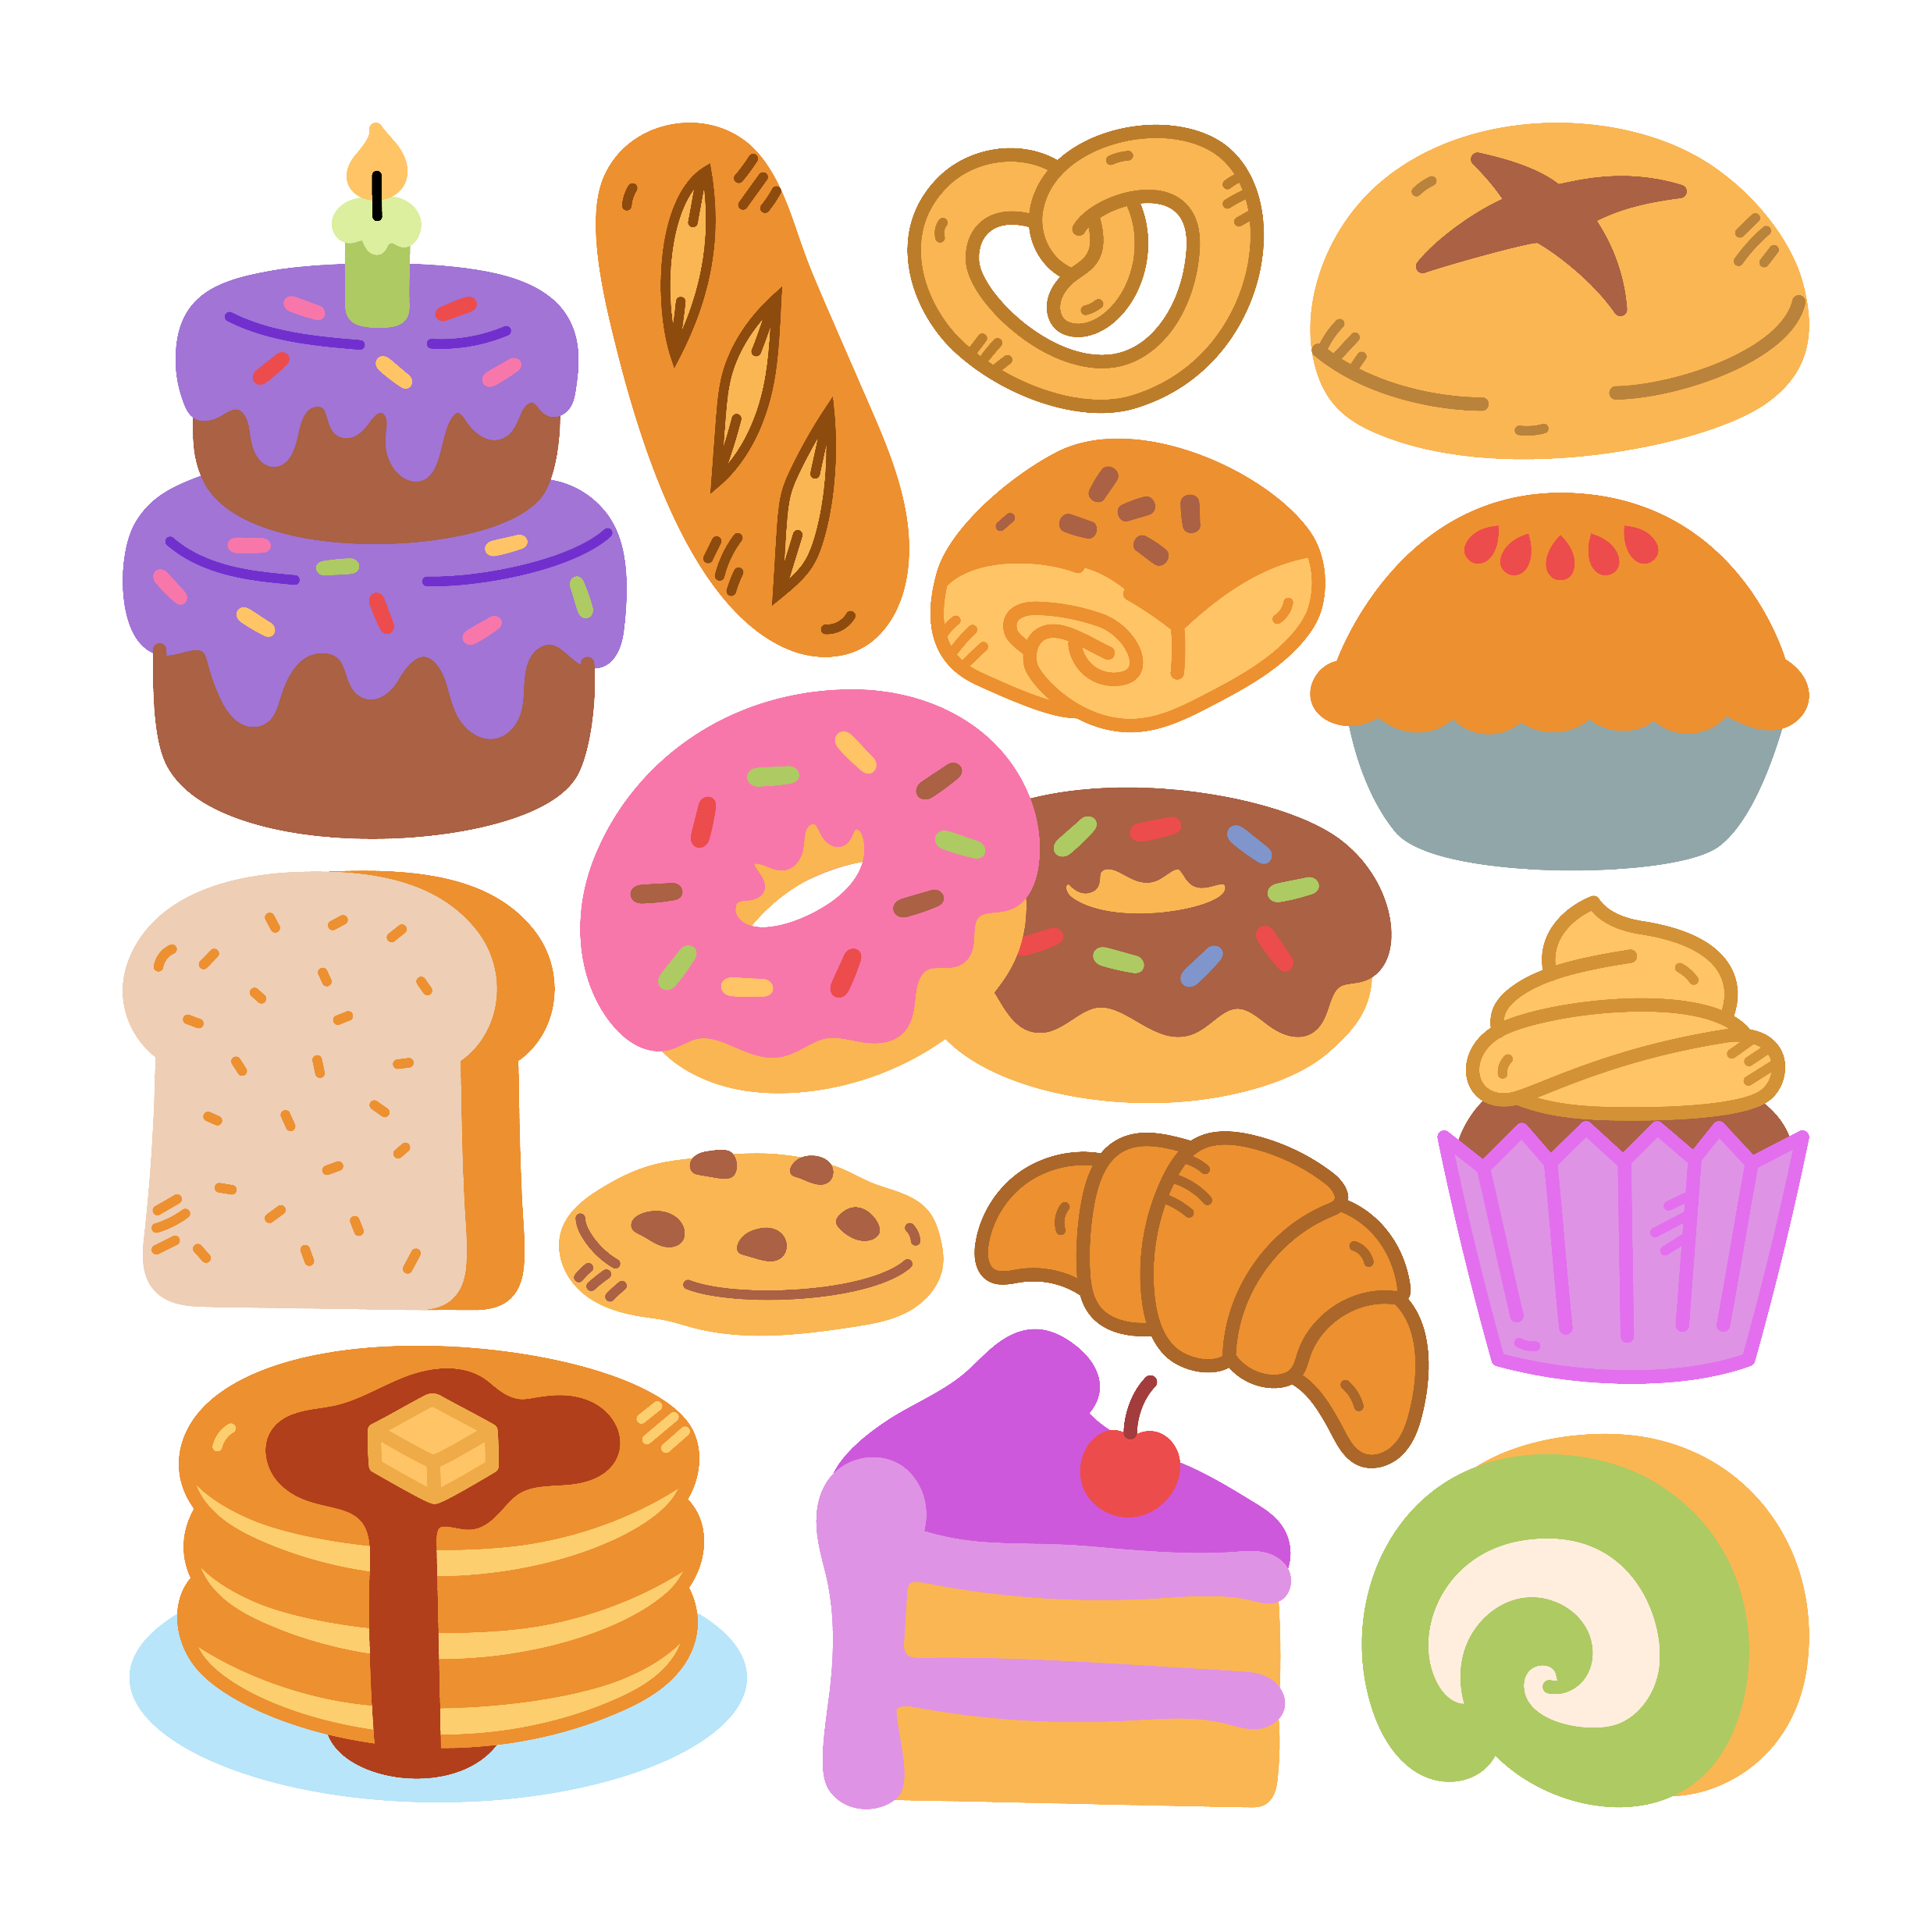
Quiz #1: Sugar is only found in candy and desserts.
True
False
Notes:
“Let’s see what you think: True or False — Sugar is only found in candy and desserts?”
[Pause for answers.]
“False! Sugar can be in everyday foods like bread and pasta too.”

Slide 4
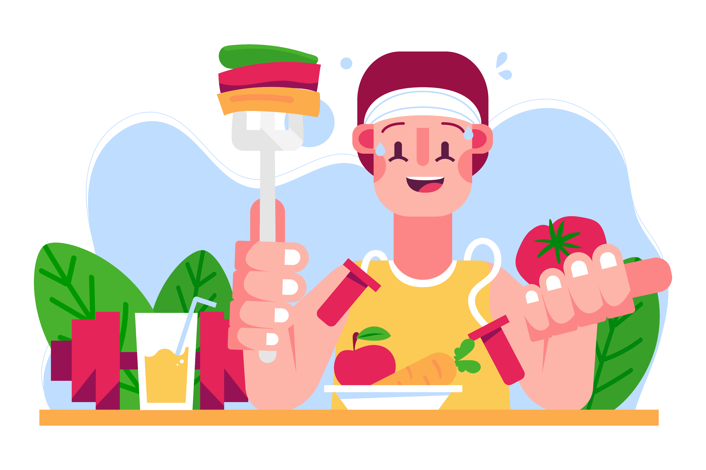
Blood Sugar = Fuel
Glucose (sugar) = body’s fuel
Like gas for a car - gives energy to run and play
Notes:
“Let’s see what you think: True or False — Sugar is only found in candy and desserts?”
[Pause for answers.]
“False! Sugar can be in everyday foods like bread and pasta too.”

Slide 5
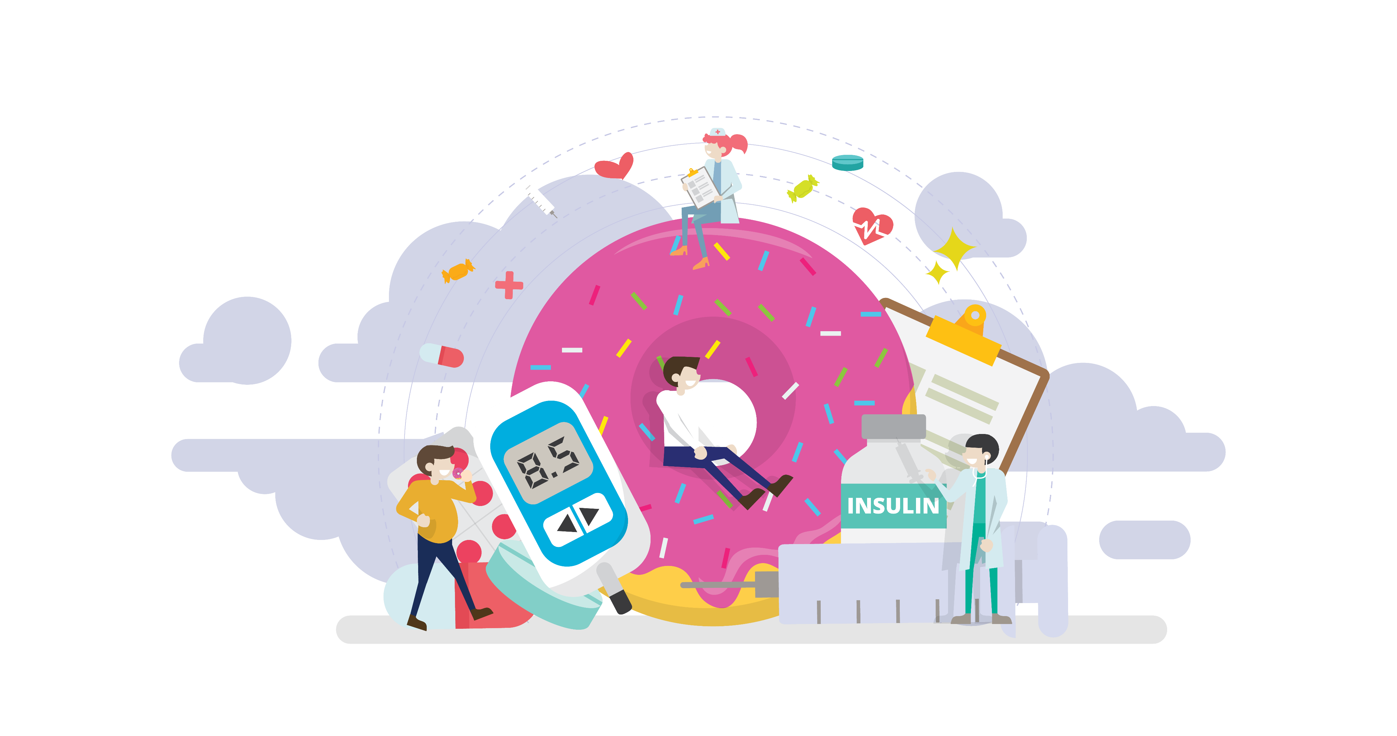
Insulin: The Key
Insulin unlocks cells so sugar can give energy
Without it, sugar stays in the blood → unhealthy
Notes:
“Think of insulin like a key that opens doors in your body so sugar can go inside and give you energy.”

Slide 6
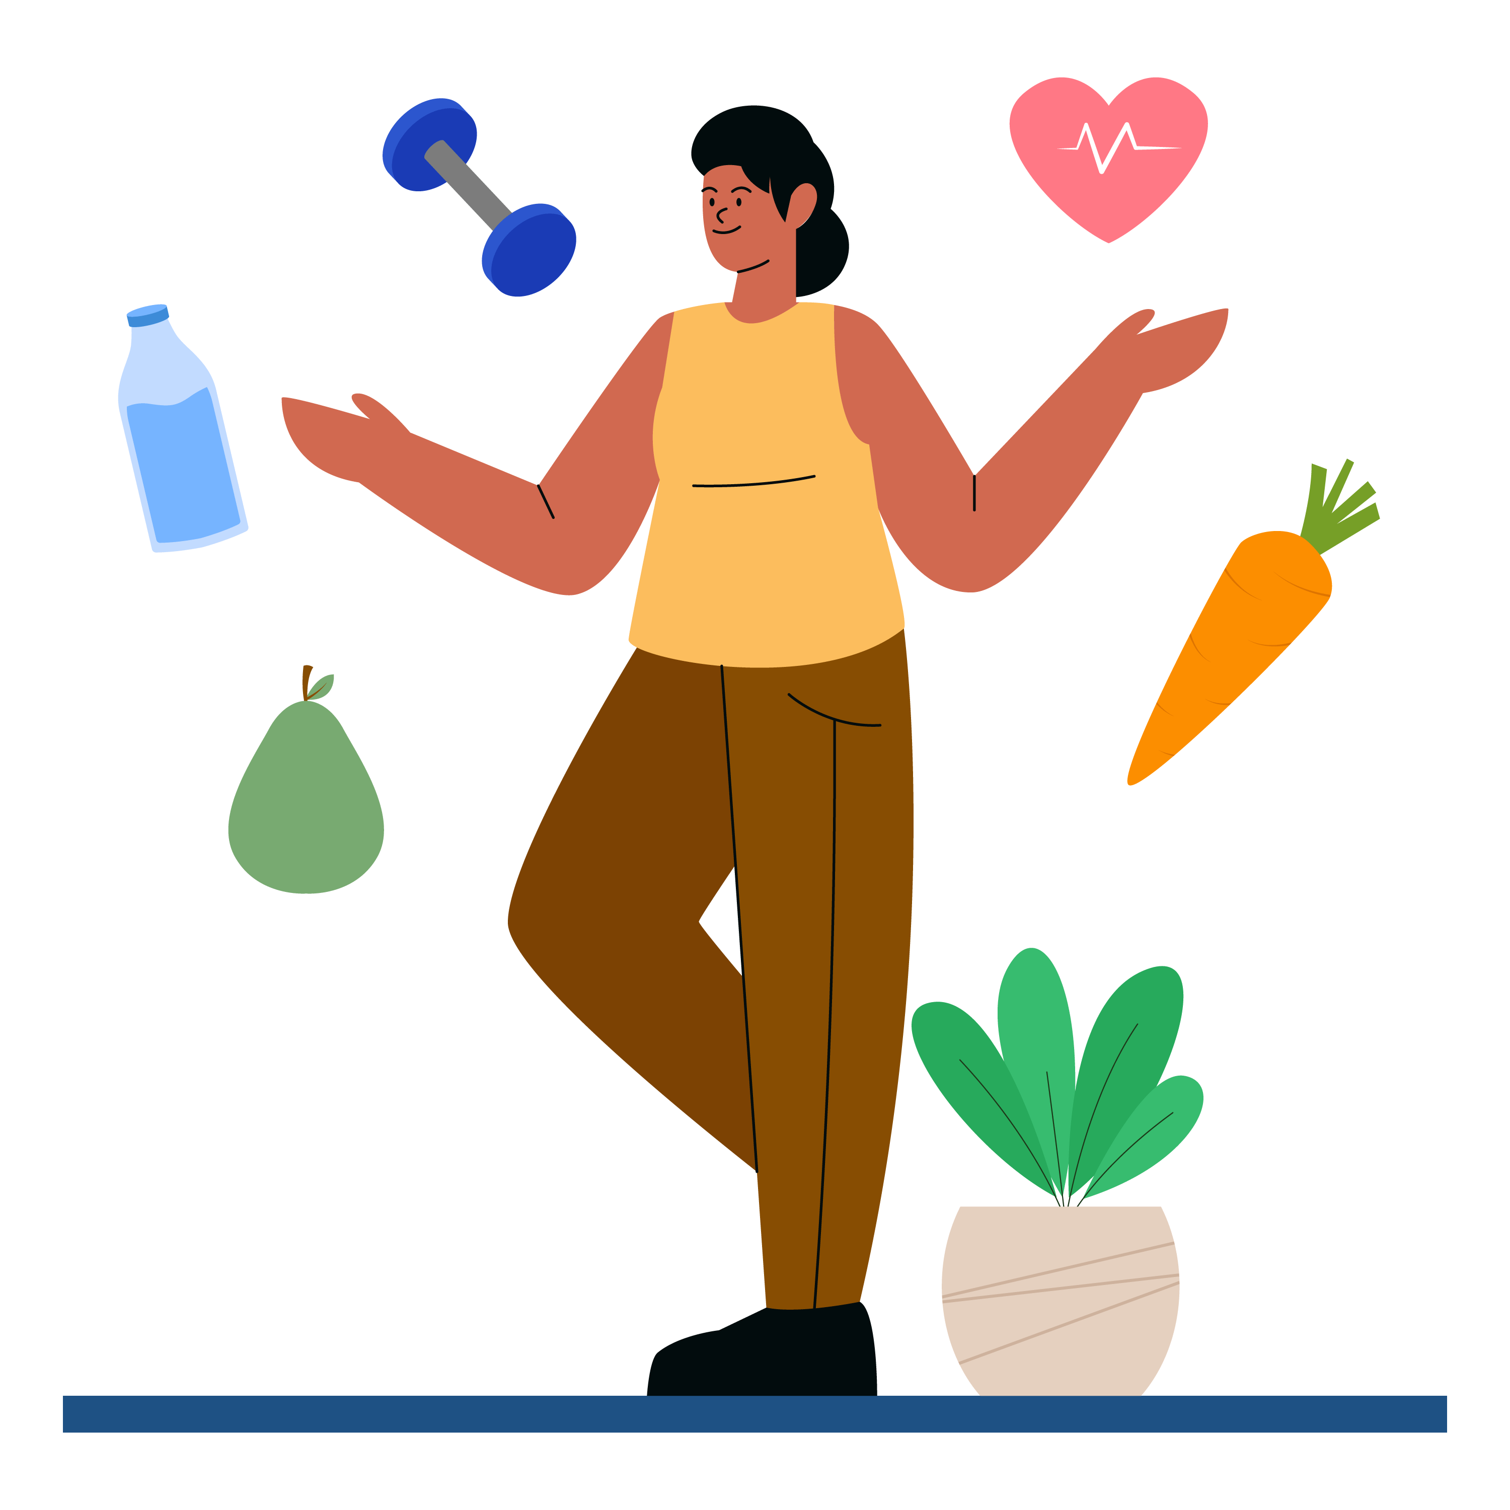
Quiz #2: What does insulin do?
Makes food taste sweet
Unlocks cells so sugar can give energy
Cleans your blood
Notes:
“Here’s a question: What does insulin do?
a) Makes food taste sweet
b) Unlocks cells so sugar can give energy
c) Cleans your blood
[Pause for answers.]
The correct answer is b! Insulin unlocks cells so sugar can fuel your body.”

Slide 7
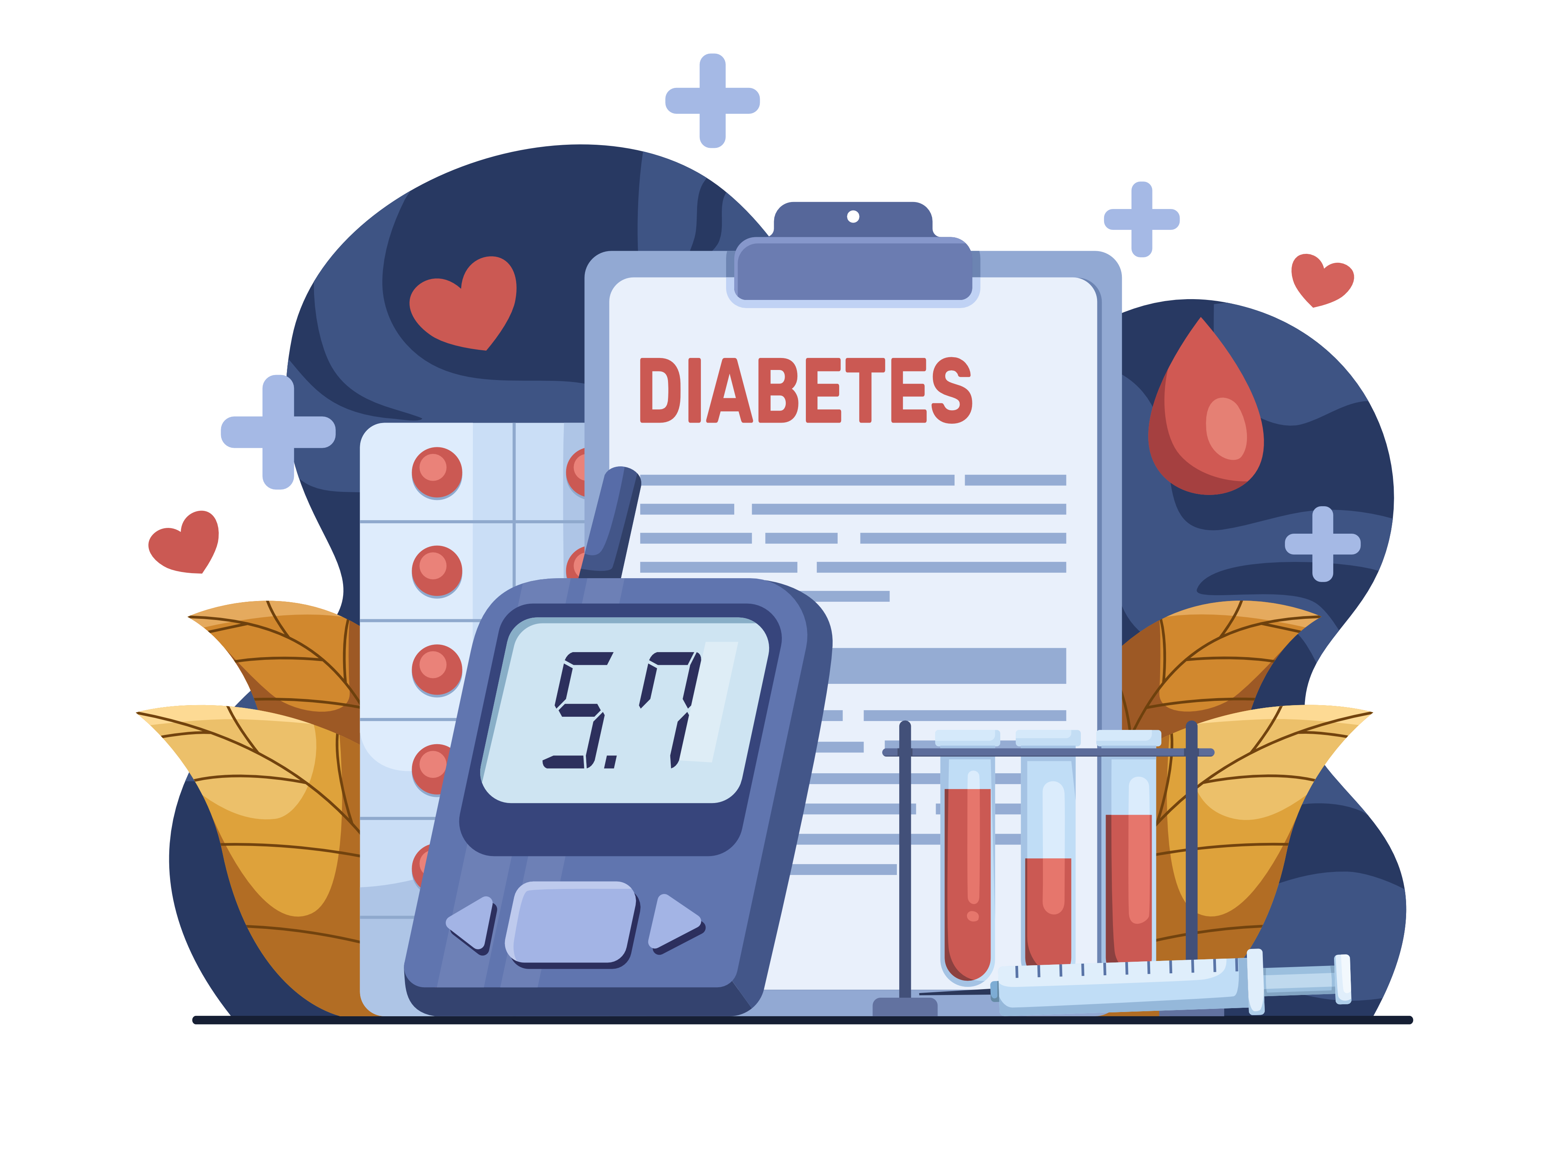
Diabetes Basics
Type 1: Pancreas doesn’t make insulin (no key at all)
Type 2: Body can’t use insulin well (key doesn’t work)
Notes:
“Sometimes, a person’s body can’t make or use insulin the right way. That’s called diabetes. With Type 1 diabetes, the pancreas doesn’t make insulin at all—no key. With Type 2 diabetes, the body has insulin, but it doesn’t work well—like a key that doesn’t fit. Either way, sugar can’t get into the cells the way it should.”

Slide 8
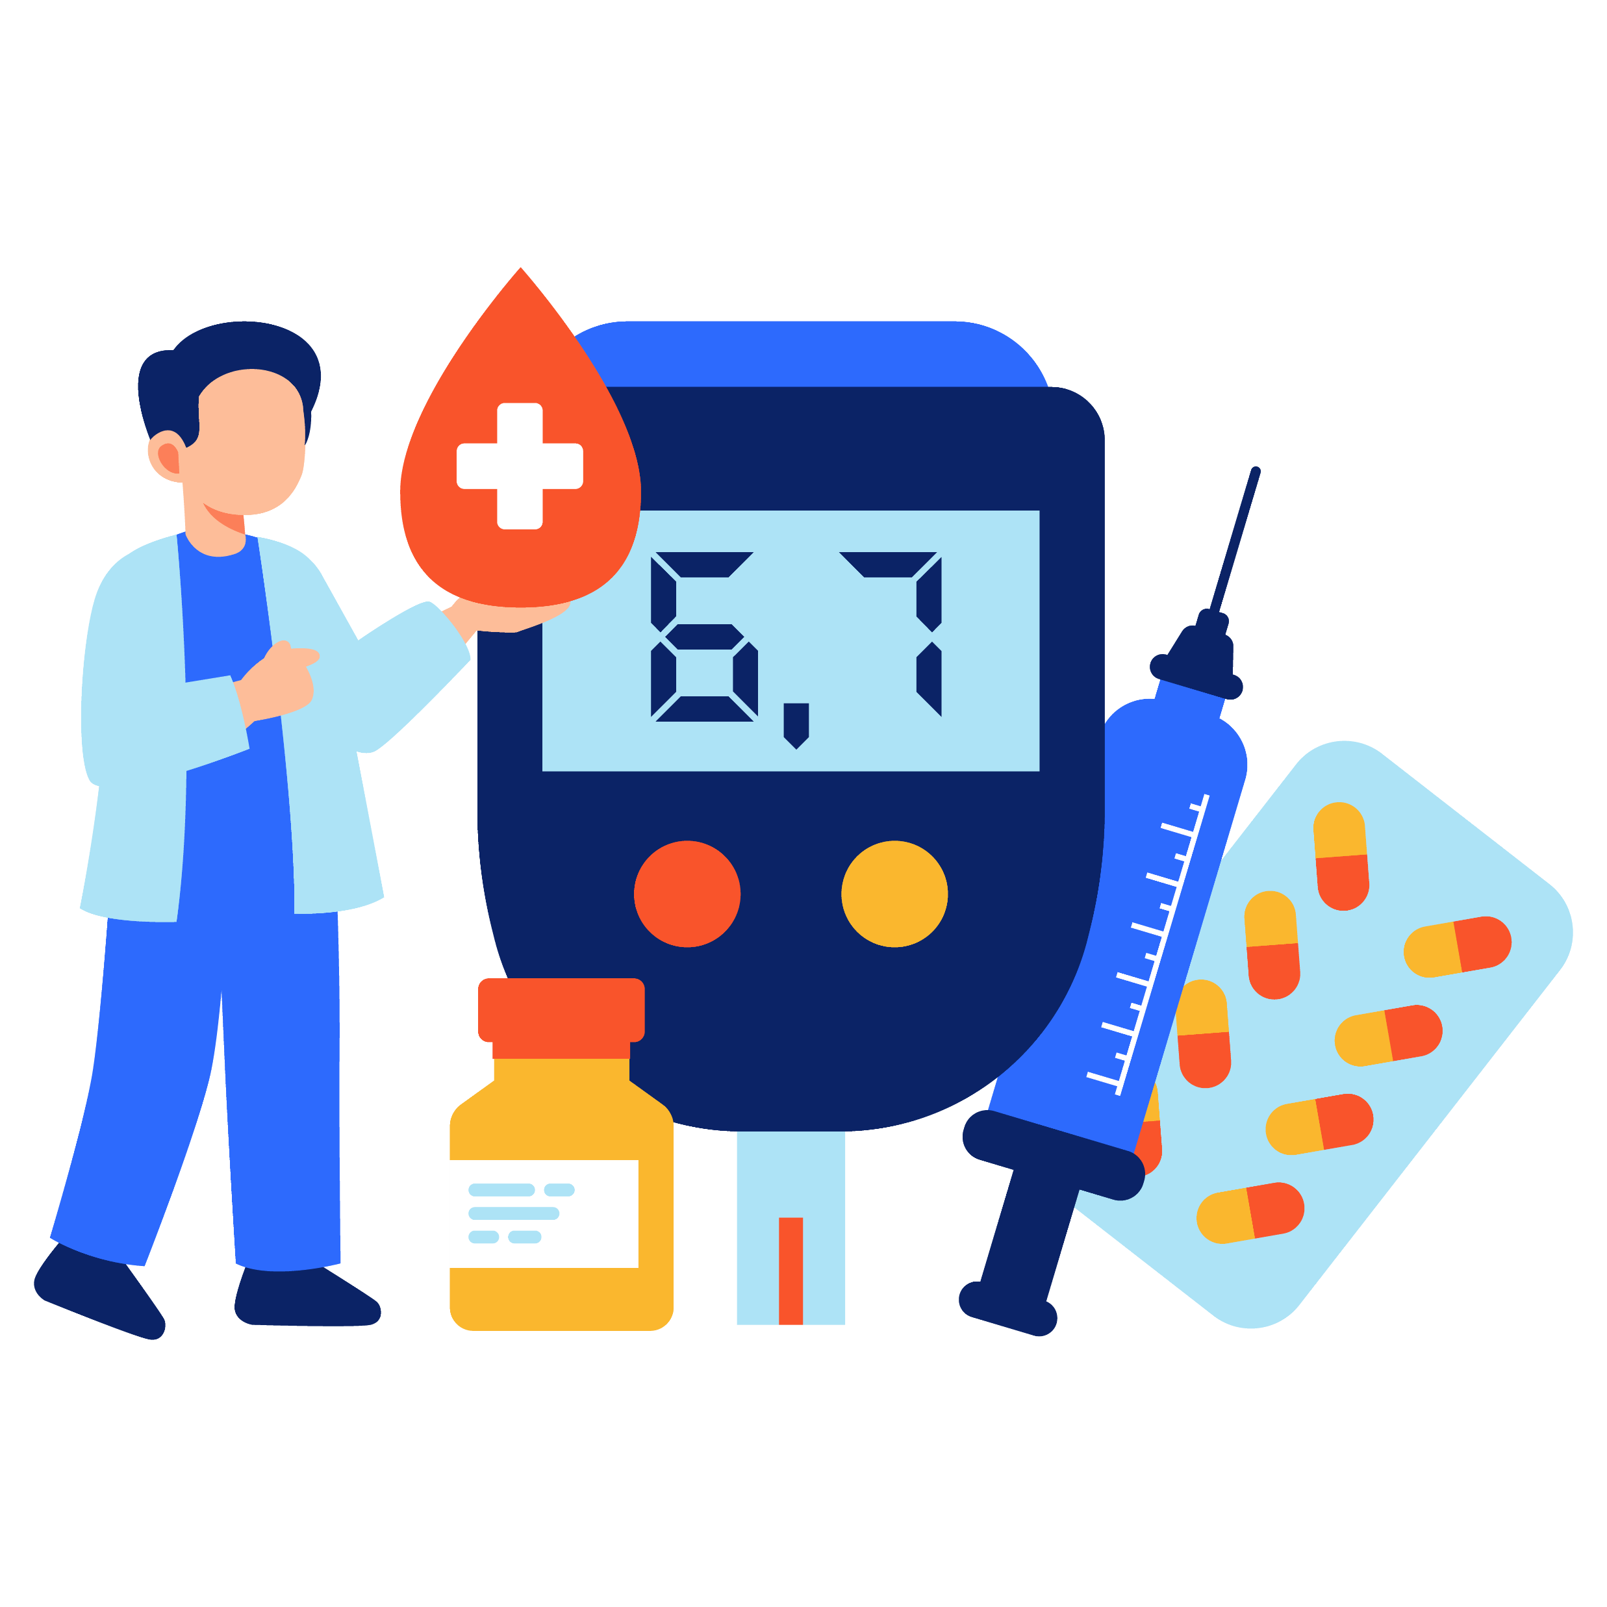
Quiz #3: Which type of diabetes is when the body has trouble using insulin properly?
Type 1
Type 2
Notes:
“Which type of diabetes is when the body has trouble using insulin properly?
a) Type 1
b) Type 2
[Pause for answers.]
The answer is b! Type 2 diabetes happens when the body doesn’t use insulin the right way.”

Slide 9
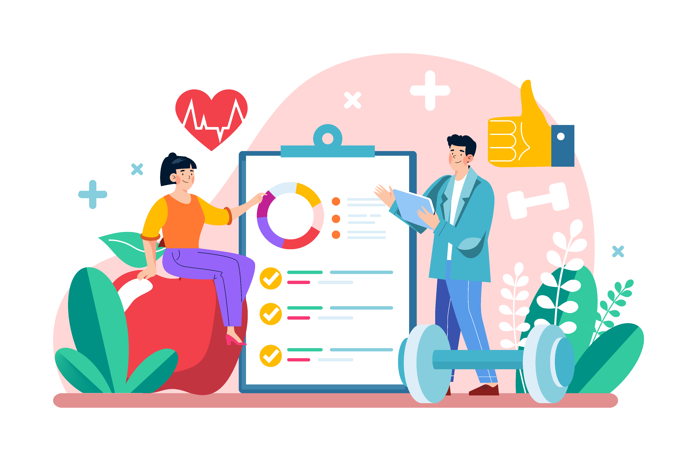
Why It Matters
Untreated diabetes can hurt eyes, nerves, kidneys, heart
Healthy eating + being active helps prevent Type 2
Notes:
“Diabetes “Which type of diabetes is when the body has trouble using insulin properly?
a) Type 1
b) Type 2
[Pause for answers.]
The answer is b! Type 2 diabetes happens when the body doesn’t use insulin the right way.”

Slide 10
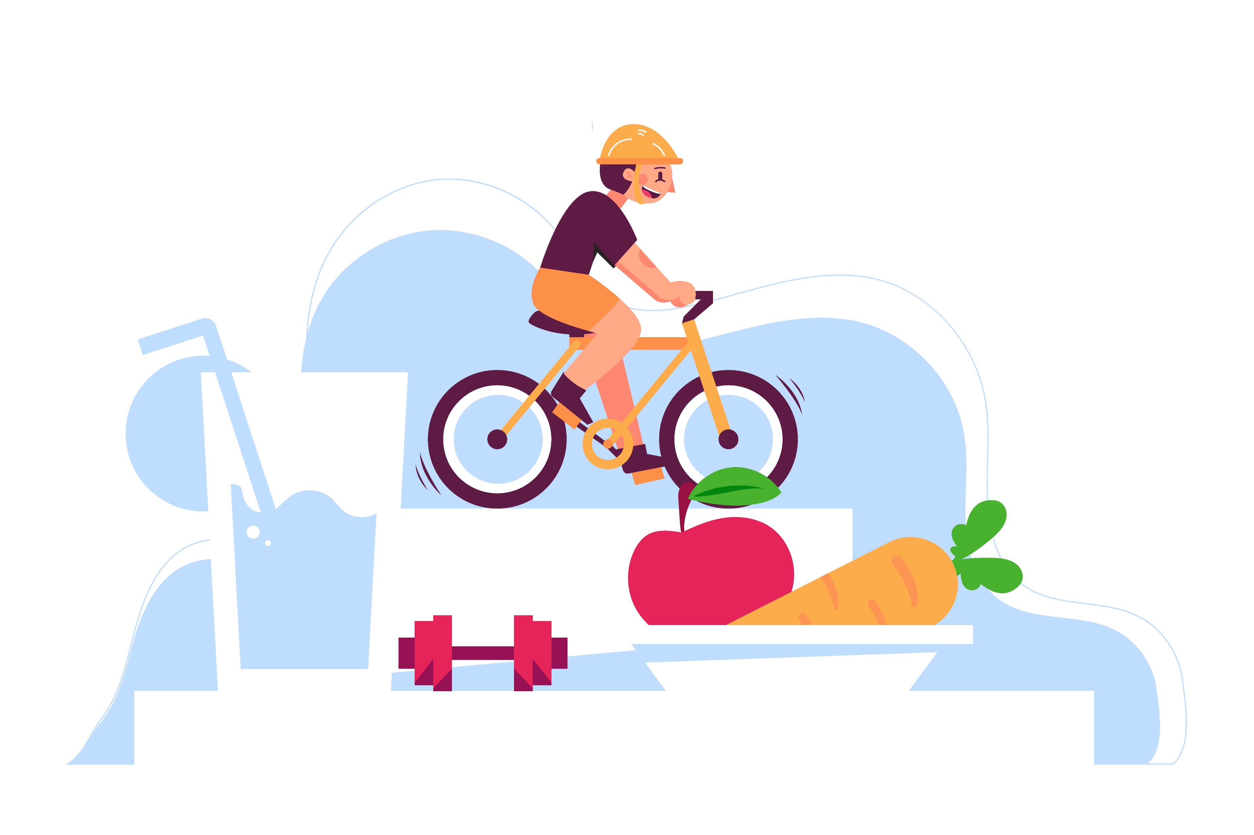
Healthy Habits
Eat less added sugar
Drink water instead of soda
Stay active every day
Notes:
“So what can we do every day to stay healthy?
Eat less added sugar
Drink water instead of soda or sugary drinks
Stay active—run, play, dance, ride your bike.
These choices protect your body and help it work the way it’s supposed to.”

Slide 11
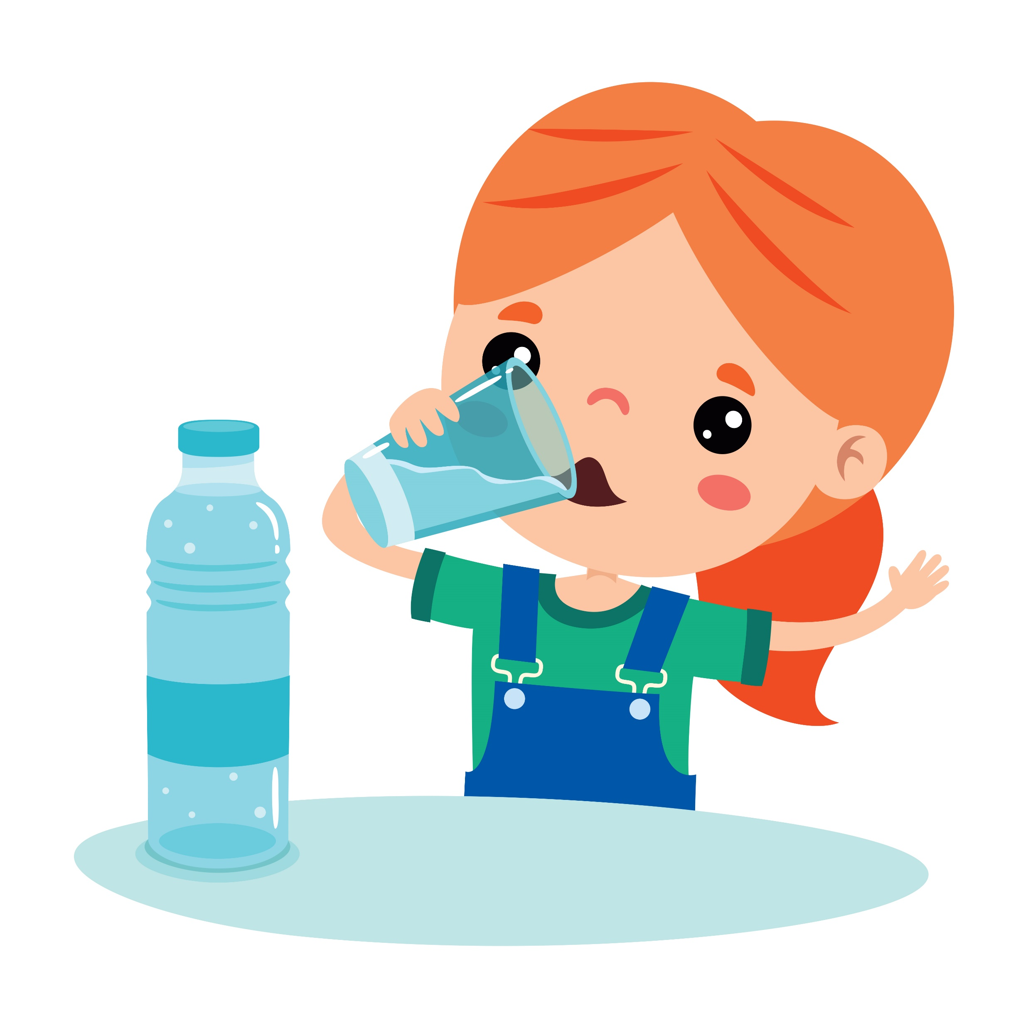
Quiz #3: Fill in the blank: The best drink to keep your body healthy is ______.
Soda
Juice
Water
Notes:
“Fill in the blank: The best drink to keep your body healthy is _____.
a) Soda
b) Juice
c) Water
[Pause for answers.]
The answer is c—water! Your body loves water more than anything else.”

Slide 12
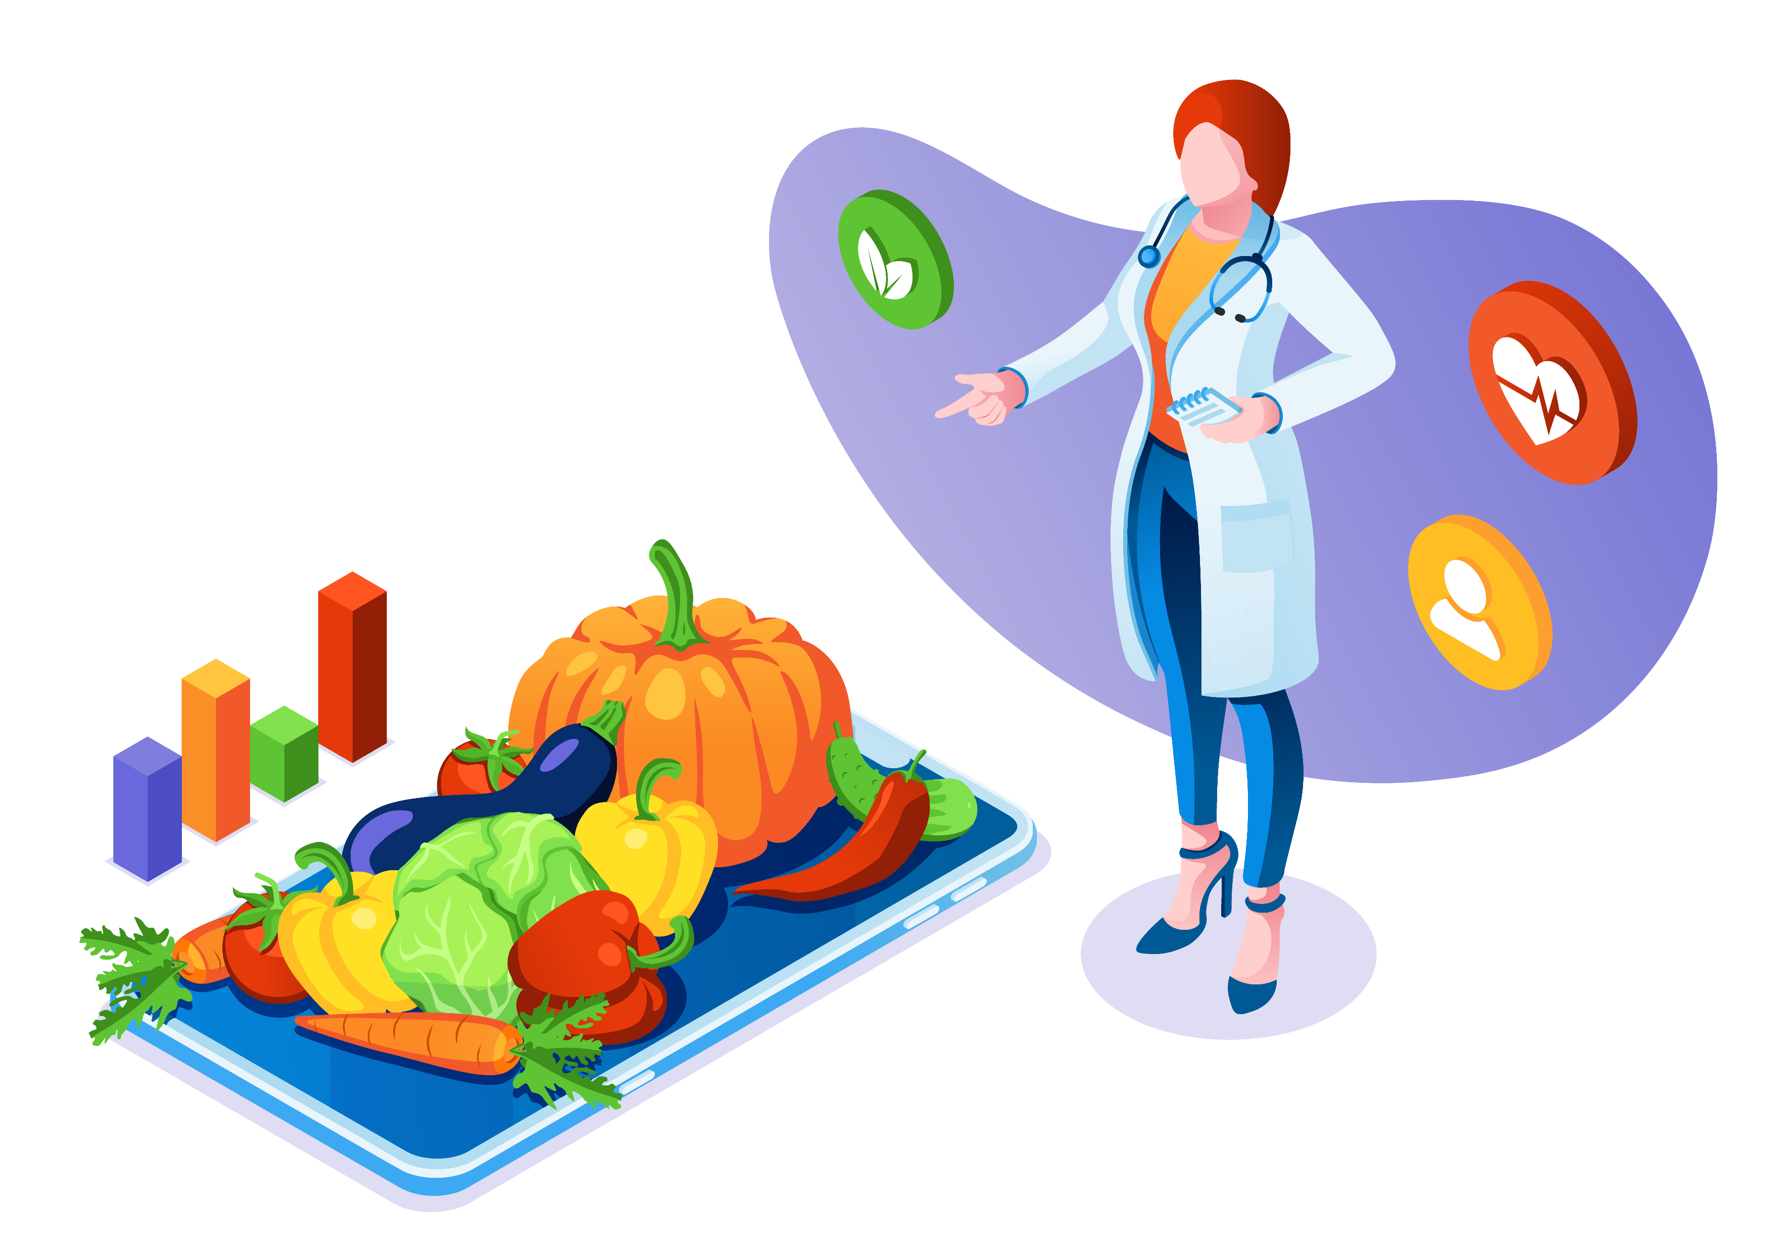
Wrap Up
Sugar = fuel, but too much is harmful
Insulin is the key that helps sugar do its job
Healthy choices = protect your future
Notes:
“Let’s wrap it up: Sugar is fuel for your body, but too much is harmful. Insulin is the key that helps sugar do its job. And healthy choices—like eating smart, moving your body, and drinking water—help protect your future. Thanks for joining me for this sweet talk!”

